Slide 1

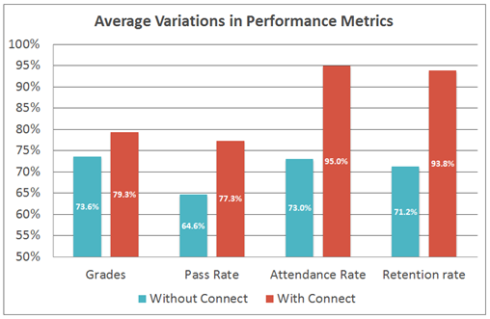
Want Better Grades?
Students who use Connect & LearnSmart are proven to be more successful in the course and receive higher grades than their peers not using Connect.

Slide 2
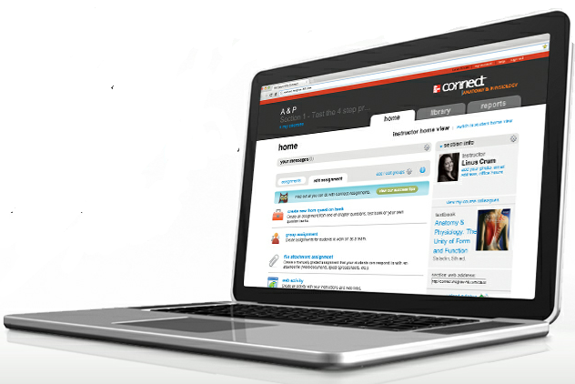
What is Connect?
With Connect, you can complete your coursework anytime and anywhere.
Connect gives you access to your assignments, eBook, quizzes, videos, animations, and more…
http://www.youtube.com/watch?v=8rx50p9m2vU

Slide 3
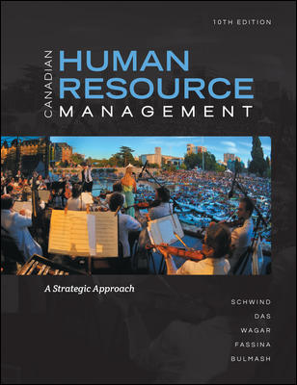
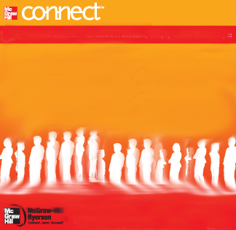
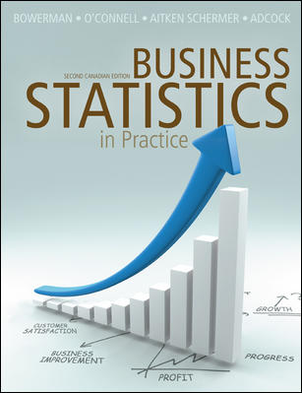

Purchase Options
Flexible Study and Pricing Solutions
Used Book
Bookstore Package: Connect + Online ebook + Printed text
GO DIGITAL AND SAVE Connect Access: Connect +Online ebook
Does not include
Connect
Or
Ebook
$144.95
$89
Available at your Campus Bookstore or on Bookstore Website

Slide 4
Get started in 4 easy steps.
Go the web address provided by your Instructor.
http://connect.mcgraw-hill.com/class/m_parlar_fall_2013_ec01_tue_7_pm
http://connect.mcgraw-hill.com/class/m_parlar_fall_2013_c01_wed_230pm
http://connect.mcgraw-hill.com/class/m_parlar_fall_2013_c02_thu_1130am
Click the “Register Now” Button.
Enter your email address.
Enter your access code, select “Buy Online”, or you can “Start Free Trial” if you don’t have an access code.
Complete the registration form, click “Submit”
Notes:
RBI (see end of deck for self-study and LSM version of registration instructions.)

Slide 5
Support
www.connectstudentsuccess.com
www.mcgrawhill.ca/support
1-800-565-5758

