Slide 1
Chapter 11
Correlation Coefficient and Simple Linear Regression Analysis

Slide 2
Simple Linear Regression
11.1 Correlation Coefficient
11.2 Testing the Significance of the Population Correlation Coefficient
11.3 The Simple Linear Regression Model
11.4 Model Assumptions and the Standard Error
11.5 The Least Squares Estimates, and Point Estimation and Prediction
11 .6 Testing the Significance of Slope and y Intercept

Slide 3
Simple Linear Regression Continued
11.7 Confidence Intervals and Prediction Intervals
11.8 Simple Coefficients of Determination and Correlation
11.9 An F Test for the Model
11.10 Residual Analysis
11.11 Some Shortcut Formulas

Slide 4
Covariance
The measure of the strength of the linear relationship between x and y is called the covariance
  The sample covariance formula:
  This is a point predictor of the population covariance

Slide 5
Covariance
Generally when two variables (x and y) move in the same direction (both increase or both decrease) the covariance is large and positive
It follows that generally when two variables move in the opposite directions (one increases while the other decreases) the covariance is a large negative number
When there is no particular pattern the covariance is a small number

Slide 6
Correlation Coefficient
L01
What is large and what is small?
  It is sometimes difficult to determine without a further statistic which we call the correlation coefficient
The correlation coefficient gives a value between -1 and +1
  -1 indicates a perfect negative correlation
  -0.5 indicates a moderate negative relationship
  +1 indicates a perfect positive correlation
  +0.5 indicates a moderate positive relationship
  0 indicates no correlation

Slide 7
Sample Correlation Coefficient
L01
This is a point predictor of the population correlation coefficient ρ (pronounced “rho”)

Slide 8
Consider the Following Sample Data
L01
Calculate the Covariance and the Correlation Coefficient
  x is the independent variable (predictor) and
  y is the dependent variable (predicted)

Slide 9
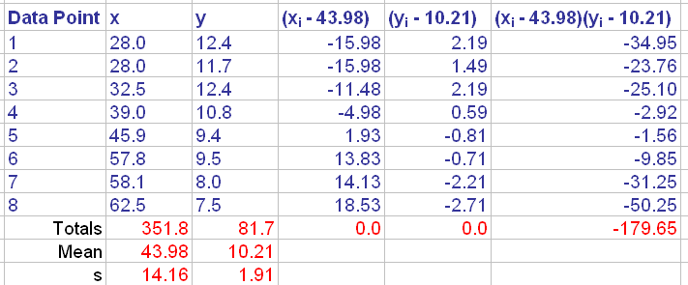
Covariance & Correlation Coefficient
L01

Slide 10
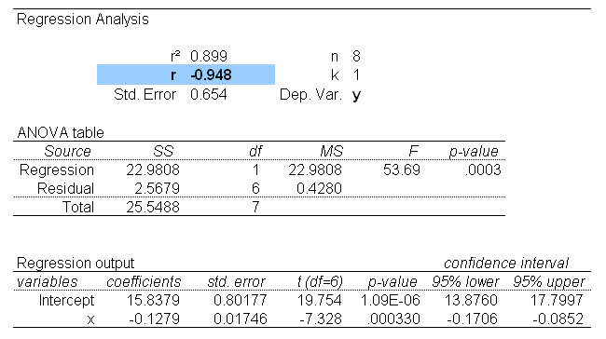
MegaStat Output
L01

Slide 11
Simple Coefficient of Determination eta² or r²
L02
eta² is simply the squared correlation value as a percentage and tells you the amount of variance overlap between the two variables x and y
Example
  If the correlation between self-reported altruistic behaviour and charity donations is 0.24, then eta² is 0.24 x 0.24 = 0.0576 (5.76%)
  Conclude that 5.76 percent of the variance in charity donations overlaps with the variance in self-reported altruistic behaviour

Slide 12
Two Important Points
L01
The value of the simple correlation coefficient (r) is not the slope of the least square line
  That value is estimated by b₁
High correlation does not imply that a cause-and-effect relationship exists
  It simply implies that x and y tend to move together in a linear fashion
  Scientific theory is required to show a cause-and-effect relationship

Slide 13
Testing the Significance of the Population Correlation Coefficient
L03
Population correlation coefficient ρ ( rho)
  The population of all possible combinations of observed values of x and y
  r is the point estimate of ρ
Hypothesis to be tested
  H₀: ρ = 0, which says there is no linear relationship between x and y, against the alternative
  H_{a}: ρ ≠ 0, which says there is a positive or negative linear relationship between x and y
Test Statistic
  Assume the population of all observed combinations of x and y are bivariate normally distributed

Slide 14
The Simple Linear Regression Model
L03
The dependent (or response) variable is the variable we wish to understand or predict (usually the y term)
The independent (or predictor) variable is the variable we will use to understand or predict the dependent variable (usually the x term)
Regression analysis is a statistical technique that uses observed data to relate the dependent variable to one or more independent variables

Slide 15
Objective of Regression Analysis
The objective of regression analysis is to build a regression model (or predictive equation) that can be used to describe, predict, and control the dependent variable on the basis of the independent variable

Slide 16
The Simple Linear Regression Model
L05
β₀ is the y-intercept; the mean of y when x is 0
β₁ is the slope; the change in the mean of y per unit change in x
ε is an error term that describes the effect on y of all factors other than x

Slide 17
Form of The Simple Linear
Regression Model
L05
The model
  μ_{y|x} = β₀ + β₁x + ε is the mean value of the dependent variable y when the value of the independent variable is x
  β₀ and β₁ are called regression parameters
  β₀ is the y-intercept and β₁ is the slope
We do not know the true values of these parameters β₀ and β₁ so we use sample data to estimate them
b₀ is the estimate of β₀ and b₁ is the estimate of β₁
ɛ is an error term that describes the effects on y of all factors other than the value of the independent variable x

Slide 18
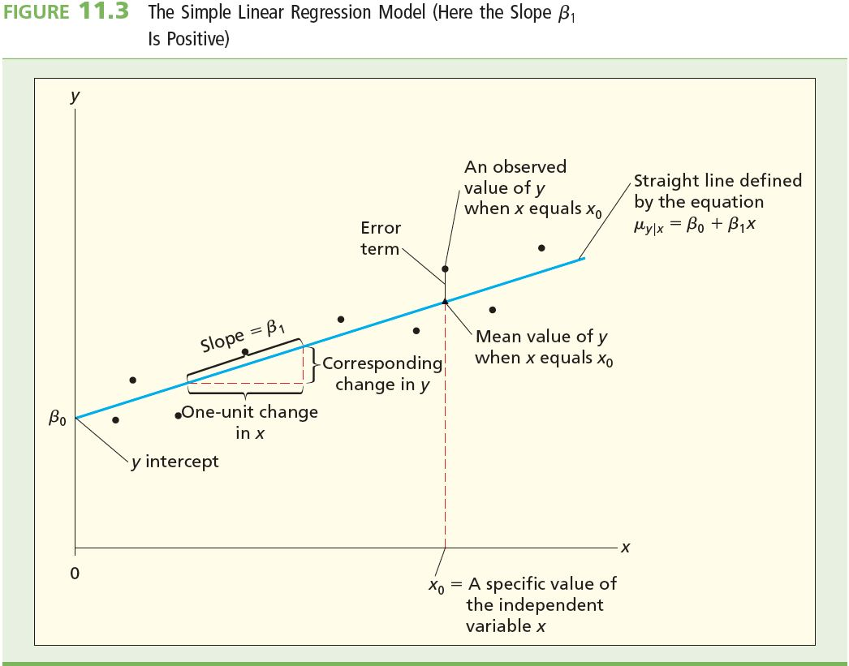
The Simple Linear Regression Model
L05

Slide 19
Example 11.1 The QHIC Case
Quality Home Improvement Centre (QHIC) operates five stores in a large metropolitan area
  QHIC wishes to study the relationship between x, home value (in thousands of dollars), and y, yearly expenditure on home upkeep
A random sample of 40 homeowners is taken, estimates of their expenditures during the previous year on the types of home-upkeep products and services offered by QHIC are taken
Public city records are used to obtain the previous year’s assessed values of the homeowner’s homes
Skip to Example 11.3

Slide 20
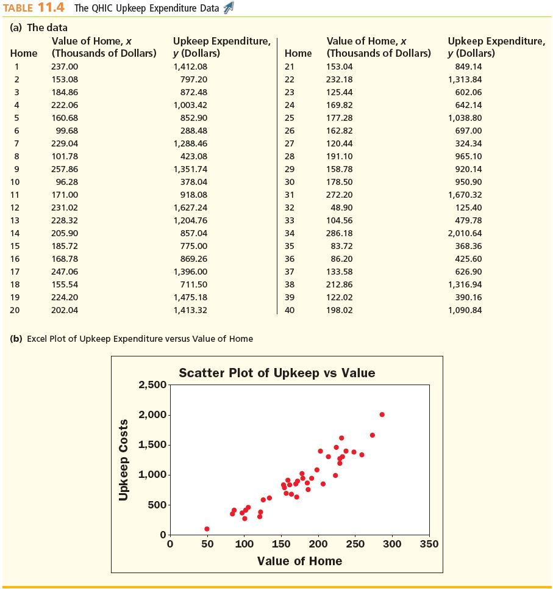
Example 11.1 The QHIC Case

Slide 21
Example 11.1 The QHIC Case
Observations
Observations
  The observed values of y tend to increase in a straight-line fashion as x increases
  It is reasonable to relate y to x by using the simple linear regression model with a positive slope (β₁ > 0)
  β₁ is the change (increase) in mean dollar yearly upkeep expenditure associated with each $1,000 increase in home value
Interpreted the slope β₁ of the simple linear regression model to be the change in the mean value of y associated with a one-unit increase in x
  we cannot prove that a change in an independent variable causes a change in the dependent variable
  regression can be used only to establish that the two variables relate and that the independent variable contributes information for predicting the dependent variable

Slide 22
Model Assumptions and the
Standard Error
The simple regression model
It is usually written as

Slide 23
Model Assumptions and the
Standard Error
The simple regression model
It is usually written as

Slide 24
Model Assumptions
L04
Mean of Zero
At any given value of x, the population of potential error term values has a mean equal to zero
Constant Variance Assumption
At any given value of x, the population of potential error term values has a variance that does not depend on the value of x
Normality Assumption
At any given value of x, the population of potential error term values has a normal distribution
Independence Assumption
Any one value of the error term ε is statistically independent of any other value of ε

Slide 25
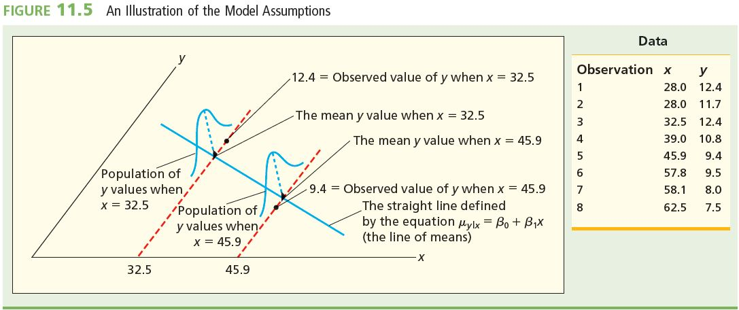
Model Assumptions Illustrated
L04

Slide 26
Mean Square Error (MSE)
This is the point estimate of the residual variance σ²
SSE is the sum of squared error

Slide 27
Sum of Squared Errors (SSE)
ŷ is the point estimate of the mean value μ_{y|x}
Return to MSE

Slide 28
Standard Error
This is the point estimate of the residual standard deviation σ
MSE is from previous slide
  Divide the SSE by n - 2 (degrees of freedom) because doing so makes the resulting s² an unbiased point estimate of σ²

Slide 29
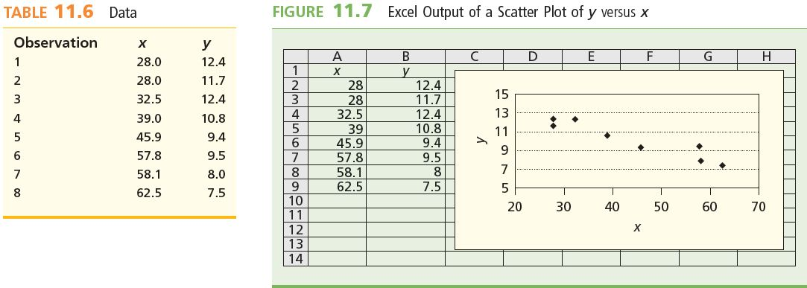
The Least Squares Estimates, and Point Estimation and Prediction
Example – Consider the following data and scatter plot of x versus y
Want to use the data in Table 11.6 to estimate the intercept β₀ and the slope β₁ of the line of means

Slide 30
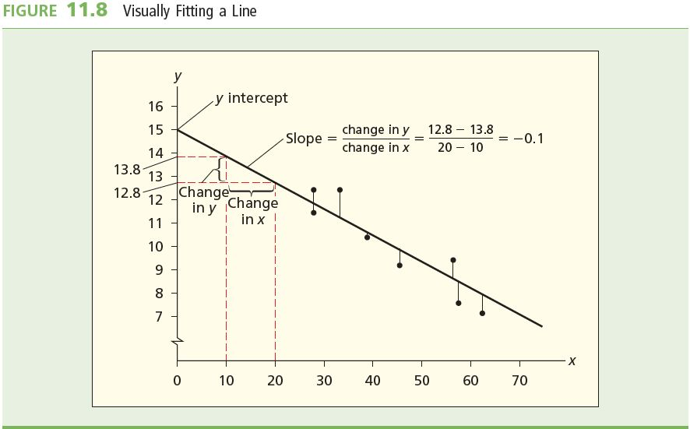
Visually Fitting a Line
We can “eyeball” fit a line
  Note the y intercept and the slope
  we could read the y intercept and slope off the visually fitted line and use these values as the estimates of β0 and β1

Slide 31
Residuals
y intercept = 15
Slope = 0.1
This gives us a visually fitted line of
  ŷ = 15 – 0.1x
    Note ŷ is the predicted value of y using the fitted line
  If x = 28 for example then ŷ = 15 – 0.1(28) = 12.2
Note that from the data in table 11.6 when x = 28, y = 12.4 (the observed value of y)
There is a difference between our predicted value and the observed value, this is called a residual
Residuals are calculated by (y – ŷ)
  In this case 12.4 – 12.2 = 0.2

Slide 32
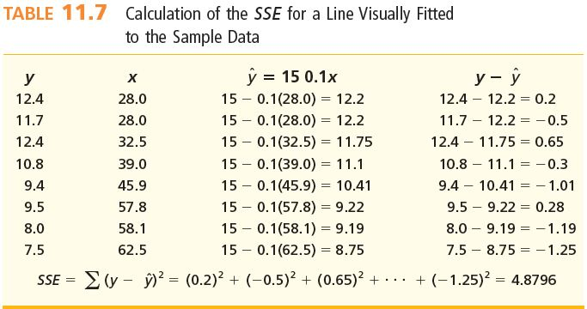
Visually Fitting a Line
If the line fits the data well the residuals will be small
An overall measure of the quality of the fit is calculated by finding the Sum of Squared Residuals also known as Sum of Squared Errors (SSE)

Slide 33
Residual Summary
To obtain an overall measure of the quality of the fit, we compute the sum of squared residuals or sum of squared errors, denoted SSE
This quantity is obtained by squaring each of the residuals (so that all values are positive) and adding the results
  A residual is the difference between the predicted values of y (we call this ŷ) from the fitted line and the observed values of y
  Geometrically, the residuals for the visually fitted line are the vertical distances between the observed y values and the predictions obtained using the fitted line

Slide 34
The Least Squares Estimates, and
Point Estimation and Prediction
The true values of β₀ and β₁ are unknown
Therefore, we must use observed data to compute statistics that estimate these parameters
Will compute b₀ to estimate β₀ and b₁ to estimate β₁

Slide 35
The Least Squares Point Estimates
L05
Estimation/prediction equation
Least squares point estimate of the slope β₁

Slide 36
The Least Squares Point Estimates
Least squares point estimate of the y intercept β₀

Slide 37
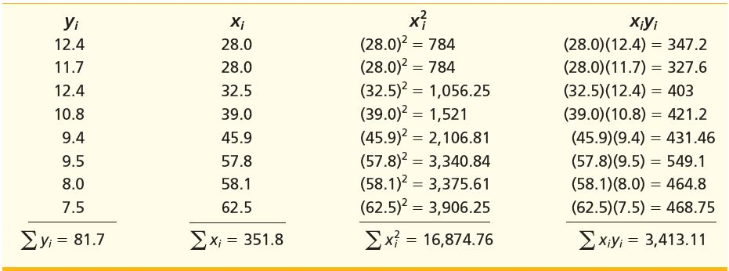
Calculating the Least Squares Point Estimates
Compute the least squares point estimates of the regression parameters β₀ and β1
Preliminary summations (table 11.6):

Slide 38
Calculating the Least Squares Point Estimates
From last slide,
  Σy_{i} = 81.7
  Σx_{i} = 351.8
  Σx²_{i} = 16,874.76
  Σx_{i}y_{i} = 3,413.11
Once we have these values, we no longer need the raw data
Calculation of b₀ and b₁ uses these totals

Slide 39
Calculating the Least Squares Point Estimates
Slope b₁

Slide 40
Calculating the Least Squares Point Estimates
y Intercept b₀

Slide 41
Calculating the Least Squares Point Estimates
L05
Least Squares Regression Equation
Prediction (x = 40)

Slide 42
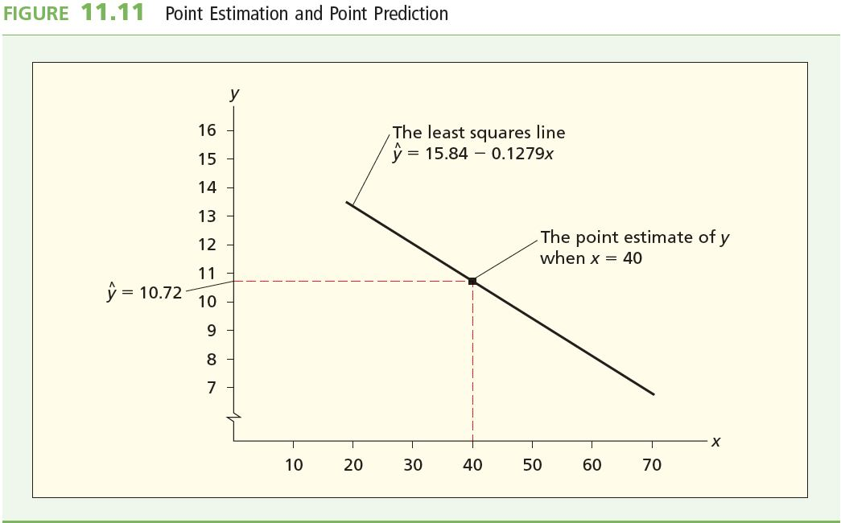
Calculating the Least Squares Point Estimates
L05

Slide 43
Testing the Significance of Slope and y Intercept
A regression model is not likely to be useful unless there is a significant relationship between x and y
Hypothesis Test
H₀: β₁ = 0 (we are testing the slope)
  Slope is zero which indicates that there is no change in the mean value of y as x changes
versus H_{a}: β₁ ≠ 0

Slide 44
Testing the Significance of Slope and y Intercept
Test Statistic
100(1-α)% Confidence Interval for β₁
  t_{α}, t_{α/2} and p-values are based on n–2 degrees of freedom

Slide 45
Testing the Significance of Slope and y Intercept
If the regression assumptions hold, we can reject H₀: β₁ = 0 at the α level of significance (probability of Type I error equal to α) if and only if the appropriate rejection point condition holds or, equivalently, if the corresponding p-value is less than α

Slide 46
Rejection Rules
Alternative | Reject H₀ If | p-Value
H_{a}: β₁ ≠ 0 | |t| > t_{α/2}* | Twice area under t distribution right of |t|
H_{a}: β₁ > 0 | t > t_{α} | Area under t distribution right of t
H_{a}: β₁ < 0 | t < –t_{α} | Area under t distribution left of t
* t > t_{α/2} or t < –t_{α/2} based on n - 2 degrees of freedom

Slide 47
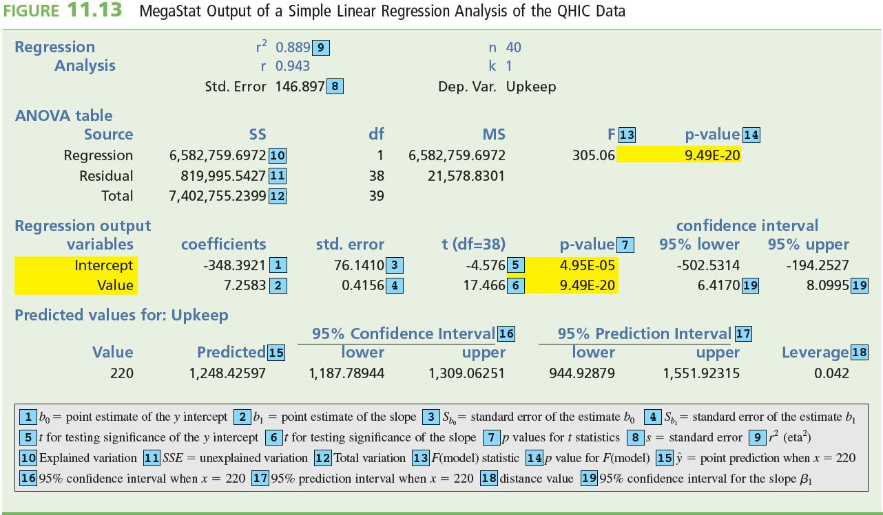
Example 11.3 The QHIC Case
Refer to Example 11.1 at the beginning of this presentation
MegaStat Output of a Simple Linear Regression

Slide 48
Example 11.3 The QHIC Case
b₀ = 2348.3921, b₁ = 7.2583 , s = 146.897, s_{b1} = 0.4156 , and t = b1/s_{b1} = 17.466
The p value related to t = 17.466 is less than 0.001 (see the MegaStat output)
Reject H₀: b₁ = 0 in favour of H_{a}: b1 ≠ 0 at the 0.001 level of significance
We have extremely strong evidence that the regression relationship is significant
  95 percent confidence interval for the true slope β is [6.4170, 8.0995] this says we are 95 percent confident that mean yearly upkeep expenditure increases by between $6.42 and $8.10 for each additional $1,000 increase in home value

Slide 49
Testing the significance of the y intercept β₀
Hypothesis H₀: β₀ = 0 versus H_{a}: β₀ ≠ 0
  If we can reject H₀ in favour of H_{a} by setting the probability of a Type I error equal to α, we conclude that the intercept β₀ is significant at the α level
Test Statistic

Slide 50
Rejection Rules
Alternative | Reject H₀ If | p-Value
H_{a}: β₀ ≠ 0 | |t| > t_{α/2}* | Twice area under t distribution right of |t|
H_{a}: β₀ > 0 | t > t_{α} | Area under t distribution right of t
H_{a}: β₀ < 0 | t < –t_{α} | Area under t distribution left of t
* that is t > t_{α/2} or t < –t_{α/2}

Slide 51
Example 11.3 The QHIC Case
Refer to Figure 11.13
b₀ = 2348.3921, S_{b0} = 76,1410 , t = 24.576, and p value = 0.000
Because t = 24.576 > t_{0.025} = 2.447 and p value < 0.05, we can reject H₀: β₀ = 0 in favour of H_{a}: β₀ ≠ 0 at the 0.05 level of significance
In fact, because p value , 0.001, we can also reject H₀ at the 0.001 level of significance
This provides extremely strong evidence that the y intercept β₀ does not equal 0 and thus is significant

Slide 52
Confidence and Prediction Intervals
The point on the regression line corresponding to a particular value of x₀ of the independent variable x is
It is unlikely that this value will equal the mean value of y when x equals x₀
Therefore, we need to place bounds on how far the predicted value might be from the actual value
We can do this by calculating a confidence interval for the mean value of y and a prediction interval for an individual value of y

Slide 53
Distance Value
Both the confidence interval for the mean value of y and the prediction interval for an individual value of y employ a quantity called the distance value
The distance value for a particular value x₀ of x is
The distance value is a measure of the distance between the value x₀ of x and x
Notice that the further x₀ is from x, the larger the distance value

Slide 54
A Confidence Interval for a Mean Value of y
Assume that the regression assumption hold
The formula for a 100(1-α) confidence interval for the mean value of y is as follows:
  This is based on n-2 degrees of freedom

Slide 55
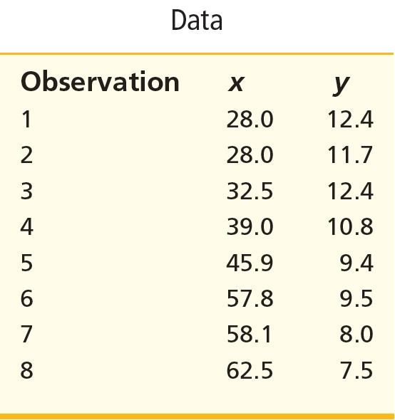
Example: The 95% Confidence Interval
From before:
  n = 8
  x₀ = 40
  x = 43.98
  SS_{xx} = 1,404.355
The distance value is given by

Slide 56
Example: The 95% Confidence Interval
From before
  x₀ = 40 gives ŷ = 10.72
  t = 2.447 based on 6 degrees of freedom
  s = 0.6542
  Distance value is 0.1363
The confidence interval is

Slide 57
A Prediction Interval for an Individual
Value of y
Assume that the regression assumption hold
The formula for a 100(1-α) prediction interval for an individual value of y is as follows:
  t_{α/2} is based on n-2 degrees of freedom

Slide 58

Example: The 95% Prediction Interval
Example 11.4 The QHIC Case
Consider a home worth $220,000
We have seen that the predicted yearly upkeep expenditure for such a home is (figure 11.13 – MegaStat Output partially shown below)
Distance Value

Slide 59
Example: The 95% Prediction Interval
From before
  x₀ = 220 gives ŷ = 1,248.43
  t = 2.024 based on 38 degrees of freedom
  s = 146.897
  Distance value is 0.042
The prediction interval is

Slide 60
Which to Use?
The prediction interval is useful if it is important to predict an individual value of the dependent variable
A confidence interval is useful if it is important to estimate the mean value
It should become obvious intuitively that the prediction interval will always be wider than the confidence interval. It’s easy to see mathematically that this is the case when you compare the two formulas

Slide 61
Simple Coefficients of Determination and Correlation
How “good” is a particular regression model at making predictions?
One measure of usefulness is the simple coefficient of determination
It is represented by the symbol r² or eta²

Slide 62
Calculating The Simple Coefficient of
Determination
Total variation is given by the formula
Explained variation is given by the formula
Unexplained variation is given by the formula
Total variation is the sum of explained and unexplained variation
eta² = r² is the ratio of explained variation to total variation

Slide 63
What Does r² Mean?
Definition: The coefficient of determination, r², is the proportion of the total variation in the n observed values of the dependent variable that is explained by the simple linear regression model
It is a nice diagnostic check of the model
For example, if r² is 0.7 then that means that 70% of the variation of the y-values (dependent) are explained by the model
This sounds good, but, don’t forget that this also implies that 30% of the variation remains unexplained

Slide 64
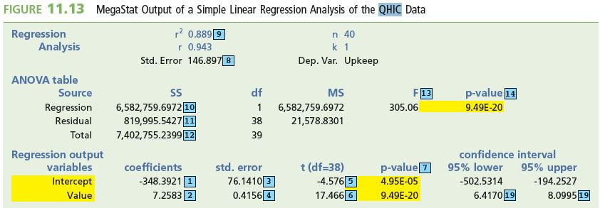
Example 11.5 The QHIC Case
It can be shown that
  Total variation = 7,402/755.2399
  Explained variation = 6,582/759.6972
  SSE = Unexplained variation = 819,995.5427
  Partial MegaStat Output reproduced below (full output Figure 11.13)

Slide 65
r² (eta²)
r² (eta²) says that the simple linear regression model that employs home value as a predictor variable explains 88.9% of the total variation in the 40 observed home-upkeep expenditures

Slide 66
An F Test for Model
L06
For simple regression, this is another way to test the null hypothesis
H₀: β₁ = 0
That will not be the case for multiple regression
The F test tests the significance of the overall regression relationship between x and y

Slide 67
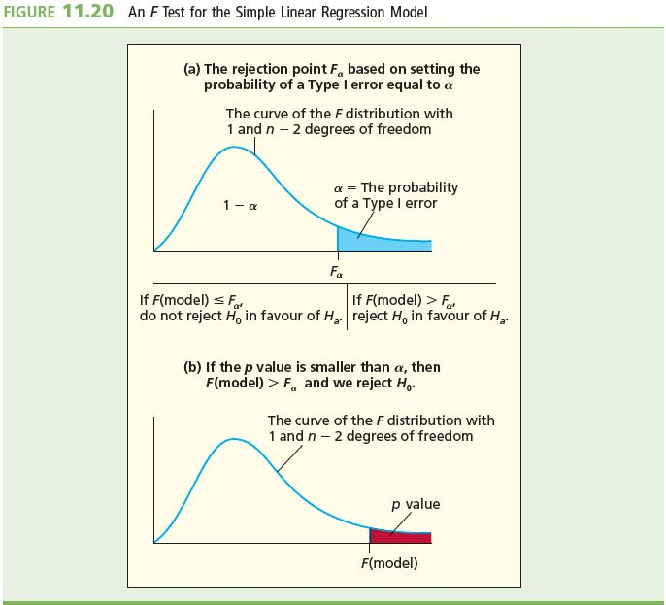
Mechanics of the F Test
L06
Hypothesis
  H₀: β₁= 0 versus
  H_{a}: β₁≠ 0
Test Statistic
Rejection Rule at the α level of significance
  Reject H₀ if
  F(model) > F_{α}
  P value < α
  F_{α} based on 1 numerator and n-2 denominator degrees of freedom

Slide 68
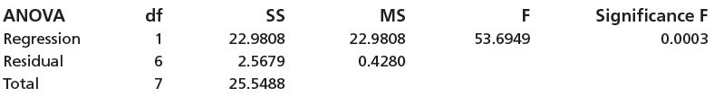
Example
L06
Partial Excel output of a simple linear regression analysis relating y to x
Explained variation is 22.9808 and the unexplained variation is 2.5679

Slide 69
Example
F(model) = 53.69
F_{0.05} = 5.99 using Table A.7 with 1 numerator and 6 denominator degrees of freedom
Since F(model) = 53.69 > F_{0.05} = 5.99, we reject H₀: β₁ = 0 in favour of H_{a}: β₁ ≠ 0 at level of significance 0.05
Alternatively, since the p value is smaller than 0.05, 0.01, and 0.001, we can reject H₀ at level of significance 0.05, 0.01, or 0.001
The regression relationship between x and y is significant

Slide 70
Table A.7: F_{0.05}
Numerator df =1
5.99
Denominator df = 6

Slide 71
Residual Analysis
Regression assumptions are as follows:
  Mean of Zero
  At any given value of x, the population of potential error term values has a mean equal to zero
  Constant Variance Assumption
  At any given value of x, the population of potential error term values has a variance that does not depend on the value of x
  Normality Assumption
  At any given value of x, the population of potential error term values has a normal distribution
  Independence Assumption
  Any one value of the error term ε is statistically independent of any other value of ε

Slide 72
Residual Analysis
Checks of regression assumptions are performed by analyzing the regression residuals
Residuals (e) are defined as the difference between the observed value of y and the predicted value of y
Note that e is the point estimate of ε
If the regression assumptions are valid, the population of potential error terms will be normally distributed with a mean of zero and a variance σ²
Furthermore, the different error terms will be statistically independent

Slide 73
Residual Analysis
The residuals should look like they have been randomly and independently selected from normally distributed populations having mean zero and variance σ²
With any real data, assumptions will not hold exactly
Mild departures do not affect our ability to make statistical inferences
In checking assumptions, we are looking for pronounced departures from the assumptions
So, only require residuals to approximately fit the description above

Slide 74
Residual Plots
Residuals versus independent variable
Residuals versus predicted y’s
Residuals in time order (if the response is a time series)
Histogram of residuals
Normal plot of the residuals

Slide 75
Sample MegaStat Residual Plots

Slide 76
Constant Variance Assumptions
To check the validity of the constant variance assumption, we examine plots of the residuals against
  The x values
  The predicted y values
  Time (when data is time series)
A pattern that fans out says the variance is increasing rather than staying constant
A pattern that funnels in says the variance is decreasing rather than staying constant
A pattern that is evenly spread within a band says the assumption has been met

Slide 77
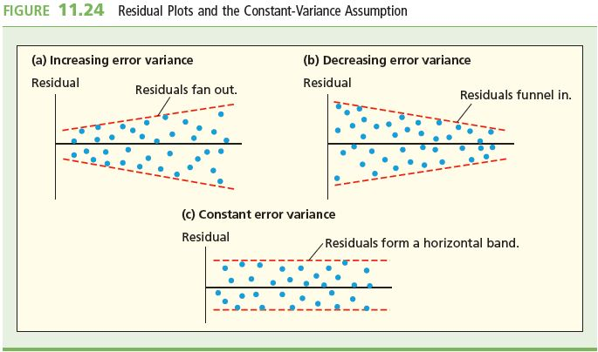
Constant Variance Visually

Slide 78
Assumption of Correct Functional
Form
If the relationship between x and y is something other than a linear one, the residual plot will often suggest a form more appropriate for the model
For example, if there is a curved relationship between x and y, a plot of residuals will often show a curved relationship

Slide 79
Normality Assumption
If the normality assumption holds, a histogram or stem-and-leaf display of residuals should look bell-shaped and symmetric
Another way to check is a normal plot of residuals
  Order residuals from smallest to largest
  Plot e_{(i)} on vertical axis against z_{(i)}
    Z_{(i)} is the point on the horizontal axis under the z curve so that the area under this curve to the left is (3i-1)/(3n+1)
If the normality assumption holds, the plot should have a straight-line appearance

Slide 80
Sample MegaStat Normality Plot
A normal plot that does not look like a straight line indicates that the normality requirement may be violated

Slide 81
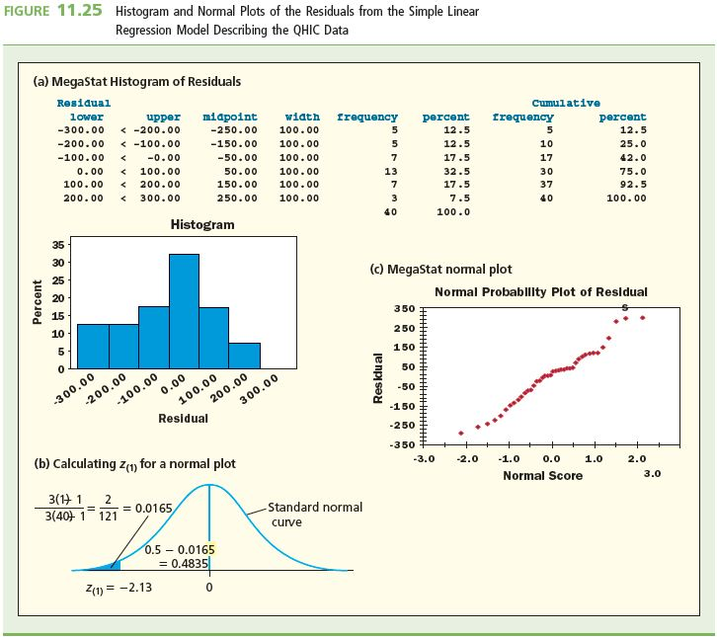
The QHIC Case
Normal Probability Plot of the Residuals

Slide 82
Independence Assumption
Independence assumption is most likely to be violated when the data are time series data
  If the data is not time series, then it can be reordered without affecting the data
  Changing the order would change the interdependence of the data
For time series data, the time-ordered error terms can be autocorrelated
  Positive autocorrelation is when a positive error term in time period i tends to be followed by another positive value in i+k
  Negative autocorrelation is when a positive error term in time period i tends to be followed by a negative value in i+k
Either one will cause a cyclical error term over time

Slide 83
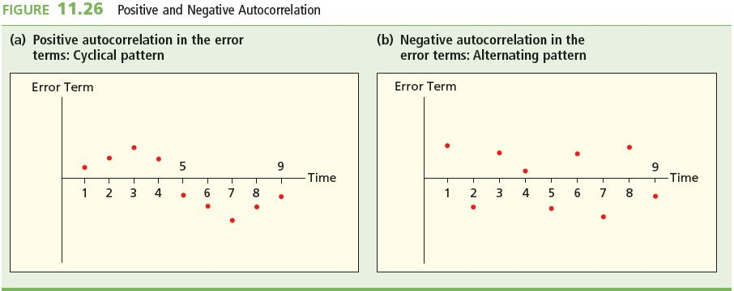
Positive and Negative Autocorrelation
Independence assumption basically says that the time-ordered error terms display no positive or negative autocorrelation

Slide 84
Durbin-Watson Test
One type of autocorrelation is called first-order autocorrelation
This is when the error term in time period t (ε_{t}) is related to the error term in time period t-1 (ε_{t-1})
The Durbin-Watson statistic checks for first-order autocorrelation
  Small values of d lead us to conclude that there is positive autocorrelation
  This is because, if d is small, the differences (et - et21) are small

Slide 85
Durbin-Watson Test Statistic
  Where e₁, e₂,…, e_{n} are time-ordered residuals
Hypothesis
  H₀ that the error terms are not autocorrelated
  H_{a} that the error terms are negatively autocorrelated
Rejection Rules (L = Lower, U = Upper)
  If d < d_{L,α}, we reject H₀
  If d > d_{U,α}, we reject H₀
  If d_{L,α} < d < d_{U,α}, the test is inconclusive
  Tables A.12, A.13, and A.14 give values for d_{L,α} and d_{U,α} at different alpha values

Slide 86
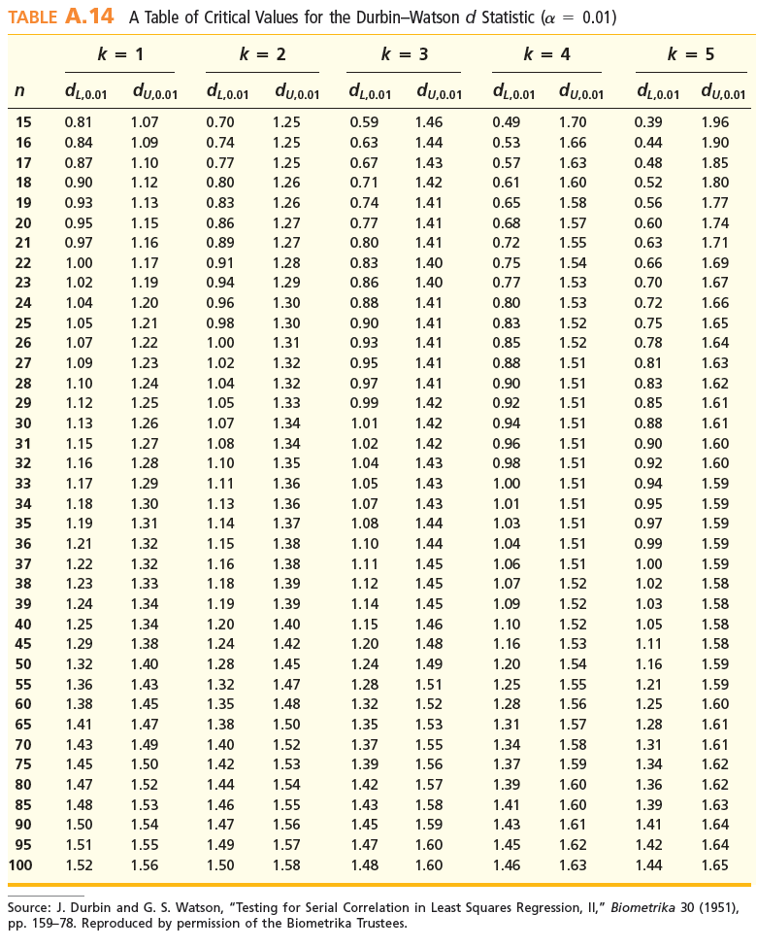
Durbin Watson Table: α=0.01
Return

Slide 87
Durbin Watson Table: α=0.05, α=0.025
Return

Slide 88
Transforming Variables
A possible remedy for violations of the constant variance, correct functional form, and normality assumptions is to transform the dependent variable
Possible transformations include
  Square root
  Quartic root
  Logarithmic
  Reciprocal
The appropriate transformation will depend on the specific problem with the original data set

Slide 89
Some Shortcut Formulas
where

Slide 90
Summary
The coefficient of correlation “r”, relates a dependent (y) variable to a single independent (x) variable – it can show the strength of that relationship
The simple linear regression model employs two parameters 1) slope 2) y intercept
It is possible to use the regression model to calculate a point estimate of the mean value of the dependent variable and also a point prediction of an individual value
The significance of the regression relationship can be tested by testing the slope of the model β₁
The F test tests the significance of the overall regression relationship between x and y
The simple coefficient of determination “r^{2”} is the proportion of the total variation in the n observed values of the dependent variable that is explained by the simple linear regression model
Residual Analysis allows us to test if the required assumptions on the regression analysis hold

