Slide 1
Chapter 10
Experimental Design and Analysis of Variance

Slide 2
Experimental Design and Analysis of Variance
10.1 Basic Concepts of Experimental Design
10.2 One-Way Analysis of Variance
10.3 The Randomized Block Design
10.4 Two-Way Analysis of Variance

Slide 3
Experimental Design #1
L01
Up until now, we have considered only two ways of collecting and comparing data:
  Using independent random samples
  Using paired (or matched) samples
Often data is collected as the result of an experiment
  To systematically study how one or more factors (the independent variable or IV) influence the variable that is being studied (the response or DV)

Slide 4
Experimental Design #2
L01
L02
In an experiment, there is strict control over the factors contributing to the experiment
  The values or levels of the factors (IV) are called treatments
    For example, in testing a medical drug, the experimenters decide which participants in the test get the drug and which ones get the placebo, instead of leaving the choice to the subjects
    The term treatment comes from an early application of this type of analysis where an analysis of different fertilizer “treatments” produced different crop yields
If we cannot control the factor(s) being studied, we say that the data obtained are observational
If we can control the factors being studied, we say that the data are experimental

Slide 5
Experimental Design #3
L02
The different treatments are assigned to objects (the test subjects) called experimental units
  When a treatment is applied to more than one experimental unit, the treatment is being “replicated”
A designed experiment is an experiment where the analyst controls which treatments used and how they are applied to the experimental units

Slide 6
Experimental Design #4
L02
In a completely randomized experimental design, independent random samples are assigned to each of the treatments
  For example, suppose three experimental units are to be assigned to five treatments
  For completely randomized experimental design, randomly pick three experimental units for one treatment, randomly pick three different experimental units from those remaining for the next treatment, and so on
    This is an example of sampling without replacement

Slide 7
Experimental Design #5
L02
Once the experimental units are assigned and the experiment is performed, a value of the response variable is observed for each experimental unit
  Obtain a sample of values for the response variable for each treatment (group)

Slide 8
Experimental Design #6
L02
In a completely randomized experimental design, it is presumed that each sample is a random sample from the population of all possible values of the response variable
  That could possibly be observed when using the specific treatment
  The samples are independent of each other

Slide 9
Example 10.1 Training Method Experiment Case
Compare three training methods to package a camera kit and its effect on the hourly packaging efficiency by new employees at a camera company
  The response variable is the number of camera boxes packaged per hour
  The training methods A (video), B (interactive) and C (standard) are the treatments

Slide 10
Example 10.1 Training Method Experiment Case
Use a completely randomized experimental design
  Have available a large pool of newly hired employees
  Need samples of size five for each training type
  Randomly select five people from the pool; assign these five to training method A (Video Training)
  Randomly select five people from the remaining new employees; these five are assigned to training method B (Interactive)
  Randomly select five people from the remaining employees; these five are assigned to training method C (Standard-reading only)
Each randomly trainee is trained using the assigned method and results of the average number of boxed packed per hour is recorded

Slide 11
Example 10.1 Training Method Experiment Case
The data is as shown below
  Let x_{ij} denote the average number of boxes packed by the j^{th} employee (j = 1,2, … , 5) using training method i (i = A, B, or C)
  Examining the box plots shown next to the data, we see some evidence that the interactive training method (B) may result in the greatest efficiency in packing camera parts

Slide 12
One-Way Analysis of Variance
L03
Want to study the effects of all p treatments on a response variable
  For each treatment, find the mean and standard deviation of all possible values of the response variable when using that treatment
  For treatment i, find treatment (Group) mean μ_{i}
One-way analysis of variance estimates and compares the effects of the different treatments on the response variable
  By estimating and comparing the treatment means μ₁, μ₂, …, μ_{p}
  One-way analysis of variance, or one-way ANOVA

Slide 13
Example 10.3 Training Method Experiment Case
L03
The mean of a sample is the point estimate for the corresponding treatment mean
x_{A} = 34.92 boxes/hr estimates μ_{A}
x_{B} = 36.56 boxes/hr estimates μ_{B}
x_{C} = 33.98 boxes/hr estimates μ_{C}

Slide 14
Example 10.3 Training Method Experiment Case
L03
The standard deviation of a sample is the point estimate for the corresponding treatment standard estimates
s_{A} = 0.7662 boxes/hr estimates σ_{A}
s_{B} = 0.8503 boxes/hr estimates σ_{B}
s_{C} = 0.8349 boxes/hr estimates σ_{C}

Slide 15
ANOVA Notation
L03
n_{i} denotes the size of the sample randomly selected for treatment i
x_{ij} is the j^{th} value of the response variable using treatment i
x_{i} is average of the sample of n_{i} values for treatment i
  x_{i} is the point estimate of the treatment mean μ_{i}
s_{i} is the standard deviation of the sample of n_{i} values for treatment i
  s_{i} is the point estimate for the treatment (population) standard deviation σ_{i}

Slide 16
One-Way ANOVA Assumptions
L05
Completely randomized experimental design
  Assume that a sample has been selected randomly for each of the p treatments on the response variable by using a completely randomized experimental design
Constant variance
  The p populations of values of the response variable (associated with the p treatments) all have the same variance
Normality
  The p populations of values of the response variable all have normal distributions
Independence
  The samples of experimental units are randomly selected, independent samples

Slide 17
Notes on Assumptions
One-way ANOVA is not very sensitive to violations of the equal variances assumption
  Especially when all the samples are about the same size
  All of the sample standard deviations should be reasonably equal to each other
  General rule, the one-way ANOVA results will be approximately correct if the largest sample standard deviation is no more than twice the smallest sample standard
Normality is not crucial
  ANOVA results are approximately valid for mound-shaped distributions
    If the sample distributions are reasonably symmetric and if there are no outliers, then ANOVA results are valid for even samples as small as 4 or 5

Slide 18
Testing for Significant Differences
Between Treatment (Group) Means
Are there any statistically significant differences between the sample (treatment) means?
The null hypothesis is that the mean of all p treatments are the same
  H₀: μ₁ = μ₂ = … = μ_{p}
The alternative is that at least two of the p treatments have different effects on the mean response
  H_{a}: at least two of μ₁, μ₂ , …, μ_{p} differ

Slide 19
Testing for Significant Differences
Between Treatment (Group) Means
Compare the between-treatment variability to the within-treatment variability
  Between-treatment variability is the variability of the sample means from sample to sample
  Within-treatment variability is the variability of the treatments within each sample

Slide 20
Example 10.3 Training Method Experiment Case
In Figure 10.1(a), the between-treatment variability is not large compared to the within-treatment variability
  The between-treatment variability could be the result of sampling variability
  Do not have enough evidence to reject H₀: μ_{A} = μ_{B} = μ_{C}
In figure 10.1(b), between-treatment variability is large compared to the within-treatment variability
  May have enough evidence to reject H₀ in favor of
  H_{a}: at least two of μ_{A}, μ_{B}, μ_{C} differ

Slide 21
To Compare the Between-Groups and Within-Group Variability
L03
Terminology
  Sums of squares
  Mean squares
  n is the total number of experimental units used in the one-way ANOVA
  is the overall mean of the observed values of the response variable
Define
  Between-groups sum of squares
  Error sum of squares

Slide 22
Partitioning the Total Variability in the
Response
L03
Total
Sum
=
Treatment
Sum
+
Error
Sum
of
Squares
of
Squares
of
Squares
SST
=
SSB
+
SSE

Slide 23
Note
L03
The overall mean x is:
  where n = n₁ + n₂ + … + n_{i} + …. n_{p}
Also

Slide 24
Mean Squares
L03
The treatment mean-squares is:
The error mean-squares is

Slide 25
F Test for Difference Between
Group Means
Suppose that we want to compare p treatment means
The null hypothesis is that all treatment means are the same:
  H₀: μ₁ = μ₂ = … = μ_{p}
The alternative hypothesis is that they are not all the same:
  H_{a}: at least two of μ₁, μ₂ , …, μ_{p} differ

Slide 26
F Test for Difference Between
Group Means
L03
Define the F statistic:
The p-value is the area under the F curve to the right of F, where the F curve has p – 1 numerator and n – p denominator degrees of freedom

Slide 27
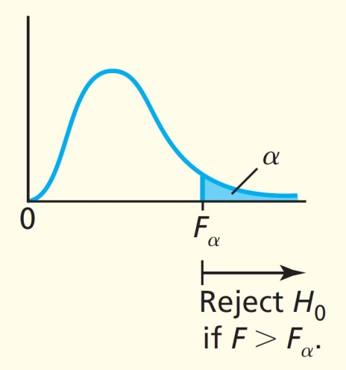
F Test for Difference Between
Group Means
Reject H₀ in favor of H_{a} at the α level of significance if
  F > F_{α} , or if
  p-value < α
F_{α} is based on p – 1 numerator and n – p denominator degrees of freedom

Slide 28
Example 10.3 Training Method Experiment Case
For the p = 3 training methods and n = 15 trainees (with 5 trainees per method):
The overall mean x is
The treatment sum of squares is

Slide 29
Example 10.3 Training Method Experiment Case
The error sum of squares is
The total sum of squares is
SST = SSB + SSE = 17.0493 + 8.028 = 25.0773

Slide 30
Example 10.3-10.4 Training Method Experiment Case
The between-groups (treatment) mean squares is
The error mean squares is
The F statistic is

Slide 31
Example 10.3-10.4 Training Method Experiment Case
At α = 0.05 significance level,
  F_{0.05} with p – 1 = 3 – 1 = 2 numerator and n – p = 15 – 3 = 12 denominator degrees of freedom
From Table A.7, F_{0.05} = 3.89
  F = 12.74 > F_{0.05} = 3.89
Therefore reject H₀ at the 0.05 significance level
  There is strong evidence that at least one of the group means (μ_{A}, μ_{B}, μ_{C}) is different
  So at least one of the three different training methods (A, B, C) have an effect on the average number of boxes packed per hour
    But which ones?
    Do pairwise comparisons (next topic)

Slide 32
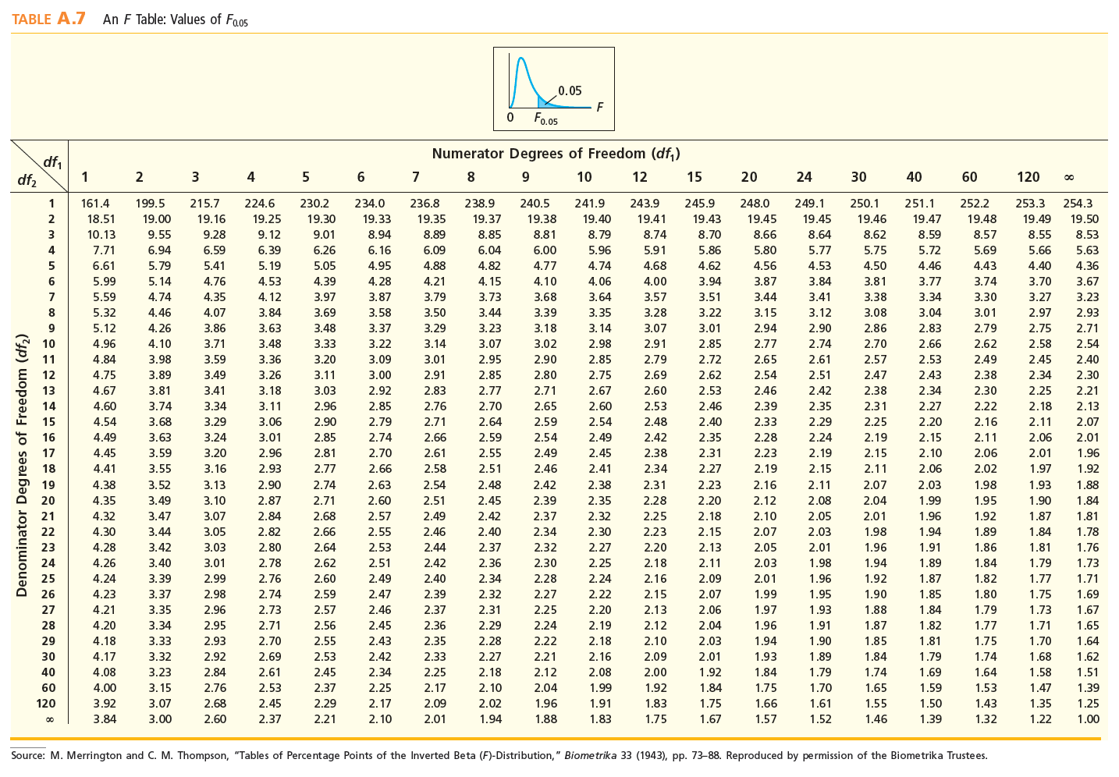
Table A.7: F_{0.05} DF₁=2 and DF₂ =12
Numerator df =2
3.89
Denominator df = 12

Slide 33
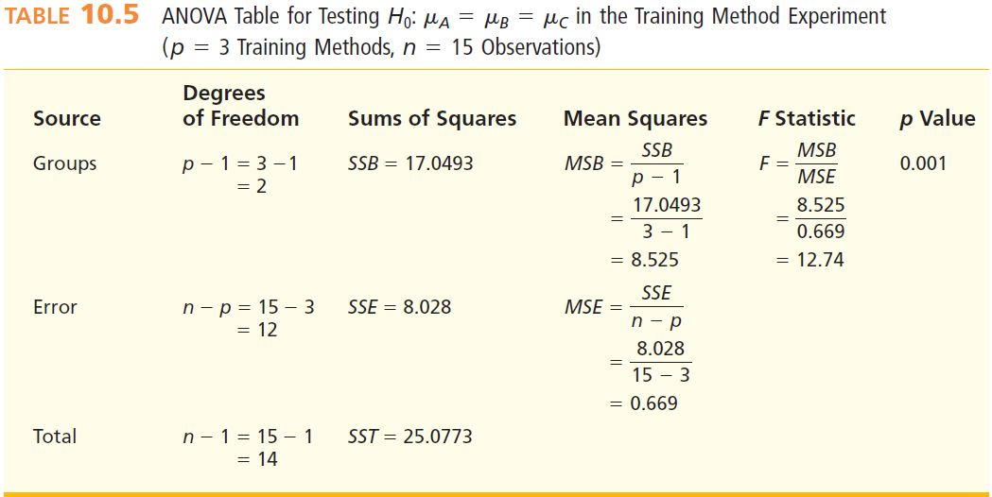
Example 10.4: Calculations
L03

Slide 34
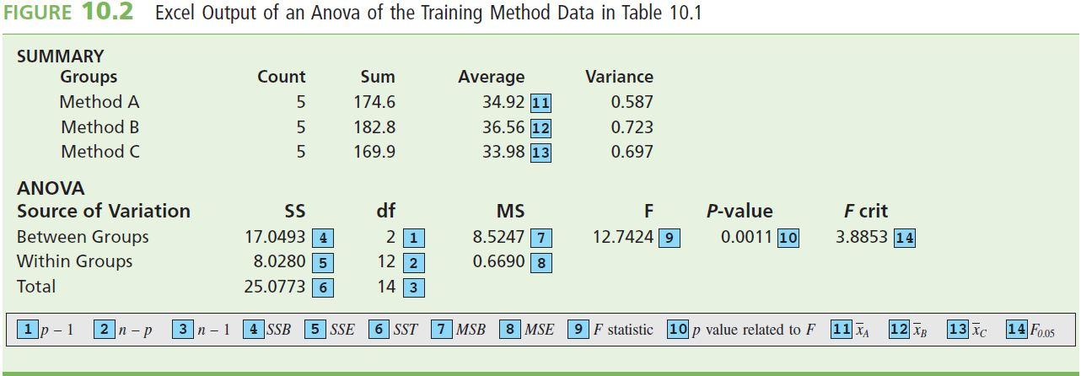
Example 10.4: Excel ANOVA Output

Slide 35
Pairwise Comparisons, Individual
Intervals
L04
Individual 100(1 - α)% confidence interval for μ_{i} – μ_{h}:
  t_{α/2} is based on n – p degrees of freedom

Slide 36
Pairwise Comparisons, Simultaneous Intervals
L04
A Tukey simultaneous 100(1-α) percent confidence interval for μ_{i} – μ_{h} is
        q_{a} is the upper α percentage point of the
        studentized range for p and (n – p), m denotes common sample size
  Tukey formula gives the most precise (shortest) simultaneous confidence interval
  Generally Tukey simultaneous confidence interval is longer than corresponding individual confidence interval
    Penalty paid for simultaneous confidence by obtaining a longer interval

Slide 37
Example 10.5 Training Method Experiment Case
A versus B , α = 0.05

Slide 38
Example 10.5 Training Method Experiment Case
Tukey simultaneous confidence intervals for μ_{A} – μ_{C} is:
For μ_{A} - μ_{C} and μ_{B} – μ_{C}
  Strong evidence that training method B yields the highest mean number of boxes packed
Click to see value lookup from table A.10

Slide 39
Table A.10: q_{0.05}
p=3
3.77
15-3=12
Return to previous slide

Slide 40
Example 10.5 Training Method Experiment Case
95% confidence interval for μ_{B} is:

Slide 41
The Randomized Block Design
L05
A randomized block design compares p treatments (for example, production methods) on each of b blocks (or experimental units or sets of units; for example, machine operators
  Each block is used exactly once to measure the effect of each and every treatment
  The order in which each treatment is assigned to a block should be random
A generalization of the paired difference design, this design controls for variability in experimental units by comparing each treatment on the same (not independent) experimental units
  Differences in the treatments are not hidden by differences in the experimental units (the blocks)

Slide 42
Randomized Block Design
L05
Define:
  x_{ij} = the value of the response variable when block j uses IV (independent variable)
  = the mean of the b values of the response variable observed in group I
  = the mean of the p values of the response variable when using block j
  = the mean of the total of the bp values of the response variable observed in the experiment

Slide 43
Randomized Block Design
L05
Blocks
Group
Means
1 2 3 … b
1
2
.
.
.
p
x_{ij} = response from treatment i and block j
Groups
Block Means

Slide 44
Example 10.6 The Defective Cardboard Box Case
Investigate the effects of four production methods on the number of defective boxes produced in an hour
Compare the methods; for each of the four production methods, the company would select several machine operators, train each operator to use the production method to which they have been assigned, have each operator produce boxes (in random order) for one hour, and record the number of defective boxes produced
The randomized design would utilize a total of 12 machine operators
The abilities of the machine operators could differ substantially, these differences might tend to conceal any real differences between the production methods
To overcome this disadvantage, the company will employ a randomized block experimental design

Slide 45
Example 10.6 The Defective Cardboard Box Case
p = 4 groups (production methods)
b = 3 blocks (machine operators)
n = 12 observations

Slide 46
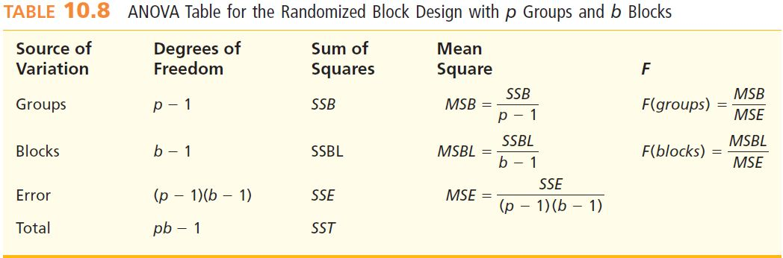
The ANOVA Table, Randomized
Blocks
L03
SST = SSB + SSBL + SSE

Slide 47
Sum of Squares
L03
SSB measures the amount of between-groups variability
SSBL measures the amount of variability due to the blocks
SST measures the total amount of variability
SSE measures the amount of the variability due to error
SSE = SST – SSB – SSBL

Slide 48
Example 10.6 Sum of Squares
  For p = 4 groups (production methods), b = 3 blocks (machine operators), n = 12 observations
  SSB = 3[(10.3333 - 7.5833)² + (10.3333 - 7.5833)² + (5.0 - 7.5833)² + (4.6667 - 7.5833)²] = 90.9167
  SSBL = 4[(6.0 - 7.5833)² + (7.75 - 7.5833)² + (9.0 - 7.5833)²] = 18.1667
  SST = (9 - 7.5833)² + (10 - 7.5833)² + (12 - 7.5833)² + (8 - 7.5833)² + (11 - 7.5833)² + (12 - 7.5833)² + (3 - 7.5833)² + (5 - 7.5833)² + (7 - 7.5833)² + (4 - 7.5833)² + (5 - 7.5833)² + (5 - 7.5833)² = 112.9167
  SSE = 112.9167 - 90.9167 - 18.1667 = 3.8333
  MSB = SSB/(p-1) = 90.9167/3 = 30.3056
  MSE = SSE/(p-1)(b-1)= 3.8333/(3)(2) = 0.6389
  MSBL = SSBL/(b-1) = 18.1667/2 = 9.0834

Slide 49
MegaStat ANOVA
L03
Locate SSB, SSBL, SST, SSE, MSB, MSE, MSBL on the ANOVA output
B
BL

Slide 50
F(groups) and F(blocks)
F(groups)
F(blocks)

Slide 51

F Test for Group Effects
Hypothesis Test
  H₀: No difference between group effects
  H_{a}: At least one group effects differ
Reject H₀ if
  F > F_{α} or
  p-value < α
    F_{α} is based on p-1 numerator and (p-1)×(b-1) denominator degrees of freedom

Slide 52
Example 10.6 Group Effects
Test at the α = 0.05 level of significance
  Reject H₀ if F(groups) > F_{0.05} (based on p-1 numerator and (p-1)(b-1) denominator degrees of freedom
F(groups) = MSB/MSE = 30.306/0.639 = 47.43
  F_{0.05} based on p-1 = 3 numerator and (p-1)(b-1) = 6 denominator degrees of freedom is 4.76 (Table A.7)
Since F(groups) > F_{0.05} (47.43 > 4.76) we reject the null hypothesis and conclude there is enough evidence at α = 0.05 that one production method has a different effect on the mean number of boxes produced per hour

Slide 53
Table A.7: F_{0.05} DF₁=3 and DF₂ =6
Return
Numerator df =2
4.76
Denominator df = 6

Slide 54
F Test for Block Effects
Hypothesis Test
  H₀: No difference between block effects
  H_{a}: At least one block effects differ
Reject H₀ if
  F > F_{α} or
  p-value < α
    F_{α} is based on b-1 numerator and (p-1)×(b-1) denominator degrees of freedom

Slide 55
Example 10.6 Block Effects
Test at the α = 0.05 level of significance
  Reject H₀ if F(groups) > F_{0.05} (based on b-1 numerator and (p-1)(b-1) denominator degrees of freedom
F(block) = MSBL/MSE = 9.083/0.639 = 14.22
  F_{0.05} based on b-1 = 2 numerator and (p-1)(b-1) = 6 denominator degrees of freedom is 5.14 (Table A.7)
Since F(block) > F_{0.05} (14.22 > 5.14) we reject the null hypothesis and conclude there is enough evidence at α = 0.05 that one machine operator has a different effect on the mean number of boxes produced per hour

Slide 56
Table A.7: F_{0.05} DF₁=2 and DF₂ =6
Return
Numerator df =2
5.14
Denominator df = 6

Slide 57
Point Estimates and Confidence Intervals in a Randomized Block ANOVA
Consider the difference between groups i and h on the mean value of the response variable
  A point estimate of this difference is
  Individual 100(1 - a)% confidence interval for this difference is
    t_{a/2} is based on (p-1)(b-1) degrees of freedom
  A Tukey simultaneous 100(1 2 A) percent confidence interval for this difference is
    q_{α} is the upper α percentage point of the studentized range for p and (p-1)(b-1) from Table A.10

Slide 58
Example 10.7 The Defective Cardboard Box Case
There is extremely strong evidence that at least one production methods has a different mean number of defective boxes produced per hour
Group means are = 10.3333, = 10.3333,
= 5.0, and = 4.6667.
Since is the smallest mean, we will use Tukey simultaneous 95 percent confidence intervals to compare the effect of production method 4 with the effects of production methods 1, 2, and 3

Slide 59
Example 10.7 The Defective Cardboard Box Case
q_{0.05} = 4.90 is the entry in Table A.10 corresponding to p = 4 and ( p - 1)(b - 1) = 6
MSE = 0.639 from ANOVA ➔

Slide 60
Example 10.7 The Defective Cardboard Box Case
Tukey simultaneous 95 percent confidence interval for the difference between the effects of production methods 4 and 1 on the mean number of defective boxes produced per hour is
  Note q_{0.05} = 4.90 for 4 and 6 degrees of freedom

Slide 61
Table A.10: q_{0.05}
p=4
4.90
(p-1)(b-1)=6
Return to previous slide

Slide 62
Two-Way Analysis of Variance
L06
A two factor factorial design compares the mean response for a levels of factor 1 (for example, display height) and each of b levels of factor 2 ( for example, display width)
A treatment is a combination of a level of factor 1 and a level of factor 2

Slide 63
Example 10.8 The Shelf Display Case
L06
The Tastee Bakery Company supplies a bakery product to many supermarkets
Study the effects of two factors—shelf display height and shelf display width—on monthly demand (measured in cases of 10 units each) for this product
The factor “display height” is defined to have three levels: B (bottom), M (middle), and T (top)
The factor “display width” is defined to have two levels: R (regular) and W (wide)

Slide 64
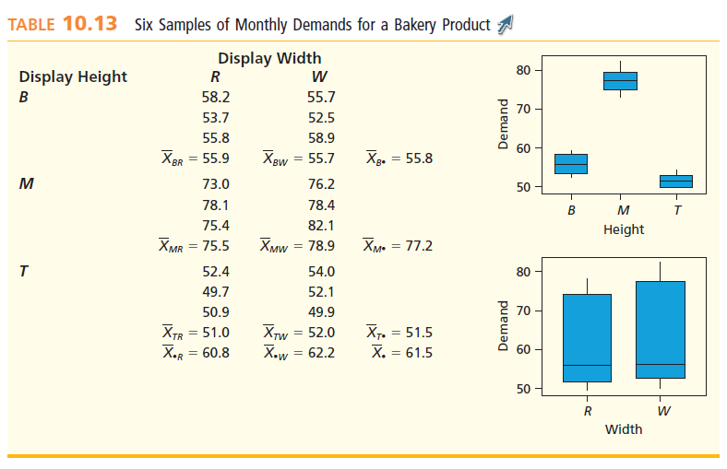
Example 10.8 The Shelf Display Case

Slide 65
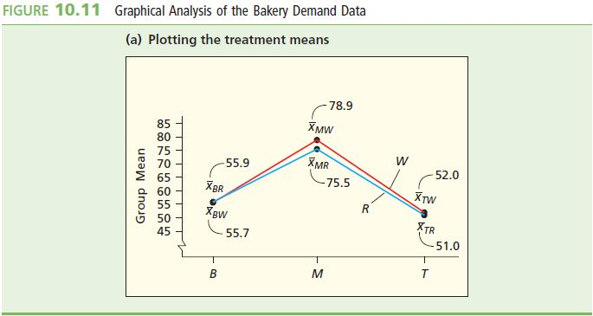
Graphical Analysis of
Bakery Demand (Plotting the Treatment Means)

Slide 66
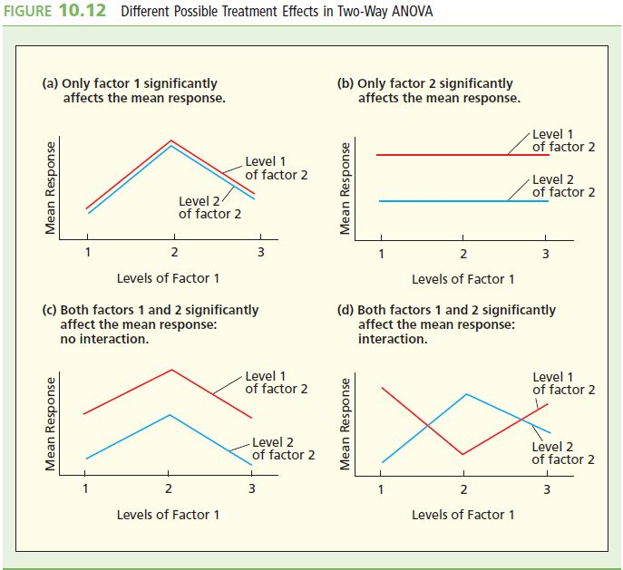
Possible Treatment Effects in
Two-Way ANOVA

Slide 67
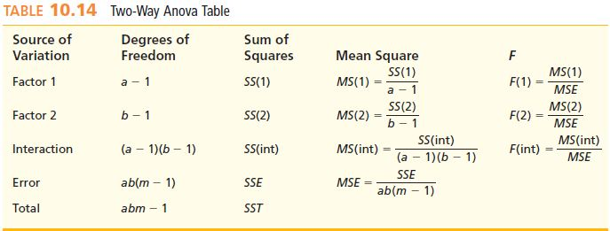
Two-Way ANOVA Table
L06

Slide 68
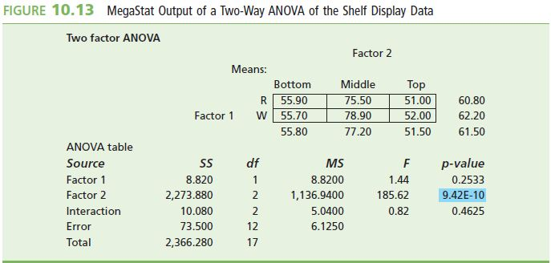
MegaStat Output
Data Summary

Slide 69
F Tests for Treatment Effects
L06
Test Statistics
  Main Effects
    F_{α} is based on a-1 and ab(m-1) degrees of freedom
    F_{α} is based on b-1 and ab(m-1) degrees of freedom
  Interaction
    F_{α} is based on (a-1)(b-1) and ab(m-1) degrees of freedom
Reject H₀ if F > F_{α} or p-value < α

Slide 70
Test for Treatment Effects
Hypothesis
  H₀ that no interaction exists between factors 1 and 2 versus the alternative hypothesis H_{a} that interaction does exist
Reject H₀ in favour of Ha at level of significance α if

Slide 71
Conclusion
F(Int) = 0.82 is less than F_{0.05} = 3.89
Cannot reject H₀ at the 0.05 level of significance
Conclude that little or no interaction exists between shelf display height and shelf display width

Slide 72
Estimation of Treatment Differences
Under Two-Way ANOVA, Factor 1
Individual 100(1 - a)% confidence interval for μ_{i•} - μ_{i’•}
  t_{a/2} is based on ab(m-1) degrees of freedom
Tukey simultaneous 100(1 - a)% confidence interval for μ_{i•} - μ_{i’•}
  q_{α} is the upper α percentage point of the studentized range for a and ab(m-1) from Table A.10

Slide 73
Estimation of Treatment Differences
Under Two-Way ANOVA, Factor 2
Individual 100(1 - a)% confidence interval for μ_{•j} - μ_{•j’}
  t_{α/2} is based on ab(m-1) degrees of freedom
Tukey simultaneous 100(1 - α)% confidence interval for μ_{•j} - μ_{•j’}
  q_{α} is the upper α percentage point of the studentized range for b and ab(m-1) from Table A.10

Slide 74
Summary
The purpose of most experiments is to compare the effects of various treatments on a response variable
Factors are set before the response variables are observed, the different values of the factors are called treatments
To analyse experimental data we study one way analysis of variance (one way ANOVA)
Differences in experimental units can conceal differences in treatments. In such cases we can employ randomized experimental block design. Each block is used exactly once to measure the effects of each and every treatment
In two way analysis of variance (two-way ANOVA) we can study the effects of two factors by carrying out a two factor experiment

