Slide 1
Chapter 9
Statistical Inferences Based on
Two Samples

Slide 2
Statistical Inferences Based on
Two Samples
9.1 z Tests about a Difference in Population Means: One-Tailed Alternative
9.2 z Tests about a Difference in Population Means: Two-Tailed Alternative
9.3 t Tests about a Difference in Population Means: One-Tailed Alternative
9.4 t Tests about a Difference in Population Means: Two-Tailed Alternative
9.5 z Tests about a Difference in Population Proportions
9.6 F Tests about a Difference in Population Variances

Slide 3
Comparing Two Population Means by Using Independent Samples: Variances Known
Suppose a random sample has been taken from each of two different populations (populations 1 and 2) and suppose that the populations are independent of each other
  Then the random samples are independent of each other
  Then the sampling distribution of the difference in sample means is normally distributed or that each of the sample sizes n1 and n2 is large ((n1, n2) is at least 40) is more than sufficient
We can easily test a hypothesis about the difference between the means

Slide 4
Z Tests: One-Tailed Alternative
L01
Suppose we wish to conduct a one-sided hypothesis test about μ₁ - μ₂
The difference between these means can be represented by “D”
  i.e. μ₁ - μ₂ = D
The null hypothesis is:
  H₀: μ₁ - μ₂ = D₀
The one-tailed alternative hypothesis is:
  H_{a}: μ₁ - μ₂ > D₀ or
  H_{a}: μ₁ - μ₂ < D₀

Slide 5
Z Tests: One-Tailed Alternative
L01
Often D₀ will be the number 0
In such a case, the null hypothesis H₀: μ₁ - μ₂ = 0 says there is no difference between the population means μ₁ and μ₂
When D₀ = 0, each alternative hypothesis implies that the population means μ₁ and μ₂ differ
Also note the standard deviation of the difference of means is:

Slide 6
Difference in Population Means:
Test Statistic (Variances Known)
L02
The test statistic is:
The sampling distribution of this statistic is a standard normal distribution
If the populations are normal and the samples are independent ...

Slide 7
z Tests About a Difference in Means
(Variances Known)
L01
Reject H₀: μ₁ – μ₂ = D₀ in favor of a particular alternative hypothesis at a level of significance if the appropriate rejection point rule holds or if the corresponding p-value is less than α
  Rules are on the next slide …

Slide 8
Z Tests: Rejection Rules
L01
L05
Null Hypothesis: H₀: μ₁ – μ₂ = D₀
Alternative Hypothesis | Reject H₀ if: | p-value
H_{a}: μ₁ – μ₂ > D₀ | z > z_{α} | Area under standard normal to the right of z
H_{a}: μ₁ – μ₂ < D₀ | z < -z_{α} | Area under standard normal to the left of –z
H_{a}: μ₁ – μ₂ ≠ D₀ * | |z| > z_{α/2} * | Twice the area under standard normal to the right of |z|
* Note For Two-Tailed Alternative either z > z_{a/2} or z < –z_{a/2}

Slide 9
Example 9.1: Bank Customer Waiting
Time Case
L02
Test the claim that the new system reduces the mean waiting time
Test at the α = 0.05 significance level the null
  H₀: μ₁ – μ₂ = 0 against the alternative H_{a}: μ₁ – μ₂ > 0
  Use the rejection rule H₀ if z > z_{α}
  At the 5% significance level, z_{α} = z_{0.05} = 1.645
  So reject H₀ if z > 1.645
Use the sample and population data in Example 7.11 to calculate the test statistic

Slide 10
Example 9.1: Bank Customer Waiting
Time Case
L02
L03
Because z = 14.21 > z_{0.05} = 1.645, reject H₀
Conclude that μ₁ – μ₂ is greater than 0 and therefore it appears as though the new system does reduce the waiting time
Alternatively we can use the p-value
  The p-value for this test is the area under the standard normal curve to the right of z = 14.21
  Since this p value is less than 0.001, we have extremely strong evidence that μ₁ - μ₂ is greater than 0 and, therefore, that the new system reduces the mean customer waiting time

Slide 11
Example 9.1: Bank Customer Waiting
Time Case
L02
L03
The new system will be implemented only if it reduces mean waiting time by more than 3 minutes
Set D₀ = 3, and try to reject the null H₀: μ₁ – μ₂ = 3 in favor of the alternative H_{a}: μ₁ – μ₂ > 3
z=2.53 > z_{0.05} = 1.645, we reject H₀ in favor of H_{a}
  There is evidence that the mean waiting time is reduced by more than 3 minutes

Slide 12
Using the p-value
L03
The p-value for this test is the area under the standard normal curve to the right of z = 2.53
  With Table A.3, the p-value is 0.5 – 0.4943 = 0.0057
    There is strong evidence against H₀
    Again there is evidence that the mean waiting time is reduced by more than 3 minutes

Slide 13
Confidence Interval
L02
A 95% confidence interval for the difference in the mean waiting time is:

Slide 14
Z Tests Rejection Rule: Two-Tailed Alternative
L01
L05
Null Hypothesis: H₀: μ₁ – μ₂ = D₀
Alternative Hypothesis | Reject H₀ if: | p-value
H_{a}: μ₁ – μ₂ ≠ D₀ * | |z| > z_{α/2} * | Twice the area under standard normal to the right of |z|
* Note For Two-Tailed Alternative either z > z_{a/2} or z < –z_{a/2}

Slide 15
Example 9.2: The Bank Customer Waiting Time Case (Two-Tailed Alternative)
L03
Provide evidence supporting the claim that the new system produces a different mean bank customer waiting time
We will test H₀: μ₁ - μ ₂ = 0 versus H_{a}: μ ₁ = μ ₂ ≠ 0 at the 0.05 level of significance
Reject H₀: μ₁ - μ ₂ = 0 if the value of |z| is greater than z_{α/2} = z_{0.025} = 1.96

Slide 16
The Bank Customer Waiting Time Case
(Two-Tailed Alternative)
L03
L05
Use the sample and population data in Example 7.11 to calculate the test statistic
  z = 14.21 is greater than z_{0.025} = 1.96
  reject H₀: μ₁ - μ ₂ = 0 in favour of
  H_{a}: μ ₁ = μ ₂ ≠ 0
Conclude that μ₁ - μ ₂ is not equal to 0
  There is a difference in the mean customer waiting times

Slide 17
t Tests About a Difference in Population Means
L02
Testing the null hypothesis H₀: μ₁ – μ₂ = D₀ under two conditions
  When variances are equal,
  When variances are unequal,

Slide 18
t Tests About a Difference in Population Means
Variances equal and unequal
L02
L05
When
  The test statistic is:
When
  The test statistic is:

Slide 19
Small Sample Intervals and Tests about
Differences in Means When Variances are Not Equal
Summary
L02
L05
If sampled populations are both normal, but sample sizes and variances differ substantially, small-sample estimation and testing can be based on the following “unequal variance” procedure
Confidence Interval
Test Statistic
For both the interval and test, the degrees of freedom are equal to

Slide 20
t Tests Rejection Rules
L01
L05
H₀: μ₁ – μ₂ = D₀
Alternative | Reject H₀ if: | p-value
H_{a}: μ₁ – μ₂ > D₀ (One-Tailed) | t > t_{α} | Area under t distribution to the right of t
H_{a}: μ₁ – μ₂ < D₀ (One-Tailed) | t < -t_{α} | Area under t distribution to the left of t
H_{a}: μ₁ – μ₂ ≠ D₀ (Two-Tailed) | |t| > t_{α/2} * | Twice the area under t distribution to the right of |t|
where t_{α}, t_{α/2}, and p-values are based on (n₁ + n₂ - 2) degrees of freedom * either t > α_{a/2} or t < –t_{α/2}

Slide 21
Paired Differences Testing
L02
If the population of differences is normal, we can reject H₀: μ_{D} = D₀ at the α level of significance (probability of Type I error equal to α) if and only if the appropriate rejection point condition holds or, equivalently, if the corresponding p-value is less than α
We need a test statistic …

Slide 22
Test Statistic for Paired Differences
L02
The test statistic is:
  D₀ = μ₁ – μ₂ is the claimed or actual difference between the population means
    D₀ varies depending on the situation
  Often D₀ = 0, and the null means that there is no difference between the population means
The sampling distribution of this statistic is a t distribution with (n – 1) degrees of freedom
Rules are on the next slide …

Slide 23
Paired Differences Rejection Rules
L01
L05
Alternative | Reject H₀ if: | p-value
H_{a}: μ_{D} > D₀ (One-Tailed) | t > t_{α} | Area under t distribution to the right of t
H_{a}: μ_{D} < D₀ (One-Tailed) | t < -t_{α} | Area under t distribution to the left of t
H_{a}: μ_{D} ≠ D₀ (Two-Tailed) | |t| > t_{α/2} * | Twice the area under t distribution to the right of |t|
where t_{α}, t_{α/2}, and p-values are based on (n – 1) degrees of freedom * either t > α_{a/2} or t < –t_{α/2}

Slide 24
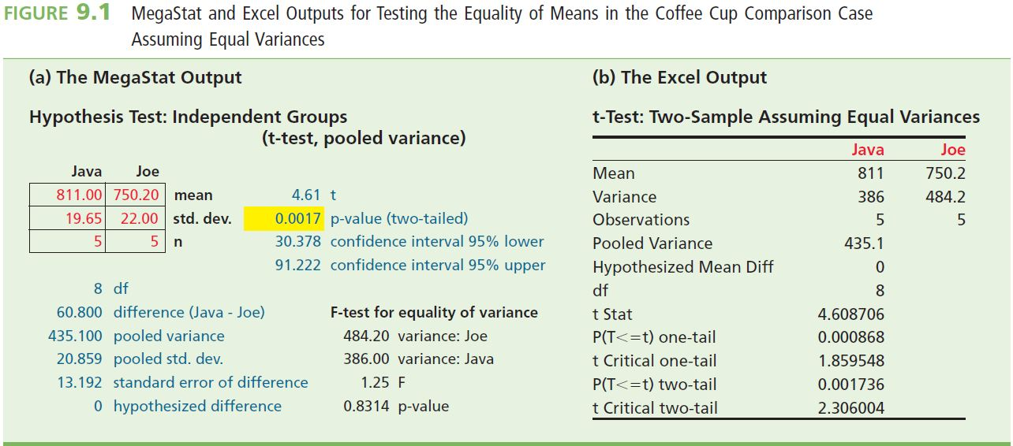
t Tests: One-Tailed Alternative
Difference in Population Means
L03
Example 9.3 The Coffee Cup Case
  In order to compare the mean hourly yields obtained by using the Java and Joe production methods, we will test H0: μ1 - μ2 = 0 versus Ha: μ1 - μ2 > 0 at the 0.05 level of significance
  To perform the hypothesis test, we will use the sample information

Slide 25
t Tests: One-Tailed Alternative
Difference in Population Means
L03
Unequal-variances procedure
Consider the bank customer waiting time situation, recall that the bank manager wants to implement the new system only if it reduces the mean waiting time by more than three minutes
Therefore, the manager will test the null hypothesis H₀: μ₁ - μ₂ = 3 versus the alternative hypothesis H_{a}: μ₁ - μ₂ > 3 at α = 0.05

Slide 26
Unequal-variances procedure
L02
L03
Suppose
  n₁ = 100 and n₂ = 100, computing the sample mean and standard deviation of each sample gives

Slide 27
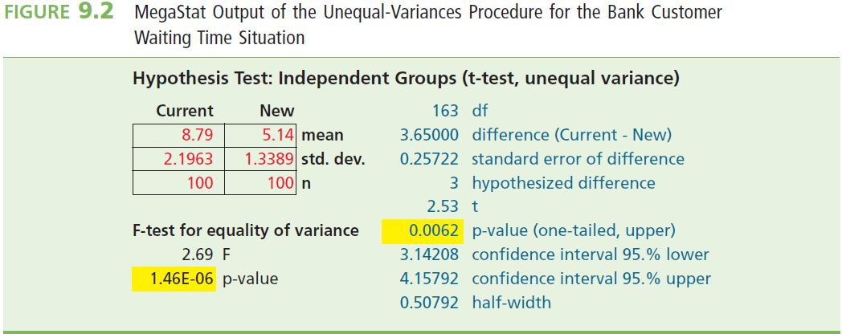
Unequal-variances procedure
L02
L03
t = 2.53 is greater than t_{0.05} = 1.65
  Reject H₀: μ₁ - μ₂ = 3 in favour of H_{a}:μ₁ 2 μ₂ > 3 at α 0.05
  The new system reduces the mean customer waiting time by more than three minutes
Examine the MegaStat output below
  t = 2.53, the associated p value is 0.0062, the very small p value tells us that we have very strong evidence against H₀

Slide 28
Example 9.3 The Coffee Cup Case
L02
L03
Reject H₀: μ₁ - μ₂ = 0 if t is greater than t_{α} = t_{0.05} = 1.860
Test Statistic:
t = 4.6087 > t_{0.05} = 1.860
  We can reject H₀
  Conclude at α = 0.05 the mean hourly yields obtained by using the two production methods differ
  Note the small p-value in figure 9.1 indicates strong evidence against H₀

Slide 29
t Tests: One-Tailed Alternative
Difference in Population Means
L02
L03
Example 9.4 The Repair Cost Comparison Case
  Forest City Casualty currently contracts to have moderately damaged cars repaired at garage 2
  However, a local insurance agent suggests that garage 1 provides less expensive repair service that is of equal quality
  Forest City has decided to give some of its repair business to garage 1 only if it has very strong evidence that μ₁, the mean repair cost estimate at garage 1, is smaller than μ₂, the mean repair cost estimate at garage 2, that is, if μ_{D} = μ₁ - μ₂ is less than zero

Slide 30
The Repair Cost Comparison Case
L02
L03
We will test H₀: μ_{D} = 0 (no difference) versus H_{a}: μ_{D} < 0 (difference – garage 1 costs are less than garage 2) at the 0.01 level of significance
Reject if t < –t_{α}, that is , if t < –t_{0.01}
  With n – 1 = 6 degrees of freedom, t_{0.01} = 3.143
  So reject H₀ if t < –3.143

Slide 31
The Repair Cost Comparison Case
L02
L03
Calculate the t statistic:
Because t = –4.2053 is less than –t_{0.01} = – 3.143, reject H₀
Conclude at the α = 0.01 significance level that it appears as though the mean repair cost at Garage 1 is less than the mean repair cost of Garage 2
From a computer, for t = -4.2053, the p-value is 0.003
Because this p-value is very small, there is very strong evidence that H₀ should be rejected and that μ₁ is actually less than μ₂

Slide 32
t Tests: Two-Tailed Alternative
Difference in Population Means
L02
L03
Example 9.5 Coffee Cup Case (Revisited)
  In order to compare the mean hourly yields obtained by using the Java and Joe methods
  Test H₀: μ₁ - μ ₂ = 0 versus H_{a}: μ ₁ - μ ₂ ≠ 0 at α = 0.05
  Reject H₀: μ₁ - μ ₂ = 0 if the absolute value of t is greater than t_{α/2} = t_{0.025} = 2.306
    df = n₁ + n₂ - 2 = 5 + 5 - 2 = 8
Test Statistic
  Because |t| = 4.6087 is greater than t_{0.025} = 2.306, reject H₀ in favor of H_{a}
  Conclude at 5% significance level that the mean hourly yields from the two catalysts do differ

Slide 33
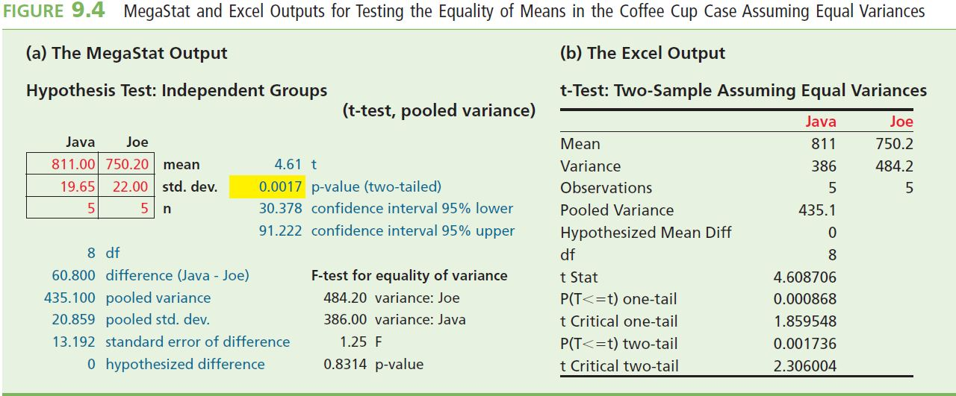
MegaStat Output
L02
L03
The p-value = 0.0017
  The very small p-value indicates that there is very strong evidence against H₀ (that the means are the same).
  Conclude on basis of p-value the same as before, that the two catalysts differ in their mean hourly yields

Slide 34
z Tests About a Difference
In Population Proportions
L02
The test statistic is:
  D₀ = p₁ – p₂ is the claimed or actual difference between the population proportions
    D₀ is a number whose value varies depending on the situation
  Often D₀ = 0, and the null means that there is no difference between the population means
The sampling distribution of this statistic is a standard normal distribution

Slide 35
z Tests About a Difference
In Population Proportions
L01
If the population of differences is normal, we can reject H₀: p₁ – p₂ = D₀ at the α level of significance (probability of Type I error equal to α) if and only if the appropriate rejection point condition holds or, equivalently, if the corresponding p-value is less than α
Rules are on the next slide …

Slide 36
z Tests Rejection Rules
L01
L05
For testing the difference of two population proportions
Alternative | Reject H₀ if: | p-value
H_{a}: p₁ – p₂ > D₀ | z > z_{α} | Area under the standard normal to the right of z
H_{a}: p₁ – p₂ < D₀ | z < -z_{α} | Area under the standard normal to the left of –z
H_{a}: p₁ – p₂ ≠ D₀ | |z| > z_{α/2} * | Twice the area under the standard normal to the right of |z|
* either t > t_{a/2} or t < –t_{a/2}

Slide 37
Note on Testing the Difference of Two Population Proportions
L02
L04
If D₀ = 0, estimate by
If D₀ ≠ 0, estimate by

Slide 38
Example 9.6 The Advertising Media Case
L04
Recall from example 7.15 that p₁ is the proportion of all consumers in the Toronto area who are aware of the new product and that p₂ is the proportion of all consumers in the Vancouver area who are aware of the new product
To test for the equality of these proportions, we will test H₀: p₁ - p₂ = 0 versus H_{a}: p₁ - p₂ ≠ 0 at the 0.05 level of significance
Samples are large

Slide 39
Example 9.6 The Advertising Media Case
L04
Since H_{a}: p₁ - p₂ ≠ 0 is of the form H_{a}: p₁ - p₂ ≠ D0
Reject H₀: p₁ - p₂ = 0 if the absolute value of z is greater than z_{α/2} = z_{0.05/2} = z_{0.025} = 1.96
  631 out of 1,000 randomly selected Toronto residents were aware of the product and 798 out of 1,000 randomly selected Vancouver residents were aware of the product, the estimate of p = p₁ = p₂ is

Slide 40
Example 9.6 The Advertising Media Case
L02
L04
Test Statistic
Because |z| - 8.2673 is greater than 1.96, we can reject H₀: p₁ - p₂ = 0 in favour of H_{a}:p₁ - p₂ ≠ 0
  The proportions of consumers who are aware of the product in Toronto and Vancouver differ
  We estimate that the percentage of consumers who are aware of the product in Vancouver is 16.7 percentage points higher than the percentage of consumers who are aware of the product in Toronto

Slide 41
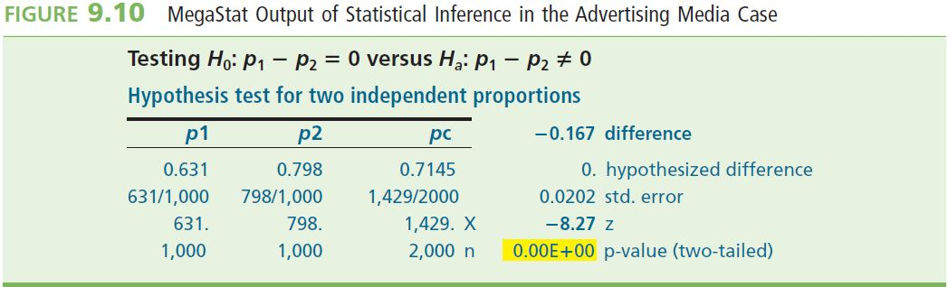
MegaStat Output
L03
The p value for this test is twice the area under the standard normal curve to the right of |z| = 8.2673
  The area under the standard normal curve to the right of 3.29 is 0.0005, the p-value for testing H₀ is less than 2(0.0005) = 0.001
  Extremely strong evidence that H₀: p₁ - p₂ = 0 should be rejected
  Strong evidence that p₁ and p₂ differ

Slide 42
F Tests About a Difference in Population Variances
L01
Population 1 has variance σ₁² and population 2 has variance σ₂²
The null hypothesis, H₀, is that the variances are the same
  H₀: σ₁² = σ₂²
The alternative is that one of them is smaller than the other
  That population has less variable, more consistent, measurements
  Suppose σ₁² > σ₂²
  Let’s look at the ratios of the variances
Test H₀: σ₁²/σ₂² = 1 versus H_{a}: σ₁²/σ₂² > 1

Slide 43
F Tests About a Difference in Population Variances
Reject H₀ in favor of H_{a} if s₁²/s₂² is significantly greater than 1
s₁² is the variance of a random sample of size n₁ from a population with variance σ₁²
s₂² is the variance of a random sample of size n₂ from a population with variance σ₂²
To decide how large s₁²/s₂² must be to reject H₀, describe the sampling distribution of s₁²/s₂²
The sampling distribution of s₁²/s₂² is described by an F distribution

Slide 44
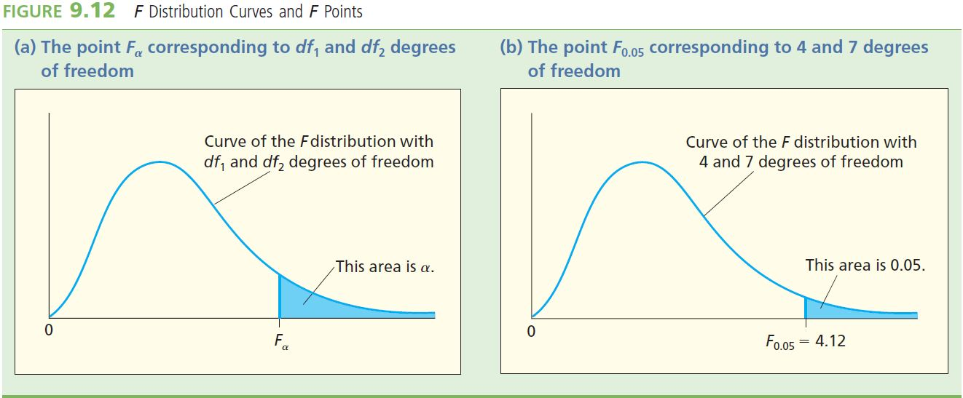
F Distribution
In order to use the F distribution
  Employ an F point, which is denoted F_{a}
  FA is the point on the horizontal axis under the curve of the F distribution that gives a right-hand tail area equal to α
  Shape depends on two parameters: the numerator number of degrees of freedom (df₁) and the denominator number of degrees of freedom (df₂)

Slide 45
The Sampling Distribution of s₁²/s₂²
L06
Suppose we randomly select independent samples from two normally distributed populations with variances σ₁² and σ₂²
If the null hypothesis H₀: σ₁²/σ₂² = 1 is true, then the population of all possible values of s₁²/s₂² has an F distribution with df₁ = (n₁ – 1) numerator degrees of freedom and with df₂ = (n₂ – 1) denominator degrees of freedom

Slide 46
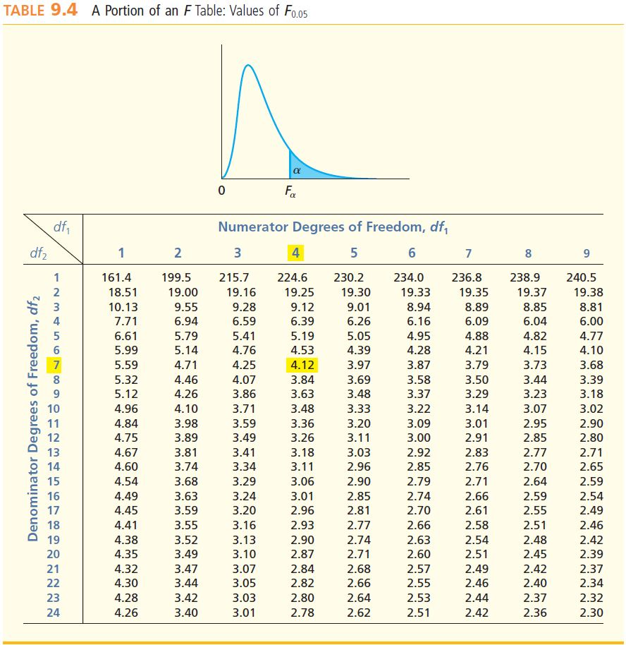
F Distribution
L06
Recall that the F point F_{α} is the point on the horizontal axis under the curve of the F distribution that gives a right-hand tail area equal to α
  The value of F_{α} depends on α (the size of the right-hand tail area) and df₁ and df₂
  Different F tables for different values of α
  See:
    Table A.6 for α = 0.10
    Table A.7 for α = 0.05
    Table A.8 for α = 0.025
    Table A.9 for α = 0.01

Slide 47
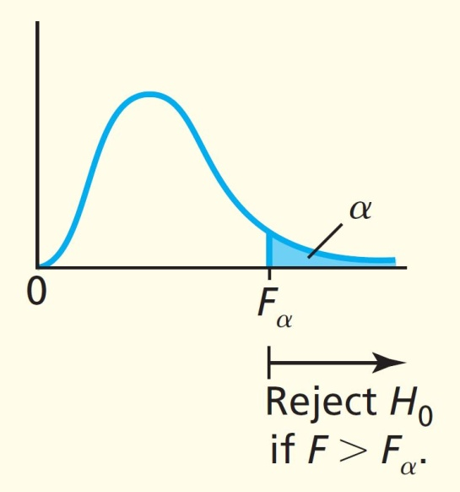
Testing Two Population Variances
(One-Tailed > Alternative)
L06
Independent samples from two normal populations
Test H₀: σ₁² = σ₂² versus H_{a}: σ₁² > σ₂²
Use the test statistic F = s₁²/s₂²
  The p-value is the area to the right of this value of F under the F curve having df₁ = (n₁ – 1) numerator degrees of freedom and df₂ = (n₂ – 1) denominator degrees of freedom
  Reject H₀ at the α significance level if:
    F > F_{α}, or
    p-value < α

Slide 48
Testing Two Population Variances
(One-Tailed < Alternative)
L06
Independent samples from two normal populations
Test H₀: σ₁² = σ₂² versus H_{a}: σ₁² < σ₂²
Use the test statistic F = s₂²/s₁²
  The p-value is the area to the right of this value of F under the F curve having df₁ = (n₁ – 1) numerator degrees of freedom and df₂ = (n₂ – 1) denominator degrees of freedom
  Reject H₀ at the α significance level if:
  F > F_{α}, or
  p-value < α

Slide 49
Testing Equality of Population
Variances
L01
Independent samples from two normal populations
Test H₀: σ₁² = σ₂² versus H_{a}: σ₁² ≠ σ₂²
Use the test statistic
The p-value is twice the area to the right of this value of F under the F curve having df₁ = (n₁ – 1) numerator degrees of freedom and df₂ = (n₂ – 1) denominator degrees of freedom
Reject H₀ at the α significance level if:
  F > F_{α/2}, or
  p-value < α

Slide 50
Example 9.7 The Coffee Cup Case
L06
The production supervisor wishes to use Figure 9.13 to determine whether σ₁ ² , the variance of the average production yields obtained by using the Java method, is smaller than σ₂ ² , the variance of the yields obtained by using the Joe method
Test the hypotheses
H₀: σ₁² = σ₂² versus Ha: σ₁² < σ₂² or σ₁² > σ₂²

Slide 51
Example 9.7 The Coffee Cup Case
L06
Using the Excel output we can compute the test statistic

Slide 52
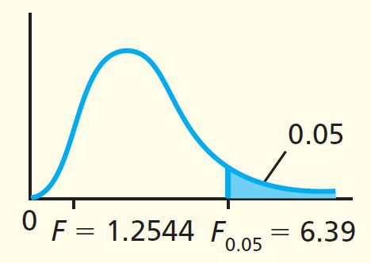
Example 9.7 The Coffee Cup Case
L06
Compare this value with F_{a} based on
  df₁ = n₂ - 1 = 5 - 1 = 4 numerator degrees of freedom and df₂ = n₁ - 1 = 5 - 1 = 4 denominator degrees of freedom at the 0.05 level of significance
F_{0.05} = 6.39
F = 1.2544 is not greater than F_{0.05} = 6.39
  we cannot reject H₀ at α = 0.05
We cannot conclude that σ₁ ² is less than σ₂ ²

Slide 53
Summary
It is possible to compare two populations using a one-tail or a two-tailed test
Hypothesis tests can be conducted on such populations (using CI’s, rejection points, or p-values)
Populations may be independent or dependent (paired difference experiments)
The value of σ may be known or unknown. This affects the type of test statistic we use (i.e. t or z)
Independent tests can involve an equal variances assumption or an unequal variances assumption
Two population variances can be compared using the F distribution

Slide 54
Table A.6 – F_{0.10} Table

Slide 55
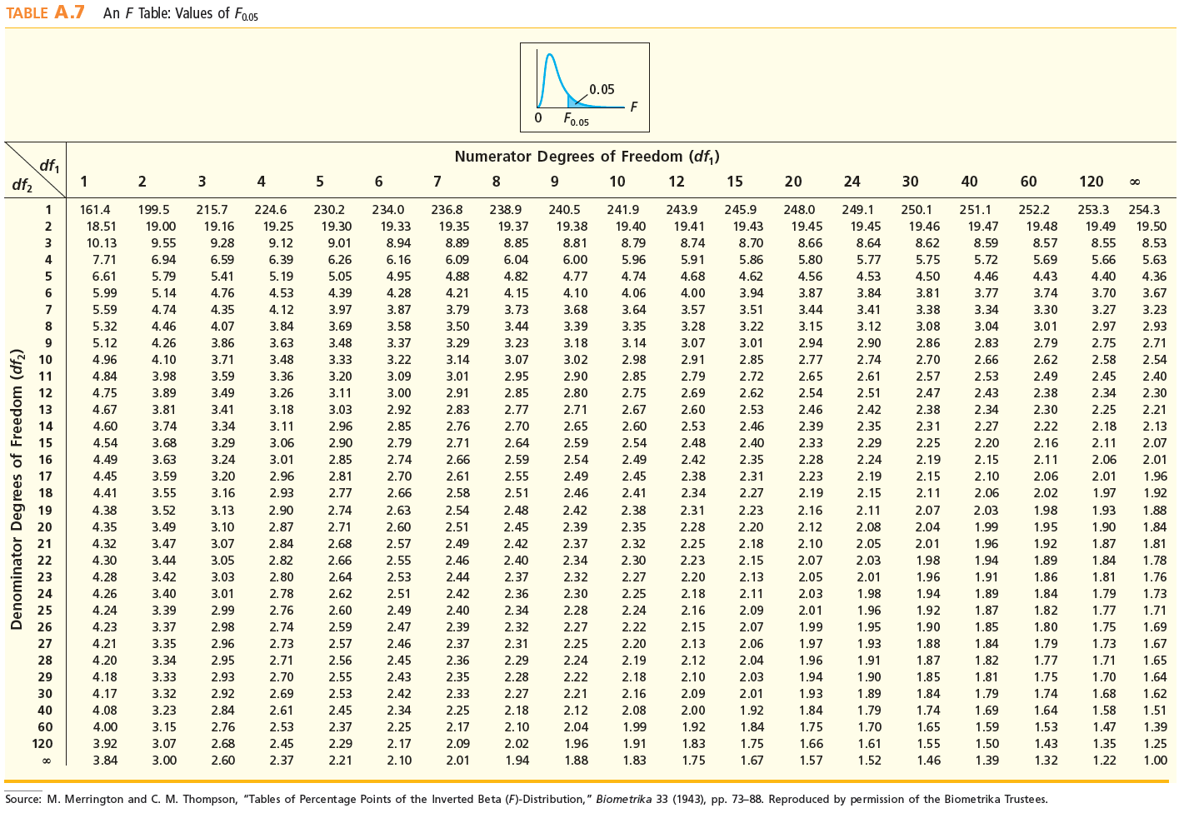
Table A.7 – F_{0.05} Table

Slide 56
Table A.8 – F_{0.025} Table

Slide 57
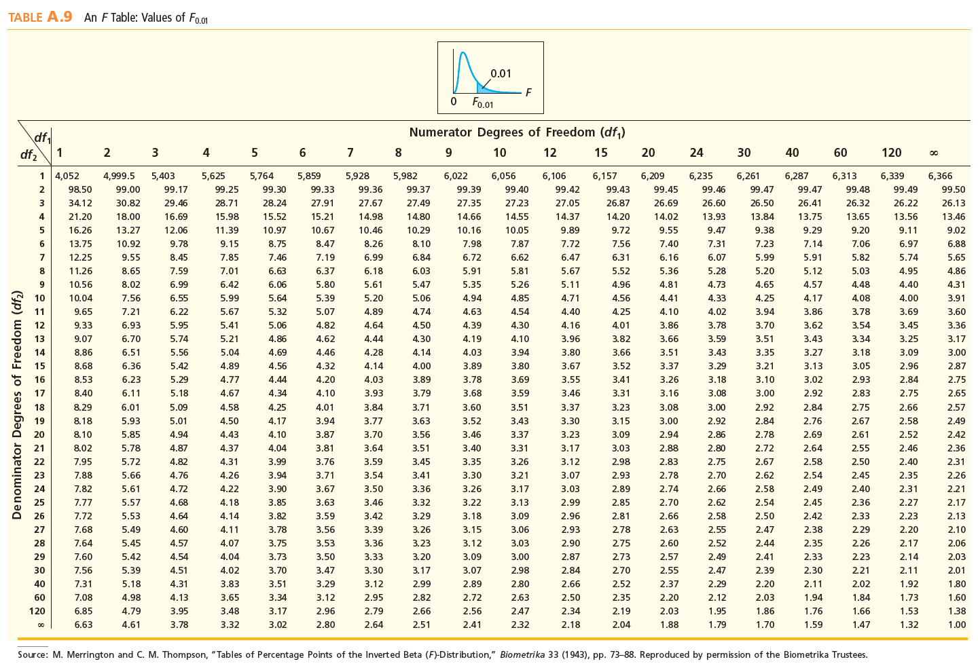
Table A.9 – F_{0.01} Table

