Slide 1
Chapter 8
Hypothesis Testing

Slide 2
Hypothesis Testing
8.1 Null and Alternative Hypotheses and Errors in Testing
8.2 Type I and Type II Errors and Their Probabilities
8.3 Z Tests about a Population Mean (σ Known): One-Sided Alternatives
8.4 Z Tests about a Population Mean (σ Known): Two-Sided Alternatives
8.5 t Tests about a Population Mean (σ Unknown)
8.6 Z Tests about a Population Proportion

Slide 3
Null and Alternative Hypotheses
L01
The null hypothesis, denoted H₀, is a statement of the basic proposition being tested. The statement generally represents the status quo and is not rejected unless there is convincing sample evidence that it is false
The alternative or research hypothesis, denoted H_{a}, is an alternative (to the null hypothesis) statement that will be accepted only if there is convincing sample evidence that it is true

Slide 4
Example 8.1: Payment Time Case Types of Hypotheses
L01
With a new billing system, the mean bill paying time μ is hoped
to be less than 19.5 days
The alternative hypothesis H_{a} is that the new billing system has a
mean payment time that is less than 19.5 days
With the old billing system, the mean bill paying time μ was close to but not less than 39 days, so much more than 19.5 days
The null hypothesis H₀ is that the new billing system has a mean payment time close to but not less than 39 days (which is more than 19.5 days)
One-Sided, “Less Than” Alternative
H₀: μ ≥ 19.5 vs.H_{a}: μ < 19.5

Slide 5
Example 8.2: Camshaft Case Types of Hypotheses
L01
An important quality characteristic is the case hardness depth, in millimeters (mm), of the engine camshaft (read case 8.2)
The optimal target value is 4.5 mm
Take μ = 4.5 mm
Test whether the case hardness is 4.5 mm on average (the null) or not (the alternative)
Two-Sided, “Not Equal To” Alternative
H₀: μ = 4.5 vs. H_{a}: μ ≠ 4.5

Slide 6
Summary of Types of Hypotheses
L01
One-Sided, “Greater Than” Alternative
H₀: μ ≤ μ₀ vs. H_{a}: μ > μ₀
One-Sided, “Less Than” Alternative
H₀ : μ ≥ μ₀ vs. H_{a} : μ < μ₀
Two-Sided, “Not Equal To” Alternative
H₀ : μ = μ₀ vs. H_{a} : μ ≠ μ₀
where μ₀ is a given constant value (with the appropriate units) that is a comparative value

Slide 7
Types of Decisions
L01
As a result of testing H₀ vs. H_{a}, will have to decide either of the following decisions for the null hypothesis H₀:
Do not reject H₀
A weaker statement than “accepting H₀”
But you are rejecting the alternative H_{a}
OR
Reject H₀
A weaker statement than “accepting H_{a}”

Slide 8
Test Statistic
L01
In order to “test” H₀ vs. H_{a}, use the “test statistic”
where μ₀ is the given value or the hypothesized mean (often the claimed to be true) and x-bar is the mean of a sample
If the population is normal, then the test statistic z follows a normal distribution but the parent population DOES NOT HAVE TO BE NORMAL

Slide 9
Example: Test Statistic
L01
In the payment time case, with μ₀ = 19.5, use the test statistic:
If z ≤ 0, then ≤ μ₀ and thus, there is evidence to support rejecting H₀ in favor of H_{a}
The point estimate indicates that μ is probably less than 19.5
If z > 0, then > μ₀ and thus, there is no evidence to support rejecting H₀
The point estimate indicates that μ is probably greater than 19.5
The larger the value of z (the farther is above μ), the stronger the evidence to support H₀

Slide 10
Type I and Type II Errors
L03
Type I Error: Rejecting H₀ when it is true
Type II Error: Failing to reject H₀ when it is false
State of Nature
Conclusion | H₀ True |  | H₀ False
Reject H₀ | Type I Error |  | Correct Decision
Do not Reject H₀ | Correct Decision |  | Type II Error

Slide 11
Error Probabilities
L03
Type I Error: Rejecting H₀ when it is true
α is the probability of making a Type I error
1 – α is the probability of not making a Type I error
Type II Error: Failing to reject H₀ when it is false
β is the probability of making a Type II error
1 – β is the probability of not making a Type II error
State of Nature
Conclusion | H₀ True |  | H₀ False
Reject H₀ | α |  | 1 - α
Do not Reject H₀ | 1 - β |  | β

Slide 12
Typical Values
L03
Usually set α to a low value
So that there is only a small chance of rejecting a true H₀
Typically, α = 0.05
For α = 0.05, strong evidence is required to reject H₀
Usually choose α between 0.01 and 0.05
α = 0.01 requires very strong evidence is to reject H₀
Sometimes choose α as high as 0.10
Tradeoff between α and β
For fixed sample size, the lower we set α, the higher is β
The higher α, the lower β

Slide 13
Z Tests about a Population Mean (σ Known): One-Sided Alternatives
L04
Test hypotheses about a population mean using the normal distribution
These tests are called Z tests
They require that the true value of the population standard deviation σ is known
In most real-world situations, σ is not known
But often is estimated from s of a single sample
When σ is unknown, test hypotheses about a population mean using the t distribution (later)
Here, assume that we know σ
Test using a “rejection point rule”

Slide 14
Steps in Testing a “Greater Than” Alternative
L04
The steps are as follows:
State the null and alternative hypotheses
Specify the significance level α
Select the test statistic
Determine the rejection rule for deciding whether or not to reject H₀
Collect the sample data and calculate the value of the test statistic
Decide whether to reject H₀ by using the test statistic and the rejection rule
Interpret the statistical results in managerial terms and assess their practical importance

Slide 15
Steps in Testing a “Greater Than” Cable Subscriptions Example
L04
Cable TV companies claim that their full cable packages cost on average $50 per month
A marketing company wants to demonstrate that it is significantly higher
State the null and alternative hypotheses
H₀: μ ≤ 50 H_{a}: μ > 50
μ is the hypothesized mean
We modify the hypothesis to
H₀: μ = 50
H_{a}: μ > 50
since if there is evidence to reject H₀ at μ = 50 then there is evidence to reject it at μ ≤ 50
Specify the significance level α
α = 0.05

Slide 16
Steps in Testing a “Greater Than” Cable Subscriptions
L04
Select the test statistic
Use the test statistic:
A positive value of this this test statistic results from a sample mean that is greater than $50
Which provides evidence against H₀ in favor of H_{a}

Slide 17
Steps in Testing a “Greater Than” Cable Subscriptions
L04
Determine the rejection rule for deciding whether or not to reject H₀
To decide how large the test statistic must be to reject H₀ by setting the probability of a Type I error to α, do the following:
The probability α is the area in the right-hand tail of the standard normal curve (one tailed test)
Use the normal table to find the point z_{α} (called the rejection or critical point)
z_{α} is the point under the standard normal curve that gives a right-hand tail area equal to α
Since α = 0.05 in the cable case, the rejection point is z_{α} = z_{0.05} = 1.645

Slide 18
Steps in Testing a “Greater Than” Cable Subscriptions
L04
Continued
Reject H₀ in favor of H_{a} if the test statistic z is greater than the rejection point z_{α}
This is the rejection rule
In the cable subscriptions example, the rejection rule is to reject H₀ if the calculated test statistic
z is > 1.645

Slide 19
Steps in Testing a “Greater Than” Cable Subscriptions
L04
Collect the sample data and calculate the value of the test statistic
Assume that σ is known and σ = $1.65
For a sample of n = 40, we observed a value of

Slide 20
Steps in Testing a “Greater Than” Cable Subscriptions
L05
L06
Decide whether to reject H₀ by using the test statistic and the rejection rule
Compare the value of the test statistic to the rejection point according to the rejection rule
In the cable case,
z = 2.20 (test statistic)
z_{0.05} = 1.645 (rejection point)
2.20 > 1.645
Therefore reject H₀: μ ≤ 50 in favor of H_{a}: μ > 50 at the 0.05 significance level
Have rejected H₀ by using a test that allows only a 5% chance of wrongly rejecting H₀
This result is “statistically significant” at the 0.05 level

Slide 21
Steps in Testing a “Greater Than” Cable Subscriptions
L05
L06
Interpret the statistical results in managerial terms and assess their practical importance
We conclude that it appears as though the mean full cable subscription package is more than $50

Slide 22
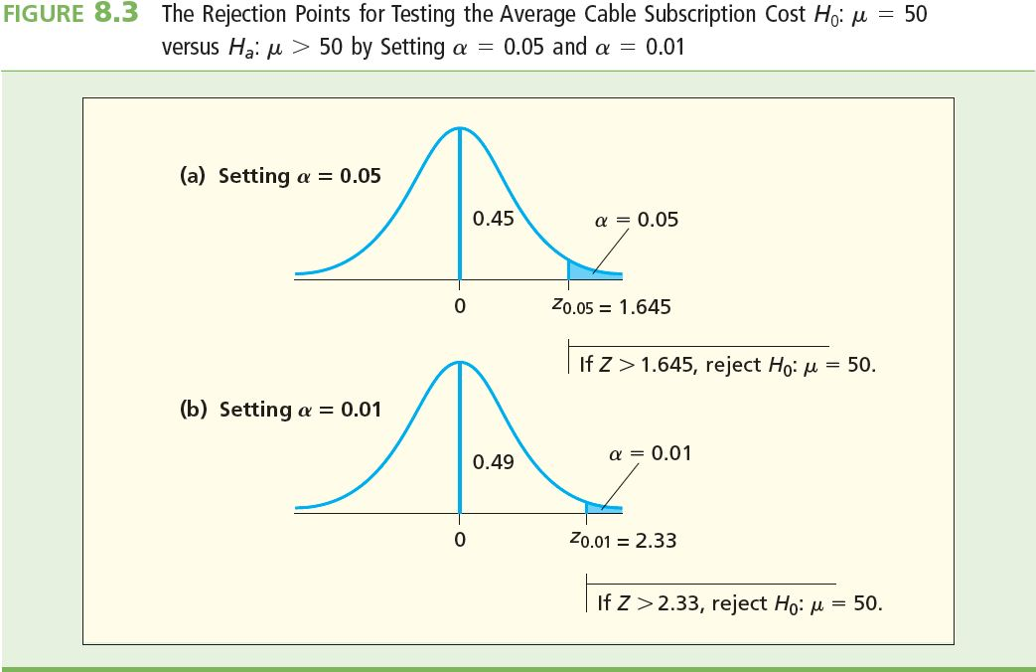
Steps in Testing a “Greater Than” Cable Subscriptions
L07
Testing H₀: μ = 50 versus H_{a}: μ > 50 for (a) α = 0.05 and (b) α = 0.01

Slide 23
Effect of α
L07
At α = 0.01, the rejection point is z_{0.01} = 2.33
In the previous example, the test statistic z = 2.20 is < z_{0.01} = 2.33
Therefore, cannot reject H₀ in favor of H_{a} at the α = 0.01 significance level
This is the opposite conclusion reached with α = 0.05
So, the smaller we set α, the larger is the rejection point, and the stronger is the statistical evidence that is required to reject the null hypothesis H₀

Slide 24
The p-Value
L08
The p-value or the observed level of significance is the probability of the obtaining the sample result if the null hypothesis H₀ is true
The p-value is a conditional probability
It measures the level of support there is for H₀ given the observed data
If the p-value is low, then that suggests that your data does not support H₀
If the p-value is not low, then that suggests that your data does support H₀
Rules:
1. If the p-value < α, then we MUST REJECT H₀
2. If the p-value > α, then we CANNOT REJECT H₀
Note: The p-value is the smallest value of α for which we can reject H₀

Slide 25
The p-Value for “Greater Than” Alternative
L08
For a greater than alternative, the p-value is the probability of observing a value of the test statistic greater than or equal to z when H₀ is true
Use p-value as an alternative to testing a greater than alternative with a z test statistic (rejection point)

Slide 26
The p-value for “Greater Than” Cable Subscriptions
L08
Testing H₀: μ ≤ 50 vs. H_{a}: μ > 50 using rejection points in (a) and p-value in (b)
Have to modify steps 4, 5, and 6 of the previous procedure to use p-values

Slide 27
Steps Using a p-value to Test a “Greater Than” Alternative
L09
Collect the sample data and compute the value of the test statistic
In the cable subscriptions example, the value of the test statistic was calculated to be
z = 2.20
Calculate the p-value by using the test statistic value
The area under the standard normal curve in the right-hand tail to the right of the test statistic z = 2.20 is the p-value
The area is 0.5 – 0.4861 = 0.0139
The p-value is 0.0139

Slide 28
Steps Using a p-value to Test a “Greater Than” Alternative Continued
L09
L10
Continued
If H₀ is true, the probability is 0.0139 of obtaining a sample whose mean is $50.575 or higher
This is a very low probability and it appears as though H₀ is not true and should therefore be rejected
Rejection Rule: We will reject H₀ if the p-value is less than α
In the cable case, α was set to 0.05
The calculated p-value of 0.0139 is < α = 0.05
This implies that the test statistic z = 2.20 is > the rejection point z_{0.05} = 1.645
Therefore reject H₀ at the α = 0.05 significance level

Slide 29
Steps in Testing a “Less Than” Alternative
The steps are as follows:
State the null and alternative hypotheses
Specify the significance level α
Select the test statistic
Determine the rejection rule for deciding whether or not to reject H₀
Collect the sample data and calculate the value of the test statistic
Decide whether to reject H₀ by using the test statistic and the rejection rule
Interpret the statistical results in managerial terms and assess their practical importance

Slide 30
Steps in Testing a “Less Than” Alternative in Payment Time Case
L10
State the null and alternative hypotheses
In the payment time case
H₀: μ ≥ 19.5 vs. H_{a}: μ < 19.5, where μ is the mean bill payment time (in days)
Specify the significance level α
In the payment time case, set α = 0.01

Slide 31
Steps in Testing a “Less Than” Alternative in Payment Time Case
L10
Select the test statistic
In the payment time case, use the test statistic
A negative value of this this test statistic results from a sample mean that is less than 19.5 days
Which provides evidence against H₀ in favor of H_{a}

Slide 32
Steps in Testing a “Less Than” Alternative in Payment Time Case
L10
Determine the rejection rule for deciding whether or not to reject H₀
To decide how much less than 0 the test statistic must be to reject H₀ by setting the probability of a Type I error to α, do the following:
The probability α is the area in the left-hand tail of the standard normal curve
Use normal table to find the rejection point –z_{α}
–z_{α} is the negative of z_{α}
–z_{α} is the point on the horizontal axis under the standard normal curve that gives a left-hand tail area equal to α

Slide 33
Steps in Testing a “Less Than” Alternative in Payment Time Case
L10
Continued
Because α = 0.01 in the payment time case, the rejection point is –z_{α} = –z_{0.01} = –2.33
Reject H₀ in favor of H_{a} if the test statistic z is calculated to be less than the rejection point ( –z_{α})
This is the rejection rule
In the payment time case, the rejection rule is to reject H₀ if the calculated test statistic is less than –2.33

Slide 34
Steps in Testing a “Less Than” Alternative in Payment Time Case
L10
Collect the sample data and calculate the value of the test statistic
In the payment time case, assume that σ is known and σ = 4.2 days
For a sample of n = 65, x-bar = 18.1077 days:

Slide 35
Steps in Testing a “Less Than” Alternative in Payment Time Case
L10
Decide whether to reject H₀ by using the test statistic and the rejection rule
Compare the value of the test statistic to the rejection point according to the rejection rule
In the payment time case, z = –2.67 is less than -z_{0.01} = –2.33
Therefore reject H₀: μ ≥ 19.5 in favor of H_{a}: μ < 19.5 at the 0.01 significance level
Have rejected H₀ by using a test that allows only a 1% chance of wrongly rejecting H₀
This result is “statistically significant” at the 0.01 level

Slide 36
Steps in Testing a “Less Than” Alternative in Payment Time Case
L10
Interpret the statistical results in managerial terms and assess their practical importance
We can conclude that the mean bill payment time of the new billing system appears to be less than 19.5 days
This is a substantial improvement over the old system by more than 50%

Slide 37
The p-value for “Less Than” The Payment Time Case
L09
Testing H₀: μ ≥ 19.5 vs.
H_{a}: μ < 19.5 using rejection points in (a) and p-value in (b)
Have to modify steps 4, 5, and 6 of the previous procedure to use p-values

Slide 38
Steps Using a p-value to Test a “Less Than” Alternative
L09
Collect the sample data and compute the value of the test statistic
In the payment time case, the value of the test statistic was calculated to be z = –2.67
Calculate the p-value using the test statistic value
In the payment time case, the area under the standard normal curve in the left-hand tail to the left of the test statistic z = –2.67
The area is 0.5 – 0.4962 = 0.0038
The p-value is 0.0038

Slide 39
Steps Using a p-value to Test a “Less Than” Alternative Continued
L10
Continued
If H₀ is true, then the probability is 0.0038 of obtaining a sample whose mean is as low as 18.1077 days or lower
This is a very low probability and it appears as though H₀ is not true and should therefore be rejected
Reject H₀ if the p-value is less than α
In the payment time case, α was 0.01
The calculated p-value of 0.0038 is < α = 0.01
This implies that the test statistic z = –2.67 is less than the rejection point –z_{0.01} = –2.33
Therefore, reject H₀ at the α = 0.01 significance level

Slide 40
Summary of Testing a One-Sided Alternative Using a Test Statistic
If σ is known we can use a z test to test H₀
We can reject H₀: μ = μ₀ at the α level of significance (probability of Type I error equal to α) if and only if the appropriate rejection point rule holds
Test Statistic | Alternative | Reject H₀ if:
 | H_{a} : μ > μ₀ | z > -z_{α}
 | H_{a} : μ < μ₀ | z < -z_{α}

Slide 41
Summary of Testing a One-Sided Alternative Using a p-value
If the population variance is known, we can reject
H₀: μ = μ₀ at the α level of significance (probability of Type I error equal to α) if and only if the corresponding p-value is less than the specified α
Test Statistic | Alternative | Reject H₀ if:
 | H_{a} : μ > μ₀ | p value < α
 | H_{a} : μ < μ₀ | p value < α

Slide 42
Z Tests about a Population Mean (σ Known): Two-Sided Alternatives
Testing a “not equal to” alternative hypothesis
The sampling distribution of all possible sample means is modeled by a normal curve
Require that the true value of the population standard deviation σ is known
What’s new and different here?
The area corresponding to the significance level α is evenly split into both the right- and left-hand tails of the standard normal curve

Slide 43
Steps in Testing a “Not Equal To” Alternative
The steps are as follows:
State the null and alternative hypotheses
Specify the significance level α
Select the test statistic
Determine the rejection rule for deciding whether or not to reject H₀
Collect the sample data and calculate the value of the test statistic
Decide whether to reject H₀ by using the test statistic and the rejection rule
Interpret the statistical results in managerial terms and assess their practical importance

Slide 44
Steps in Testing a “Not Equal To” Alternative in Camshaft Case
L06
State the null and alternative hypotheses
In the camshaft case, H₀: μ = 4.5 vs.
H_{a}: μ ≠ 4.5, where μ is the mean hardness depth of the camshaft (in mm)
Specify the significance level α
In the camshaft case, set α = 0.05
Select the test statistic
In the camshaft case, use the test statistic:

Slide 45
Steps in Testing a “Not Equal To” Alternative in Camshaft Case
L06
Continued
A positive value of this test statistic results from a sample mean that is greater than 4.5 mm
Which provides evidence against H₀ and for H_{a}
A negative value of this this test statistic results from a sample mean that is less than 4.5 mm
Which also provides evidence against H₀ and for H_{a}
A very small value close to 0 (either very slightly positive or very slightly negative) of this this test statistic results from a sample mean that is nearly 4.5 mm
Which provides evidence in favor of H₀ and against H_{a}

Slide 46
Steps in Testing a “Not Equal To” Alternative in Camshaft Case
L06
Determine the rejection rule for deciding whether or not to reject H₀
To decide how different the test statistic must be from zero (positive or negative) to reject H₀ in favor of H_{a} by setting the probability of a Type I error to α, do the following:
Divide the value of α in half to get α/2. This tail probability will be distributed in each tail of the standard normal curve (a two-tailed test), with α/2 in the left tail and α/2 in the right tail

Slide 47
Steps in Testing a “Not Equal To” Alternative in Camshaft Case
L06
Continued
Use the normal table to find the rejection points z_{α/2} and –z_{α/2}
z_{α/2} is the point on the horizontal axis under the standard normal curve that gives a right-hand tail area equal to α/2
–z_{α/2} is the point on the horizontal axis under the standard normal curve that gives a left-hand tail area equal to α/2

Slide 48
Steps in Testing a “Not Equal To” Alternative in Camshaft Case
L04
Continued
Because α = 0.05 in the camshaft case, α/2=0.025
The area under the standard normal to the right of the mean is 0.5 – 0.025 = 0.475
From Table A.3, the area is 0.475 for z = 1.96
The rejection points are
z_{α} = z_{0.025} = 1.96 OR –z_{α} = – z_{0.025} = – 1.96
Reject H₀ in favour of H_{a} if the test statistic z satisfies either:
z greater than the rejection point z_{α/2} or
–z less than the rejection point –z_{α/2}
This is the rejection rule

Slide 49
Steps in Testing a “Not Equal To” Alternative in Camshaft Case
L04

Slide 50
Steps in Testing a “Not Equal To” Alternative in Camshaft Case #6
L04
Collect the sample data and calculate the value of the test statistic
In the camshaft case, assume that σ is known and σ = 0.47 mm
For a sample of n = 40, x-bar = 4.26 mm
Then

Slide 51
Steps in Testing a “Not Equal To” Alternative in Camshaft Case
L06
Decide whether to reject H₀ by using the test statistic and the rejection rule
Compare the value of the test statistic to the rejection point according to the rejection rule
In the camshaft case, z = –3.02 is less than – z_{0.025} = –1.96
Therefore we must reject H₀: μ = 4.5 in favor of H_{a}: μ ≠ 4.5 at the 0.05 significance level
We have rejected H₀ using a test that allows for only a 5% chance of wrongly rejecting H₀
This result is said to be “statistically significant” at the 5% level of significance

Slide 52
Steps in Testing a “Not Equal To” Alternative in Camshaft Case
L06
Interpret the statistical results in managerial terms and assess their practical importance
We can conclude that it appears as though the mean hardness depth of the camshaft is not 4.5 mm
Using = 4.26 and s = 0.47, we estimate that
99.73 percent of all individual camshaft hardness depths are in the interval
This estimated tolerance interval says that, because of a somewhat small mean of 4.26, we estimate that we are producing some hardness depths that are below the lower specification limit of 3 mm
Changes must be made to the manufacturing process

Slide 53
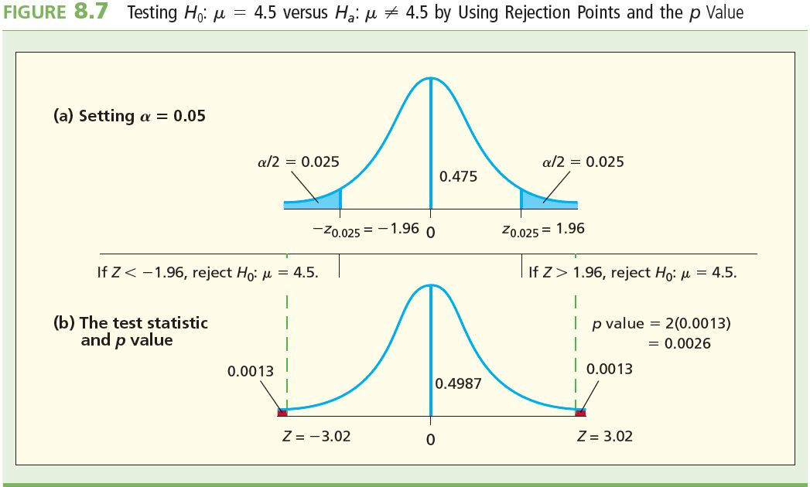
Steps in Testing a “Not Equal To” Alternative in Camshaft Case
L04
Testing H₀: μ = 4.5 versus H_{a}: μ ≠ 4.5 for α = 0.05

Slide 54
Steps Using a p-value to Test a “Not Equal To” Alternative
L09
Collect the sample data and compute the value of the test statistic
In the camshaft case, the value of the test statistic was calculated to be z = –3.02
Calculate the one-sided p-value using the test statistic value
In the camshaft case, the area under the standard normal curve in the left-hand tail to the left of the test statistic value z = –3.02
The area is 0.5 – 0.4987 = 0.0013
The one-sided p-value is 0.0013

Slide 55
Steps Using a p-value to Test a “Not Equal To” Alternative Continued
L09
Continued
We are conducting a two-sided test though, and therefore, need a two-sided p-value. All we need to do is double the one-sided p-value
Our two-sided p-value would be 2(0.0013) = 0.0026
This is a very low probability and it appears as though H₀ is not true and should therefore be rejected
Reject H₀ if the two-sided p-value is less than α
In the camshaft case, α was 0.05
The calculated two-sided p-value of 0.0026 is < α = 0.05
Therefore reject H₀ at the α = 0.05 significance level
We would also reject H₀ at the 1% significance level

Slide 56
Summary of a Two-Sided Test (“Not Equal to” Alternative)
L09
Using a z statistic to test H₀ when the population variance is known, we can reject H₀: μ = μ₀ at the α level of significance (probability of Type I error equal to α) if and only if:
α/2 is the area under the standard normal curve to the right of z_{α/2}
α/2 is the area under the standard normal curve to the left of –z_{α/2}
Test Statistic | Alternative | Reject H₀ if:
 | H_{a} : μ ≠ μ₀ | z > z_{α/2} ⁽¹⁾ or 2-sided p-value < α
 |  | z < –z_{α/2} ⁽²⁾ or 2-sided p-value < α

Slide 57
Weight of Evidence Against the Null (Generally Speaking)
L09
Calculate the test statistic and the corresponding p-value
You can rate the strength of the conclusion, in general, about H₀ according to these guidelines:
With a p-value < 0.10, there is some evidence to reject H₀
With a p-value < 0.05, there is strong evidence to reject H₀
With a p-value < 0.01, there is very strong evidence to reject H₀
With a p-value < 0.001, there is extremely strong evidence to reject H₀
So, the smaller the p-value, the stronger the evidence is against H_{o}

Slide 58
Using Confidence Intervals to Test Hypotheses
The null hypothesis H₀ can be rejected in favor of the alternative H_{a} at some level of significance, α, if and only if the 100(1 – α)% confidence interval for μ does not contain μ₀
where μ₀ is the claimed value for the population mean
In other words, if the confidence interval does not contain the claimed value μ₀, then the null hypothesis can be rejected
Conversely, if the confidence interval does contain the claimed value μ₀, then the null hypothesis cannot be rejected

Slide 59
Example: Using Confidence Intervals to Test Hypotheses
In the camshaft case, the 95% confidence interval for μ is
which does not contain target value of 4.5 mm
Therefore we must reject the null hypothesis that μ is
4.5 mm at the 0.05 significance level
Here, the confidence level 1 – α = 0.95 and the significance level α = 0.05
These sum to 1, so here see that the confidence level and significance levels are complementary

Slide 60
Using Confidence Intervals to Test Hypotheses (continued)
The α we use here is the same α that we used in Chapter 7
The confidence level is 1 – α
The significance level is α
(1 – α ) + α = 1, so the confidence level and significance levels are complementary

Slide 61
t Tests about a Population Mean (σ Unknown)
Suppose the population being sampled is normally distributed
The population standard deviation σ is unknown, as is the usual situation
If the population standard deviation σ is unknown, then it will have to estimated from a sample standard deviation s
Under these two conditions, have to use the t distribution to test hypotheses
The t distribution from Chapter 7

Slide 62
Defining the t Random Variable (σ Unknown)
Define a new random variable t:
with the definition of symbols as before
The sampling distribution of this random variable is a t distribution with n – 1 degrees of freedom

Slide 63
Defining the t Statistic (σ Unknown)
Let x-bar be the mean of a sample of size n with standard deviation s
Also, μ₀ is the claimed value of the population mean
Define a new test statistic
If the population being sampled is normal, and
If s is used to estimate σ, then …
The sampling distribution of the t statistic is a t distribution with n – 1 degrees of freedom

Slide 64
t Tests about a Population Mean (σ Unknown)
Same rejection rules apply here that applied with our Z-tests
Reject H₀: μ = μ₀ in favor of a particular alternative hypothesis H_{a} at the α level of significance if and only if the test statistic lies in the appropriate rejection region or, equivalently, if the corresponding p-value is less than α
We have the following rules …

Slide 65
t Tests about a Population Mean (σ Unknown) Continued
L09
t_{α}, t_{α/2}, and p-values are based on n – 1 degrees of freedom (for a sample of size n)
* either t > t_{α/2} or t < –t_{α/2}
Alternative | Reject H₀ if: | p-value (reject H_{o} if p-value < α)
H_{a}: μ > μ₀ | t > t_{α} | Area under t distribution to right of t
H_{a}: μ < μ₀ | t < –t_{α} | Area under t distribution to left of –t
H_{a}: μ ≠ μ₀ | |t| > t _{α/2} * | Twice area under t distribution to right of |t|

Slide 66
Example 8.5
In 2001, the mean credit card interest rate is as it was at the rate of 18.8%
A financial officer wishes to study whether the increased competition in the credit card business has reduced interest rates
This is the null hypothesis H₀: μ = 18.8
The alternative to be tested is that the current mean interest rate isn’t as it was back in 2001, but in fact has decreased
This is the alternative hypothesis H_{a}: μ < 18.8
Test at the α = 0.05 level of significance
If H₀ can be rejected at the 5% level, then conclude that it appears as though the mean rate now is less than 18.8% rate charged in 2001

Slide 67
Example 8.5
L04
We randomly select n = 15 credit cards
We know:
n = 15
= 16.828
s = 1.538
α = 0.05
Then df = n – 1 = 14
We will assume the population of the rates of all cards is approximately normal

Slide 68
Example 8.5
L04
The rejection rule is: Reject H₀: μ = 18.8 against H_{a}: μ < 18.8 if t < −t_{α}
For α = 0.05 and with df = 14, −t_{α} = −t_{0.05} =−1.761
Calculate the value of the t statistic:
Because t = −4.97 < t_{0.05} = −1.761, reject H₀
Therefore, conclude at 5% significance level that it appears as though the mean interest rate is lower than it was in 2001
In fact it was observed to be 18.8 – 16.827 = 1.973% lower
Our observed result of 16.827 is said to be “statistically significant” at α = 5%

Slide 69
p-value for Example 8.5
L09
L10
The p-value here is the left-hand tail area under the t curve with df = 14 to the left of t = −4.97
Our observed t value is off the t table, so using the table, we would say that our p-value < 0.0005.
A statistical software package can easily calculate the exact p-value. It turns out that the p-value is actually 0.000103, which is less than 0.0005.
This says that if the claimed mean of 18.8 % is true, then there is only about a 1/10,000 chance of randomly selecting a sample of 15 credit cards whose mean rate would be as low as or lower than 16.827%
This p-value is < 0.05, 0.01, 0.001
We would reject H₀ at the 0.05, 0.01, 0.001 significance levels
Our result is highly significant

Slide 70
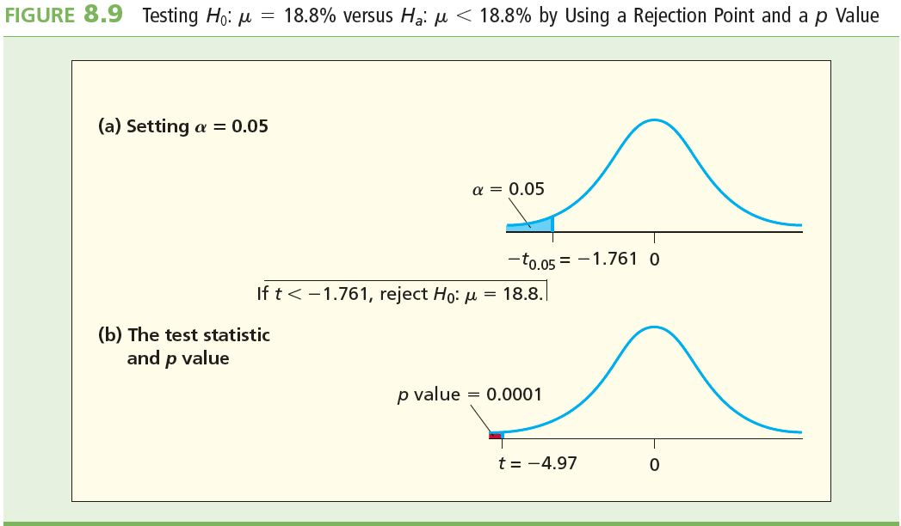
p-value outputs
L09

Slide 71
Z Tests about a Population Proportion
If the sample size n is large, we can reject H₀: p = p₀ at the α level of significance (probability of Type I error equal to α) if and only if the appropriate rejection point condition holds or, equivalently, if the corresponding p-value is less than α
We have the following rules …

Slide 72
Z Tests about a Population Proportion
Alternative | Reject H₀ if: | p-value
H_{a}: p > p₀ | z > z_{α} | Area under standard normal to the right of z
H_{a}: p < p₀ | z < -z_{α} | Area under standard normal to the left of –z
H_{a}: p ≠ p₀ | |z| > z_{α/2} * | Twice the area under standard normal to the right of |z|
The test statistic is:
* either z > z_{a/2} or z < –z_{a/2}

Slide 73
Example 8.8: Virol (Z test about p)
L06
Virol has been shown to provide relief for 70% of all patients suffering from upper respiratory infections. A drug company believes that its competing drug, Phantol, is more effective than Virol
Let’s test H_{o} at α = 5% using rejection points and p-values.
Test H₀: p = 0.70 versus H_{a}: p > 0.70

Slide 74
Example 8.8: Virol (Z test about p)
L06
A random sample of 300 patients was taken and 231 indicated that the drug had effectively treated their upper respiratory infections
So, we have n = 300 and
In order to test H_{o}, we need a test statistic:

Slide 75
Example 8.8: Virol (Z test about p)
L06
Reject H₀: p = 0.70 if the value of Z is greater than z_{A} = z_{0.05} = 1.645
Note that using this procedure is valid because np₀ = 300(0.70) = 210 and n(1 - p₀) = 300(1 - 0.70) = 90 are both at least 5
Comparing values:
z = 2.65 > z_{0.05} = 1.645
> z_{0.01} = 2.33
< z_{0.001} = 3.09
So reject H₀ at the 0.05 and 0.01 significance levels but do not reject at the 0.001 level

Slide 76
Using p-values
L09
For z = 2.65, the p-value is:
p-value = P(z > 2.65) = (0.5 – 0.4960) = 0.004
(table A.3)
But p = 004 < α = 0.05
< α = 0.01
> α = 0.001
So (again) reject H₀ at the 0.05 and 0.01 significance levels but do not reject at the 0.001 level

Slide 77
Summary
Hypothesis tests are used to test the strength of a statement for a population
The null hypothesis H₀ is the statement being tested, it is the status quo, it is not rejected for the alternative hypothesis H_{a} unless there is convincing statistical evidence otherwise
There are three common ways to test a hypothesis 1) rejection region 2) p-value 3) confidence intervals
P-values can give more information as it is the value of α at which the decision will change
Types of parameters which we test in this chapter are means, proportions
Type I errors occur when a true null hypothesis is rejected and type II errors occur when a false null hypothesis is not rejected

Slide 78
Summary

