Slide 1
Chapter 7
Confidence Intervals

Slide 2
Confidence Intervals
7.1 z-Based Confidence Intervals for a Population Mean: σ Known
7.2 t-Based Confidence Intervals for a Population Mean: σ Unknown
7.3 Sample Size Determination
7.4 Confidence Intervals for a Population Proportion
7.5 Comparing Two Population Means by Using Independent Samples: Variances Known
7.6 Comparing Two Population Means by Using Independent Samples: Variances Unknown

Slide 3
Confidence Intervals
7.7 Comparing Two Population Means by Using Paired Differences
7.8 Comparing Two Population Means by Using Large Independent Samples

Slide 4
z-Based Confidence Intervals for a Mean: σ Known
L01
The starting point is the sampling distribution of the sample mean
  Recall from Chapter 6 that if a population is normally distributed with mean μ and standard deviation σ, then the sampling distribution of x is normal with mean μ_{x} = μ and standard deviation
  Use a normal curve as a model of the sampling distribution of the sample mean
    Exactly, because the population is normal
    Approximately, by the Central Limit Theorem for large samples

Slide 5
Generalizing about confidence intervals
L01
The probability that the confidence interval will contain the population mean μ in repeated samples is denoted by 1 − α
  1 – α is referred to as the confidence coefficient
  (1 – α) × 100% is called the confidence level. The confidence level is the success rate for the method
  The confidence coefficient within 2 standard deviations is, 1 – α = 0.9544
  A 95% confidence level is most commonly used.
  Focus on values such as 90%, 95%, 98%, 99%

Slide 6
General Confidence Interval
L01
In general, the probability is 1 – α that the population mean μ is captured in the interval in repeated samples is:
  The normal point z_{α/2} gives a right hand tail area under the standard normal curve equal to α/2
  The normal point - z_{α/2} gives a left hand tail area under the standard normal curve equal to α/2
  The area under the standard normal curve between -z_{α/2} and z_{α/2} is 1 – α

Slide 7
Sampling Distribution of All
Possible Sample Means

Slide 8
z-Based Confidence Intervals for a Mean with σ Known
If a population has standard deviation σ (known), and if the population is normal or if sample size is large (n ≥ 30), then a (1−α)100% confidence interval for μ is:

Slide 9
95% Confidence Level
L02
For a 95% confidence level,
  1 – α = 0.95
  α = 0.05
  α/2 = 0.025
For 95% confidence, need the normal point z_{0.025}
  The area under the standard normal curve between -z_{0.025} and z_{0.025} is 0.95
  Then the area under the standard normal curve between 0 and z_{0.025} is 0.475
  From the standard normal table, the area is 0.475 for z = 1.96
  Then z_{0.025} = 1.96

Slide 10
Z Score Lookup
L02
z = 1.96
0.4750

Slide 11
95% Confidence Interval
L02
The 95% confidence interval for μ when the population standard deviation is known is:

Slide 12
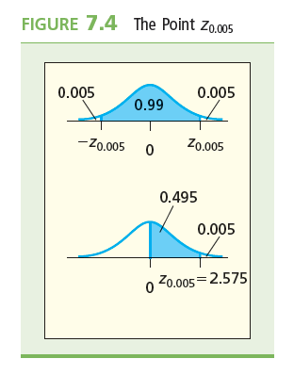
99% Confidence Level
For a 99% confidence level,
  1 – α = 0.99
  α = 0.01
  α/2 = 0.005
For 99% confidence, need the normal point z_{0.005}
  The area under the standard normal curve between -z_{0.005} and z_{0.005} is 0.99
  Then the area under the standard normal curve between 0 and z_{0.005} is 0.495
  From the standard normal table, the area is 0.495 for z = 2.575
  Then z_{0.025} = 2.575

Slide 13
Z Score Lookup
L02
z = 2.575
which is between
2.57 and 2.58
0.495

Slide 14
99% Confidence Interval
L02
The 95% confidence interval for μ when the population standard deviation is known is:

Slide 15
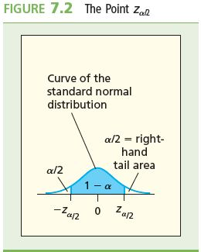
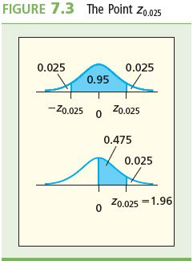
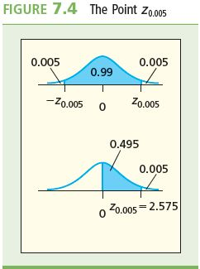
The Effect of α on Confidence
Interval Width
L02
z_{a/2} = z_{0.025} = 1.96
z_{a/2} = z_{0.005} = 2.575

Slide 16
Example 7.1: The SlimPhone
L02
Given that x = 70.12 g
σ = 0.6 g
n = 5, construct a 0.95 and 0.99 confidence interval for the mass of the SlimPhone
95% Confidence Interval:
99% Confidence Interval:

Slide 17
Notes on the Example
L02
The 99% confidence interval is slightly wider than the 95% confidence interval
  The higher the confidence level, the wider the interval
We are 99 percent confident that the true population mean mass of the SlimPhone is between 69.429 g and 70.811 g
  Note that when the level of confidence is increased, everything else being equal, the confidence interval becomes wider
  There is a price to pay here with the increased confidence
  Precision or accuracy is lost as the level of confidence increases

Slide 18
t-Based Confidence Intervals for a Mean with σ Unknown
L04
If σ is unknown (which is usually the case), we can construct a confidence interval for μ based on the sampling distribution of
If the population is normal, then for any sample size n, this sampling distribution is called the t distribution

Slide 19
The t Distribution
L02
L04
The curve of the t distribution is similar to that of the standard normal curve
  Symmetrical and bell-shaped
  The t distribution is more spread out than the standard normal distribution
  The spread of the t is given by the number of degrees of freedom
    Denoted by df
    For a sample of size n, there are one fewer degrees of freedom, that is, df = n – 1

Slide 20
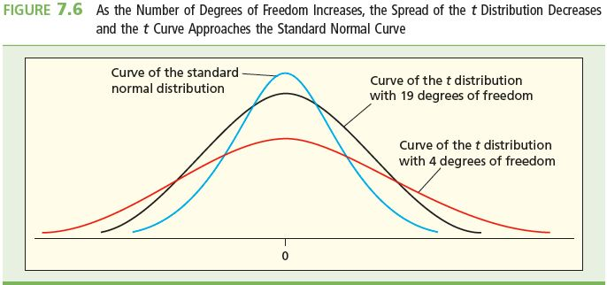
Degrees of Freedom and the t-Distribution
As the number of degrees of freedom increases, the spread
of the t distribution decreases and the t curve approaches
the standard normal curve

Slide 21
The t Distribution and Degrees of Freedom
L04
For a t distribution with n – 1 degrees of freedom,
  As the sample size n increases, the degrees of freedom also increases
  As the degrees of freedom increase, the spread of the t curve decreases
  As the degrees of freedom increases indefinitely, the t curve approaches the standard normal curve
    If n ≥ 30, so df = n – 1 ≥ 29, the t curve is very similar to the standard normal curve

Slide 22
t and Right Hand Tail Areas
L02
Use a t point denoted by t_{α}
  t_{α} is the point on the horizontal axis under the t curve that gives a right hand tail equal to α
  So the value of t_{α} in a particular situation depends on the right hand tail area α and the number of degrees of freedom
    df = n – 1
    α = 1 – α , where 1 – α is the specified confidence coefficient

Slide 23
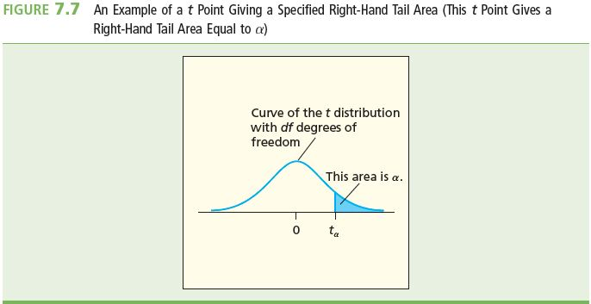
t and Right Hand Tail Areas
L04

Slide 24
Using the t Distribution Table
L02
Rows correspond to the different values of df
Columns correspond to different values of α
See Table 7.3, Table A.4 in Appendix A and the table on the inside of the back cover of the text
  Table 7.3 and the table on the inside back cover give us t points for df 1 to 30, then for df = 40, 60, 120, and ∞
    On the row for ∞, the t points are the z points
  Table A.4 is more detailed. It gives us t points for df = 1 to 100, then 120 and ∞
  Always look at the accompanying figure for guidance on how to use the table

Slide 25
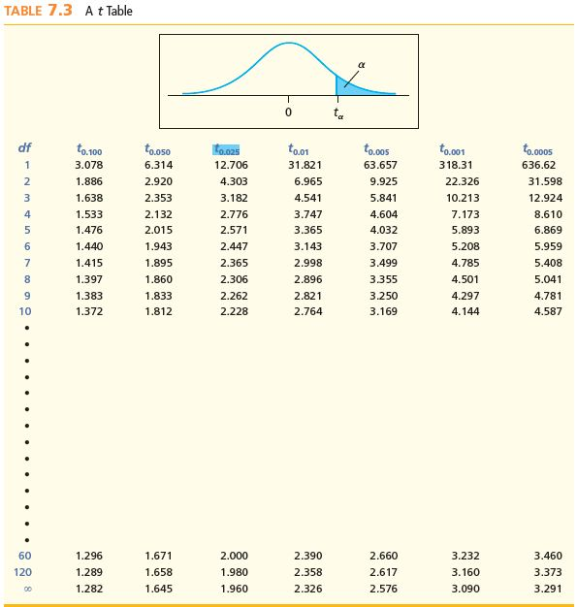
Table 7.3: t Distribution Table
L04

Slide 26
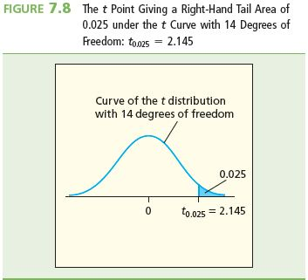
Using the t Distribution
Example: Find t_{α} for a sample of size n = 15 and right hand tail area of 0.025
For n = 15, df = 14
  α= 0.025
  Note that α = 0.025 corresponds to a confidence level of 0.95

Slide 27
t Table Lookup t_{α}
L04
t_{0.025,14}=2.145
2.145

Slide 28
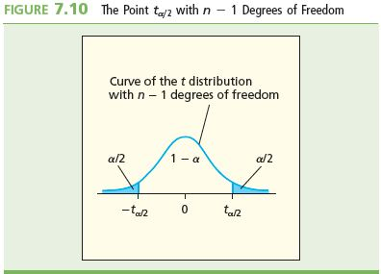
t-Based Confidence Intervals for a
Mean: σ Unknown
L02
If the sampled population is normally distributed with mean μ, then a (1−α)100% confidence interval for μ is
  t_{α/2} is the t point giving a right-hand tail area of α/2 under the t curve having n – 1 degrees of freedom

Slide 29
Example 7.4: Debt-to-Equity Ratios
L02
L04
Estimate the mean debt-to-equity ratio of the loan portfolio of a bank
Select a random sample of 15 commercial loan accounts
Summary data: x = 1.34, s = 0.192, n = 15
Want a 95% confidence interval for the ratio
We will assume that all ratios are normally distributed but now σ is unknown
We cannot use a Z distribution here
What do we do instead?

Slide 30
Example 7.4 Debt-to-Equity Ratios
L02
L04
Have to use the t distribution
At 95% confidence,
  1 – α = 0.95 so α = 0.05 and α/2 = 0.025
  For n = 15, df = 15 – 1 = 14
Use the t table to find t_{α/2} for df = 14
  t_{α/2} = t_{0.025} = 2.145 for df = 14
The 95% confidence interval:

Slide 31
Sample Size Determination (z)
L03
L05
If σ is known, then a sample of size
  so that x is within E (Margin of Error) units of μ, with 100(1-α)% confidence

Slide 32
Sample Size Determination (t)
L03
L05
If σ is unknown and is estimated from s, then a sample of size
  so that x is within E units of μ, with 100(1-α)% confidence. The number of degrees of freedom for the t_{α/2} point is the size of the preliminary sample minus 1

Slide 33
Example 7.5: Pharmaceutical Products
L03
L05
The lab at a pharmaceutical products factory analyzes a specimen from each batch of a product
To verify the concentration of the active ingredient, management ask that the results are accurate to within ±0.005 with 95% confidence

Slide 34
Example 7.5: Pharmaceutical Products
L03
L05
We can calculate how many measurements must be made if we are given that σ = 0.0068 g/L
  Rounding up we see that a sample size of n = 8 is needed. Note that if σ is unknown we can estimate using s and use the t table in which case you would have to know the sample size.

Slide 35
Confidence Intervals for a
Population Proportion
L06
If the sample size n is large ̽, then a (1−α)100% confidence interval for p is:
  *̽ Here n should be considered large if both

Slide 36
Example 7.8: Phe-Mycin Side Effects
L06
The company wishes to estimate p, the proportion of all patients who would experience nausea as a side effect when being treated with Phe-Mycin
  Given: n = 200
For 95% confidence, z_{α/2} = z_{0.025} = 1.96 and

Slide 37
Determining Sample Size for
Confidence Interval for p
L07
A sample size
will yield an estimate, precisely within E units of p, with 100(1-α)% confidence
  Note that the formula requires a preliminary estimate of p. The most conservative value of p = 0.5 is generally used when there is no prior information on p

Slide 38
Phe-Mycin Side Effects: Sample Size Determination
L07
Suppose the drug company wishes to find the size of the random sample that is needed in order to obtain a 2 percent margin of error (E = 0.02) with 95 percent confidence
In Example 7.8, we employed a sample of 200 patients to compute a 95 percent confidence interval for p
  We are very confident that p is between 0.122 and 0.228
  0.228 is the reasonable value of p that is closest to 0.5, the largest reasonable value of p(1 - p) is 0.228(1 - 0.228) = 0.1760

Slide 39
Comparing Two Population Means by Using Independent Samples: Variances Known
L08
Suppose that the populations are independent of each other which leads that the samples are independent of each other
The sampling distribution of the difference in sample means is normally distributed

Slide 40
Sampling Distribution of the
Difference of Two Sample Means #1
L08
Suppose population 1 has mean μ₁ and variance σ₁²
  From population 1, a random sample of size n₁ is selected which has mean x₁ and variance σ₁²
Suppose population 2 has mean μ₂ and variance σ₂²
From population 2, a random sample of size n₂ is selected which has mean x₂ and variance σ₂²

Slide 41
Sampling Distribution of the
Difference of Two Sample Means #2
L08
The sampling distribution of the difference of two
sample means:
  Is normal, if each of the sampled populations is normal , approximately normal if the sample sizes n₁ and n₂ are large
  Has mean μ_{x1–x2} = μ₁ – μ₂
  Has standard deviation

Slide 42
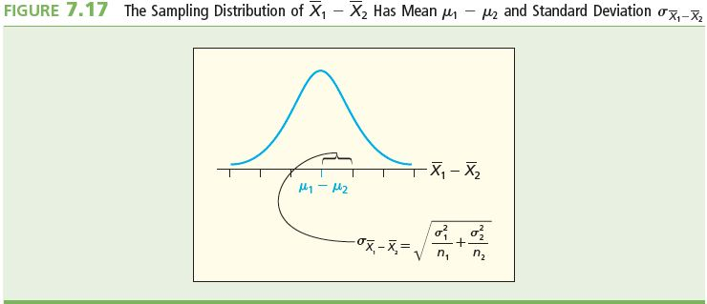
Sampling Distribution of the
Difference of Two Sample Means #3
L08

Slide 43
z-Based Confidence Interval for the Difference in Means (Variances Known) #1
L09
Let be the mean of a sample of size n₁ that has been randomly selected from a population with mean μ₁ and standard deviation σ₁
Let be the mean of a sample of size n₂ that has been randomly selected from a population with mean μ₂ and standard deviation σ₂
Suppose each sampled population is normally distributed or that the samples sizes n₁ and n₂ are large
Suppose the samples are independent of each other
Then …

Slide 44
z-Based Confidence Interval for the Difference in Means (Variances Known)
L08
Then a 100(1 – α) percent confidence interval for the difference in populations μ₁–μ₂ is:

Slide 45
Example 7.11 The Bank Customer Waiting Time Case
A random sample of size 100 waiting times observed under the current system of serving customers has a sample waiting time mean of 8.79 minutes
  Call this population 1
  Assume population 1 is normal
  If it’s not normal, we need a large sample size (100 is large)
  The variance is 4.7
A random sample of size 100 waiting times observed under the new system of serving customers has a sample mean waiting time of 5.14 minutes
  Call this population 2
  Assume population 2 is normal
  If it’s not normal, we need a large sample size (100 is large)
  The variance is 1.9
Then if the samples are independent …

Slide 46
Example 7.11 The Bank Customer Waiting Time Case
L08
At 95% confidence, z_{α/2} = z_{0.025} = 1.96, and
According to the calculated interval, the bank manager can be 95% confident that the new system reduces the mean waiting time by between 3.15 and 4.15 minutes

Slide 47
Comparing Two Population Means by Using Independent Samples: Variances Unknown
L08
Generally, the true values of the population variances σ₁² and σ₂² are not known. They have to be estimated from the sample variances s₁² and s₂², respectively
Also need to estimate the standard deviation of the sampling distribution of the difference between sample means
Two approaches:
  If it can be assumed that σ₁² = σ₂² = σ² , then calculate the “pooled estimate” of σ²
  If σ₁² ≠ σ₂² , then use approximate methods

Slide 48
Pooled Estimate of σ²
L08
Assume that σ₁² = σ₂² = σ²
The pooled estimate of σ² is the weighted averages of the two sample variances, s₁² and s₂²
The pooled estimate of σ² is denoted by s_{p}² is:
The estimate of the population standard deviation of the sampling distribution is:

Slide 49
t-Based Confidence Interval for the Difference in Means (Variances Unknown)
Select two independent random samples from two normal populations with equal variances
Then a 100(1 – α) percent confidence interval for the difference in populations μ₁ – μ₂ is:
where
and t_{α/2} is based on (n₁ + n₂ – 2) degrees of freedom (df)

Slide 50
Example 7.12: The Coffee Cup Case
A production supervisor at a coffee cup production plant must determine which of two production processes, Java and Joe, maximizes the hourly yield for coffee cup production
In order to compare the mean hourly yields obtained by using the two processes, the supervisor runs the process using each method for five one-hour periods

Slide 51
Example 7.12: The Coffee Cup Case
L08
The difference in mean hourly yield for coffee cup production (Java production (1) vs. Joe production (2) processes)
Given:
  Assume that populations of all possible hourly yields for the two processes are both normal with the same variance
The pooled estimate of σ² is
Let μ₁ be the mean hourly yield for Java and let μ₂ be the mean hourly yield for Joe

Slide 52
Example 7.12: The Coffee Cup Case
L08
Want the 95% confidence interval for μ₁ – μ₂ (Java – Joe)
df = (n₁ + n₂ – 2) = (5 + 5 – 2) = 8
At 95% confidence, t_{α/2} = t_{0.025}
For 8 degrees of freedom, t_{0.025} = 2.306
The 95% confidence interval is
  Notice that our CI is entirely positive. This suggests that the Java process is better, on average, than the Joe process. In fact, we can be 95% confident that the mean hourly yield from the Java process is between 30.38 and 91.22 kg higher than that of using the Joe process.

Slide 53
Comparing Two Population Means by Using Paired Differences
Before, drew random samples from two different populations
Now, have two different processes (or methods)
Draw one random sample of units and use those units to obtain the results of each process
  For instance, use the same individuals for the results from one process vs. the results from the other process
    E.g., use the same individuals to compare “before” and “after” treatments
  By using the same individuals, eliminating any differences in the individuals themselves and just comparing the results from the two processes

Slide 54
Paired Difference Experiments
L09
Let μ_{d} be the mean of population of paired differences
  μ_{d} = μ₁ – μ₂ , where μ₁ is the mean of population 1 and μ₂ is the mean of population 2
Let and s_{d} be the mean and standard deviation of a sample of paired differences that has been randomly selected from the population
  is the mean of the differences between pairs of values from both samples

Slide 55
t-Based Confidence Interval for
Paired Differences in Means
L09
If the sampled population of differences is normally distributed with mean μ_{d}, then a (1-α)100% confidence interval for μ_{d} = μ₁ - μ₂ is:
  where for a sample of size n, t_{a/2} is based on n – 1 degrees of freedom

Slide 56
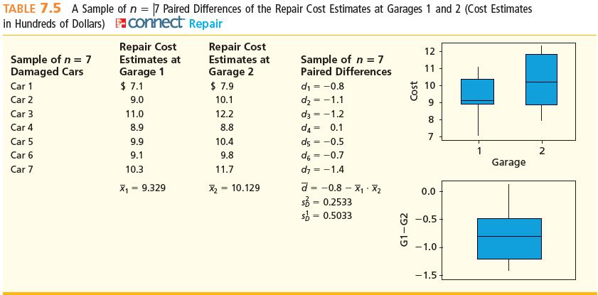
Example 7.13: The Repair Cost Comparison Case (Paired Differences)
L09
A Sample of 7 Paired Differences of the Repair Cost Estimates at Garage 1 and Garage 2

Slide 57
Example 7.13 & 7.14: The Repair Cost Comparison Case (Paired Differences)
L09
Repair costs are given in $100’s
Sample of n = 7 damaged cars
  Each damaged car is taken to Garage 1 for its estimated repair cost, and then is taken to Garage 2 for its estimated repair cost
Estimated repair costs at Garage 1: x₁ = 9.329
Estimated repair costs at Garage 2: x₂ = 10.129
We have a sample of n = 7 paired differences
and

Slide 58
Example 7.13 & 7.14
L09
With 95% confidence and with n – 1 = 7 – 1 = 6 degrees of freedom, we have t_{α/2} = t_{0.025,6} = 2.447
The 95% confidence interval is
We can be 95% confident that the mean of all possible paired differences of repair cost estimates at the two garages is between -$126.54 and -$33.46
Here, we notice that this CI is entirely negative. In this case, it suggests that the repair costs were higher, on average at Garage 2 than they were at Garage 1, anywhere from $33.46 to $126.54 higher, on average, with 95% confidence

Slide 59
Comparing Two Population Proportions
By Using Large, Independent Samples
L10
Select a random sample of size n₁ from a population, and let denote the proportion of units in this sample that fall into the category of interest
Select a random sample of size n₂ from another population, and let denote the proportion of units in this sample that fall into the same category of interest
Suppose that n₁ and n₂ are large enough
  n₁ p₁ ≥ 5, n₁ (1 - p₁) ≥ 5, n₂ p₂ ≥ 5, and n₁ (1 – p₂) ≥ 5

Slide 60
Comparing Two Population
Proportions Continued
L10
Then the population of all possible values
of
  Has approximately a normal distribution if each of the sample sizes n₁ and n₂ is large
    Here, n₁ and n₂ are large enough if n₁ p₁ ≥ 5, n₁ (1 - p₁) ≥ 5, n₂ p₂ ≥ 5, and n₁ (1 – p₂) ≥ 5
  Has mean
  Has standard deviation

Slide 61
Confidence Interval for the Difference of Two Population Proportions
L09
If the random samples are independent of each other, then the following a 100(1 – α) percent confidence interval for

Slide 62
Example 7.15 & 7.16: The Advertising Media Case (Difference of Proportions—Large Samples)
L10
631 of 1000 randomly selected customers in Toronto were aware of a new product
798 of 1000 randomly selected customers in Vancouver were aware of a new product
a point estimate of
p₁ - p₂ is

Slide 63
Example 7.15 & 7.16: The Advertising Media Case (Difference of Proportions—Large Samples)
L09
n₁ and n₂ can be considered large since:

Slide 64
Example 7.15 & 7.16: The Advertising Media Case (Difference of Proportions—Large Samples)
L10
A 95% confidence interval estimate for p₁ – p₂ is:

Slide 65
Example 7.15 & 7.16: The Advertising Media Case (Difference of Proportions—Large Samples)
L10
A 95% confidence interval estimate for p₁ – p₂ is:
  This interval says we are 95 percent confident that p₁, the proportion of all consumers in the Toronto area who are aware of the product, is between 0.2059 and 0.1281 less than p₂, the proportion of all consumers in the Vancouver area who are aware of the product

Slide 66
Summary
Confidence intervals can be computed for means, proportions and totals for infinite and finite populations
If σ is known a confidence interval can be found using the normal distribution (z table), if not then we can use the point estimate s and the student t table as long as the underlying population is known to be normal or that the sample is large
Sampling sizes can be computed to estimate a population proportion with a prescribed confidence level and a prescribed margin of error
Confidence intervals for parameters that are not much larger than the sample size are also possible to compute
Populations may be independent or dependent (paired difference experiments)

Slide 67
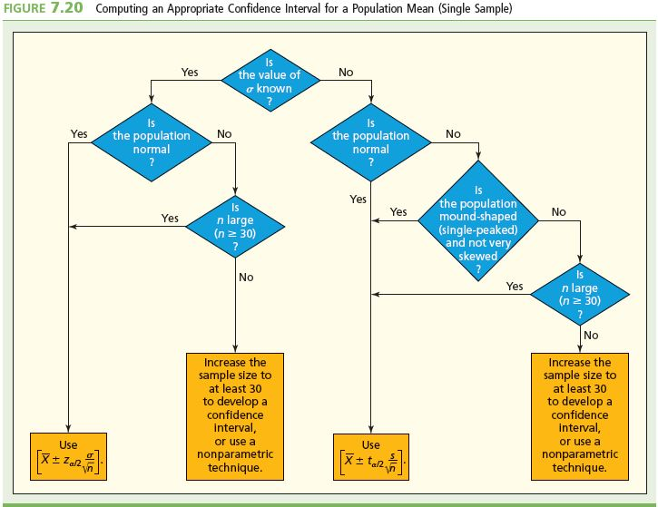
Summary: Selecting an Appropriate
Confidence Interval for a Population Mean

