Slide 1
Chapter 6
Sampling Distributions

Slide 2
Sampling Distributions
6.1 The Sampling Distribution of the Sample Mean
6.2 The Sampling Distribution of the Sample Proportion

Slide 3
Sampling Distribution of the Sample Mean
L01
L02
What is the sampling distribution of the sample mean?
  It is the probability distribution of all of the sample means obtainable from all possible samples of size n from a population of size N
  For example, consider throwing a dice indefinitely and noting the outcomes (the number of dots that come up)
  We can create a sampling distribution of the sampling mean of lets say size n=2 by throwing two dice and noting the outcomes. There will be 36 possible outcomes (1,1), (1,2) … (6,5), (6,6)
  We take the mean of all the outcomes and list all them all as shown

Slide 4
Samples of n=2
L01

Slide 5
Sampling Distribution of the Sample Mean
L02

Slide 6
Example 6.1: The Sampling Distribution of the Sampling Mean
L01
The Punch Game – A game board has holes numbered 1 to 6. Inside each hole is a slip of paper with the number 10, 20, 30, 40, 50, 60 representing cash prizes in the thousands of dollars
You can punch just one hole and claim the prize or have the option of punching two holes and claiming the average of the numbers on the slips of paper – Which should you choose? Which is riskier?

Slide 7
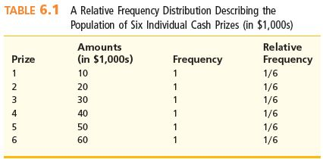
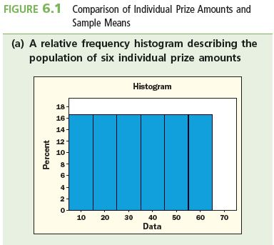
Example 6.1: The Sampling Distribution of the Sampling Mean
L01
Punching one hole has a 16.667% (1/6) chance of any of the prizes as shown in the relative frequency table below

Slide 8
Example 6.1: The Sampling Distribution of the Sampling Mean
L01
From the plots of the relative frequency distribution we can see that the mean is the same for both but the sample means plot is more bell-shaped and less spread out than the individual prizes
  Punching one hole gives a prize ranging from $10,000-60,000 with an equal probability of each prize
  Punching two holes gives a minimum prize of $15,000 and a maximum prize of $55,000
  By punching two holes instead of one, you are reducing the variability of the prize amounts, thus reducing your risk
  There is a probability of 13/15 of receiving at least $25,000
  If you punch one hole, you are only guaranteed $10,000 and have a 10/15 or 2/3, chance of winning at least $25,000

Slide 9
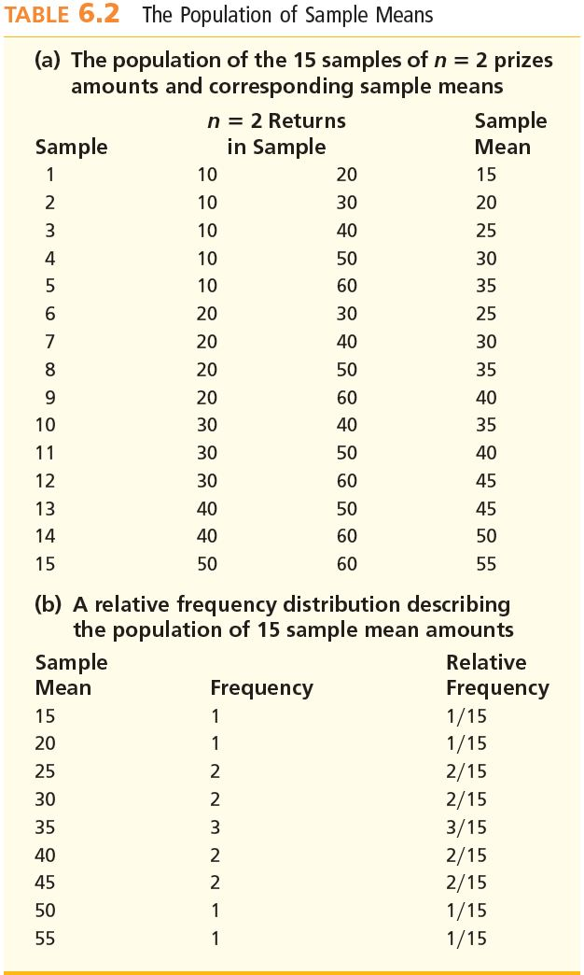
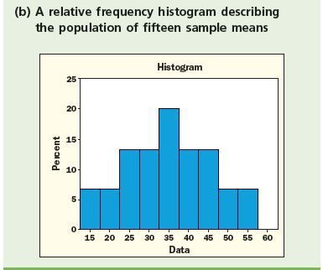
Example 6.1: The Sampling Distribution of the Sampling Mean
L01
L02
Punching two holes and winning the average of the outcomes gives the following sample means and the corresponding relative frequency distribution
  6C2 = 15 possible outcomes since n=2

Slide 10
Example 6.1: The Sampling Distribution of the Sampling Mean
Summary
  If you are willing to take the risk, then you should punch only one hole
  If you are more conservative then you should punch two holes as the risk is less
  Diversification is less risky (apply this to a stock portfolio)
  Reducing the volatility reduces the risk

Slide 11
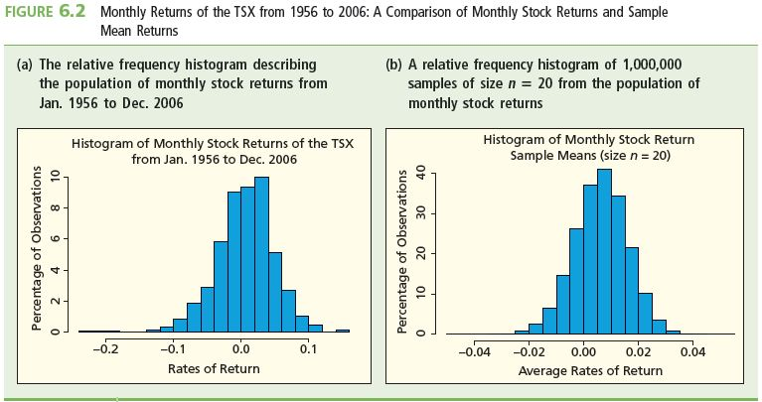
Monthly Stock Returns vs. Sample Means n=20
L01
Figure 6.2(a) shows the relative frequency histogram of the monthly percentage returns for the 50-year period ended December 2006
The mean and standard deviation of the monthly returns are 0.624 percent and 4.42 percent, respectively

Slide 12
General Conclusions
L01
L06
If the population of individual items is normal, then the population of all sample means is also normal (see figure 6.2 below)
Even if the population of individual items is not normal, there are circumstances when the population of all sample means is normal -Central Limit Theorem (see figure 6.1(a) and (b) above)

Slide 13
General Conclusions Continued
L03
L04
The mean of all possible sample means equals the population mean
  That is, μ = μ_{x}
The standard deviation σ_{x} of all sample means is less than the standard deviation of the population
  That is, σ_{x} < σ
    Each sample mean averages out the high and the low measurements, and so are closer to μ than many of the individual population measurements

Slide 14
Results from Sampling All Stocks
L03
L04
Observations figure 6.2 (a) and (b)
  Both histograms appear to be bell-shaped and centered over the same mean of 0.624%
  The histogram of the sample mean returns looks less spread out than that of the individual returns
Statistics
  Mean of all sample means: μ_{x} = μ = 0.624%
  Standard deviation of all possible means:

Slide 15
And the Empirical Rule
The empirical rule holds for the sampling distribution of the sample mean
  68.26% of all possible sample means are within (plus or minus) one standard deviation σ_{x} of μ
  95.44% of all possible observed values of x are within (plus or minus) two σ_{x} of μ
    In the example., 95.44% of all possible sample mean returns are in the interval [0.624 ± (2×0.988)] = [0.624 ± 1.976]
    That is, 95.44% of all possible sample means are between -1.352% and 2.6%
  So 99.73% of all possible observed values of x are within (plus or minus) three σ_{x} of μ

Slide 16
Properties of the Sampling
Distribution of the Sample Mean #1
L03
If the population being sampled is normal, then so is the sampling distribution of the sample mean, x
The mean of the sampling distribution of x is
μ_{x} = μ
That is, the mean of all possible sample means is the same as the population mean

Slide 17
Properties of the Sampling
Distribution of the Sample Mean #2
L04
The variance of the sampling distribution of x is
That is, the variance of the sampling distribution of x is directly proportional to the variance of the population, and inversely proportional to the sample size

Slide 18
Properties of the Sampling
Distribution of the Sample Mean #3
L04
The standard deviation σ_{x} of the sampling distribution of x is
  That is, the standard deviation of the sampling distribution of x is
    directly proportional to the standard deviation of the population, and
    inversely proportional to the square root of the sample size

Slide 19
Notes
The formulas for σ²_{x} and σ_{x} hold if the sampled population is infinite
The formulas hold approximately if the sampled population is finite but if N is much larger (at least 20 times larger) than the n (N/n ≥ 20)
  x is the point estimate of μ, and the larger the sample size n, the more accurate the estimate
  Because as n increases, σ_{x} decreases as 1/√n
    Additionally, as n increases, the more representative is the sample of the population
      So, to reduce σ_{x}, take bigger samples!

Slide 20
Example 6.2: Fuel Efficiency
Population of all fuel economies (measured in litres per hundred km) that could potentially be produced
  Population is normal with mean μ = 7.6 and standard deviation σ = 0.2
  Draw all possible samples of size n
  Then the sampling distribution of the sample mean is normal with mean μ_{x} = μ and standard deviation of
  In particular, draw samples of size:
    n = 5
    n = 50

Slide 21
Example 6.2: Fuel Efficiency
Suppose that a sample of 50 produced a sample mean of 7.51 L/100 km
Determine whether or not the sample information provides strong statistical evidence that the population mean, μ, is less than 7.6 L/100 km

Slide 22
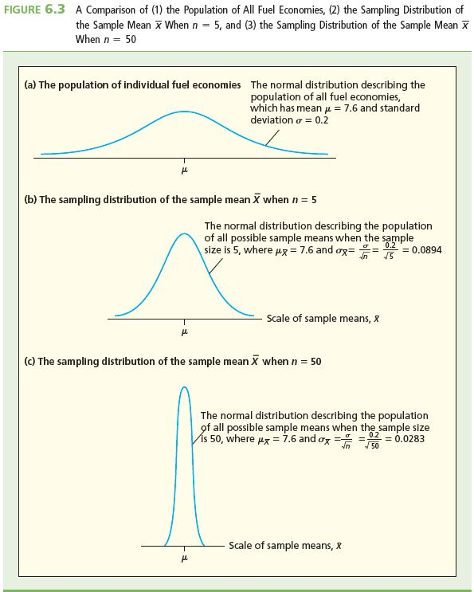
Effect of Sample Size
L03
L04

Slide 23
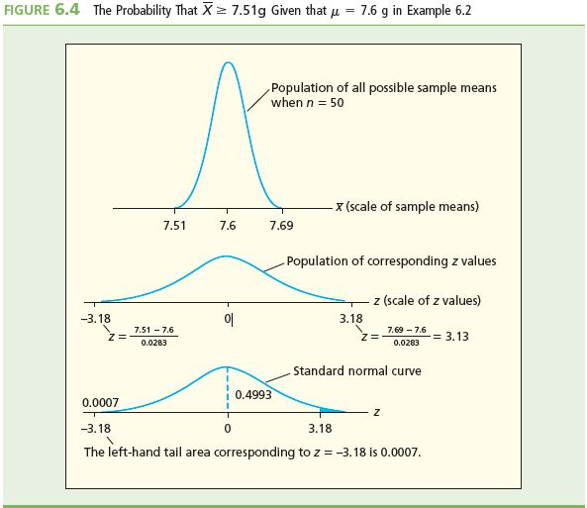
Example 6.2: Fuel Efficiency
In order to determine whether or not the mean fuel economy is less than 7.6 L/100 km
  Assume for now that μ = 7.6 L/100 km and use the sample information to determine whether or not we should reject this assumption (μ = 7.6 L/100 km) in favour of the alternative claim that the mean fuel economy might actually be lower
7/10,000 chance

Slide 24
Observations
If μ = 7.6 L/100 km, then about 7 in 10,000 of all sample means are equal to 7.5 L/100 km or smaller. (see Figure 6.4) This suggests that it is very unlikely that μ = 7.6 L/100 km
  There is very little support for that claim and, in fact, it appears as though μ is actually lower than 7.6

Slide 25
Central Limit Theorem
L07
Consider sampling from a non-normal population
Still have: and
  Exactly correct if infinite population
  Approximately correct if population size N finite but much larger than sample size n
    Especially if N ≥ 20 × n
But if population is non-normal, what is the shape of the sampling distribution of the sample mean?
  Is it normal, like it is if the population is normal?
  Yes, the sampling distribution is approximately normal if the sample is large enough, even if the population is non-normal
  By the “Central Limit Theorem”

Slide 26
The Central Limit Theorem #2
L07
No matter what the probability distribution is that describes the population, if the sample size n is large enough, then the population of all possible sample means is approximately normal with mean and standard deviation
Further, the larger the sample size n, the closer the sampling distribution of the sample mean is to being normal
  In other words, the larger n, the better the approximation

Slide 27
The Central Limit Theorem #3
L07
Random Sample (x₁, x₂, …, x_{n})
X
as n → large
Sampling Distribution of Sample Mean
(nearly normal)
Population Distribution
(μ, σ)
(right-skewed)

Slide 28
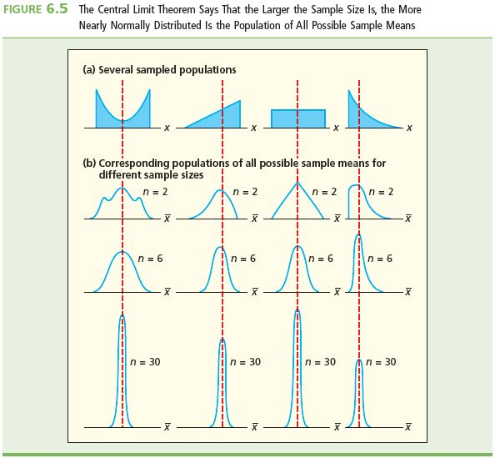
Example: Effect of Sample Size
L07
The larger the sample size, the more nearly normally distributed is the population of all possible sample means
Also, as the sample size increases, the spread of the sampling distribution decreases

Slide 29
How Large?
L07
How large is “large enough?”
If the sample size is at least 30, then for most sampled populations, the sampling distribution of sample means is approximately normal
  Here, if n is at least 30, it will be assumed that the sampling distribution of x is approximately normal
    If the population is normal, then the sampling distribution of x is normal no regardless of the sample size
    Refer to Figure 6.6 on next slide
      Shown in Fig 6.6(a) is an exponential (right skewed) distribution
      In Figure 6.6(b), 1,000 samples of size n = 5
        Slightly skewed right
      In Figure 6.6(c), 1,000 samples with n = 30
        Approximately bell-shaped and normal

Slide 30
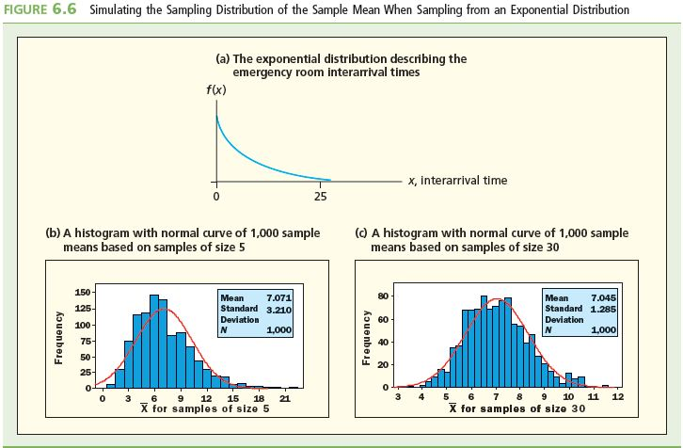
Example: Central Limit Theorem Simulation
L07

Slide 31
Unbiased Estimates
L08
A sample statistic is an unbiased point estimate of a population parameter if the mean of all possible values of the sample statistic equals the population parameter
x is an unbiased estimate of μ because μ_{x}=μ
  In general, the sample mean is always an unbiased estimate of μ
  The sample median can also be an unbiased estimate of μ
    But not always—only when the population is symmetric.

Slide 32
Unbiased Estimates Continued
L08
The sample variance s² is an unbiased estimate of σ²
  That is why s² has a divisor of n–1 and not n
However, s is not an unbiased estimate of σ
  Even so, the usual practice is to use s as an estimate of σ

Slide 33
Minimum Variance Estimates
L08
Want the sample statistic to have a small standard deviation
  All values of the sample statistic should be clustered around the population parameter
    Then, the statistic from any sample should be close to the population parameter
    Given a choice between unbiased estimates, choose one with smallest standard deviation
    The sample mean and the sample median are both unbiased estimates of μ
    The sampling distribution of sample means generally has a smaller standard deviation than that of sample medians

Slide 34
Minimum Variance Estimates Continued
L08
The sample mean is a minimum-variance unbiased estimate of μ
  When the sample mean is used to estimate μ, we are more likely to obtain an estimate close to μ than if we used any other sample statistic
  Therefore, the sample mean is the preferred estimate of μ

Slide 35
Finite Populations
L08
If a finite population of size N is sampled randomly and without replacement, must use the “finite population correction” to calculate the correct standard deviation of the sampling distribution of the sample mean
  If N is less than 20 times the sample size, that is,
  if N < 20 × n
  Then

Slide 36
Finite Populations Continued
L08
The finite population correction factor is
and the corrected standard error is

Slide 37
Punch Game: Finite Populations
L08
In the example of sampling n = 2 punches from N = 6 holes
  Here, N/n = 3 (<20), so to calculate σ_{x}, must use the finite population correction
  Then
    Note that the finite population correction factor is less than one, thus making the adjusted value of σ_{x} less than its original value of 12.076%

Slide 38
Sampling Distribution of the Sample Proportion
L05
L06
The probability distribution of all possible sample proportions is the sampling distribution of the sample proportion
If a random sample of size n is taken from a population, then the sampling distribution of is
  approximately normal, if n is large
    How large?
    Check: both np and n(1-p) must be at least 5
  has mean
  has standard deviation
  where p is the population proportion and is a sampled proportion

Slide 39
Summary
A sampling distribution is a probability distribution that describes the population of all possibilities of the values of the sample statistic
The probability distribution of the population of all possible sample means is called the sampling distribution of the sampling mean
The Central Limit Theorem says that if the sampled population is not normally distributed then the sampling distribution of the sampling mean is approximately normally distributed when the sample size is large (≥30)
The sample mean is a minimum-variance unbiased point estimate of the mean of a normally distributed population
If the sample size is large, the sampling distribution of a sample proportion is approximately a normal distribution
There are rules for determining what is “large”. In this case, we want both np and n(1-p) to be at least 5.

