Slide 1
Chapter 5
Continuous Random Variables

Slide 2
Continuous Random Variables
5.1 Continuous Probability Distributions
5.2 The Uniform Distribution
5.3 The Normal Probability Distribution
5.4 The Cumulative Normal Table
5.5 Approximating the Binomial Distribution by Using the Normal Distribution
5.6 The Exponential Distribution

Slide 3
Continuous Probability Distributions
L01
A continuous random variable may assume any numerical value in one or more intervals
Use a continuous probability distribution to assign probabilities to intervals of values
  Many business measures such as sales, investment, costs and revenue can be represented by continuous random variables
  Other names for a continuous probability distribution are probability curve or probability density function

Slide 4
Properties of Continuous
Probability Distributions
L01
Properties of f(x): f(x) is a continuous function such that
  f(x) ≥ 0 for all x
  The total area under the curve of f(x) is equal
  Essential point: An area under a continuous probability distribution is a probability equal to 1

Slide 5
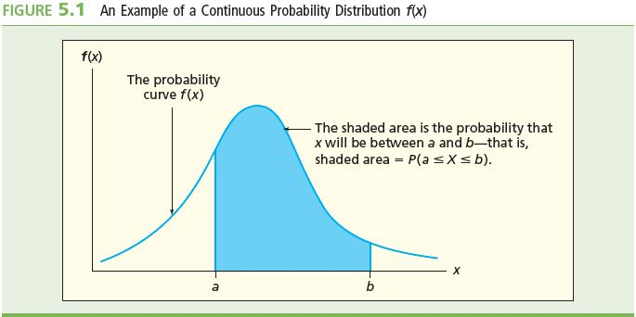
Area and Probability
L01
The blue-colored area under the probability curve f(x) from the value x = a to x = b is the probability that x could take any value in the range a to b
  Symbolized as P(a ≤ x ≤ b)
    Or as P(a < x < b), because each of the interval endpoints has a probability of 0

Slide 6
Distribution Shapes
L01
Symmetrical and rectangular
  The uniform distribution
    Section 5.2
Symmetrical and bell-shaped
  The normal distribution
    Section 5.3
Skewed
  Skewed either left or right
    Section 5.6 for the right-skewed exponential distribution

Slide 7
The Uniform Distribution
L02
If c and d are numbers on the real line (c < d), the probability curve describing the uniform distribution is:
The probability that x is any value between the given values a and b (a < b) is:
  Note: The number ordering is c < a < b < d

Slide 8
The Uniform Distribution Continued
L02
The mean μ_{X} and standard deviation σ_{X} of a uniform random variable x are:
  These are the parameters of the uniform distribution with endpoints c and d (c < d)

Slide 9
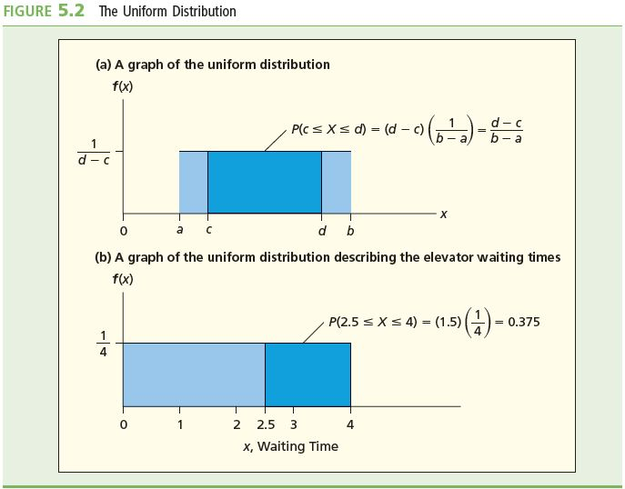
The Uniform Probability Curve
L02

Slide 10
Notes on the Uniform Distribution
L02
The uniform distribution is symmetrical
  Symmetrical about its center μ_{X}
  μ_{X} is the median
The uniform distribution is rectangular
  For endpoints c and d (c < d and c ≠ d) the width of the distribution is d – c and the height is
  1/(d – c)
  The area under the entire uniform distribution is 1
    Because width × height = (d – c) × [1/(d – c)] = 1
    So P(c ≤ x ≤ d) = 1
    See panel a of Figure 5.2 (previous slide)

Slide 11
Example 5.1: Uniform Waiting Time #1
L02
The amount of time, x, that a randomly selected hotel patron waits for an elevator
x is uniformly distributed between zero and four minutes
  So c = 0 and d = 4, and
  and

Slide 12
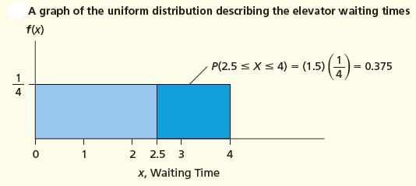
Example 5.1: Uniform Waiting Time #2
L02
What is the probability that a randomly selected hotel patron waits at least 2.5 minutes for an elevator?
  The probability is the area under the uniform distribution in the interval [2.5, 4] minutes
    The probability is the area of a rectangle with height ¼ and base 4 – 2.5 = 1.5
  P(x ≥ 2.5) = P(2.5 ≤ x ≤ 4) = ¼ × 1.5 = 0.375

Slide 13
Example 5.1: Uniform Waiting Time #3
L02
What is the probability that a randomly selected hotel patron waits less than one minutes for an elevator?
  P(x ≤ 1) = P(0 ≤ x ≤ 1) = 1 x ¼ = 0.25
    This is the area of the rectangle (length x height)

Slide 14
Example 5.1: Uniform Waiting Time
L02
Expect to wait the mean time μ_{X}
with a standard deviation σ_{X} of
The mean time plus/minus one standard deviation is:
  μ_{X} – σ_{X} = 2 – 1.1547 = 0.8453 minutes
  μ_{X} + σ_{X} = 2 + 1.1547 = 3.1547 minutes

Slide 15
The Normal Probability Distribution
L02
The normal probability distribution is defined by the equation
for all values x on the real number line, where
is the mean and σ is the standard deviation,
π = 3.14159 … and e = 2.71828 is the base of natural logarithms

Slide 16
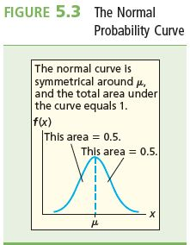
The Normal Probability Distribution
The normal curve is symmetrical around its mean and bell-shaped
  So μ is also the median
  The tails of the normal extend to infinity in both directions
    The tails get closer to the horizontal axis but never touch it
  The area under the entire normal curve is 1
    The area under either half of the curve is 0.5

Slide 17
Properties of the Normal Distribution
L02
There is an infinite number of possible normal curves
  The particular shape of any individual normal depends on its specific mean μ and standard deviation σ
The highest point of the curve is located over the mean
mean = median = mode
  All the measures of central tendency equal each other
    This is the only probability distribution for which this is true

Slide 18
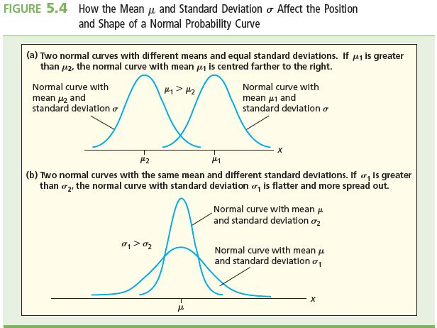
The Position and Shape of the Normal Curve
L02
The mean m positions the peak of the normal curve over the real axis
The variance s² measures the width or spread of the normal curve

Slide 19
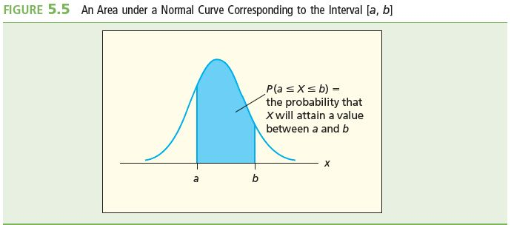
Normal Probabilities
L02
Suppose x is a normally distributed random variable with mean m and standard deviation s
The probability that x could take any value in the range between two given values a and b (a < b) is P(a ≤ x ≤ b)
P(a ≤ x ≤ b) is the area colored in blue under the normal curve and between the values
x = a and x = b

Slide 20
Three Important Areas under the Normal Curve
L02
1. P(μ – σ ≤ x ≤ μ + σ) = 0.6826
  So 68.26% of all possible observed values of x are within (plus or minus) one standard deviation of m
2. P(μ – 2σ ≤ x ≤ μ + 2σ ) = 0.9544
  So 95.44% of all possible observed values of x are within (plus or minus) two standard deviations of m
3. P(μ – 3σ ≤ x ≤ μ + 3σ) = 0.9973
  So 99.73% of all possible observed values of x are within (plus or minus) three standard deviations of m

Slide 21
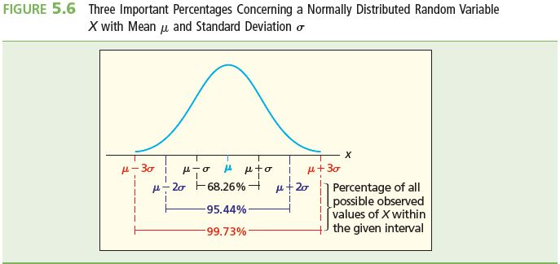
Three Important Areas under the Normal Curve (Visually)
L02
The Empirical Rule for Normal Populations

Slide 22
The Standard Normal Distribution #1
L03
If x is normally distributed with mean μ and standard deviation σ, then the random variable z is described by this formula:
z is normally distributed with mean 0 and standard deviation 1; this normal is called the standard normal distribution

Slide 23
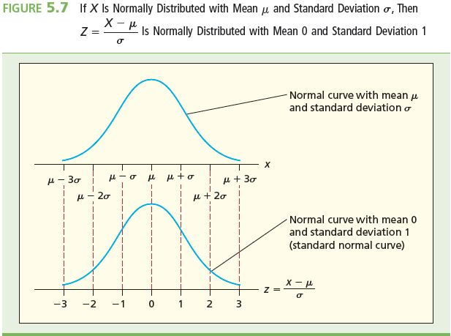
The Standard Normal Distribution #2
L03
z measures the number of standard deviations that x is from the mean μ
  The algebraic sign on z indicates on which side of μ is
  z is positive if x > μ (x is to the right of μ on the number line)
  z is negative if x < μ (x is to the left of μ on the number line)

Slide 24
The Standard Normal Table #1
L03
The standard normal table is a table that lists the area under the standard normal curve to the right of the mean (z = 0) up to the z value of interest
  See Table 5.1
  Also see Table A.3 in Appendix A
    Always look at the accompanying figure for guidance on how to use the table

Slide 25
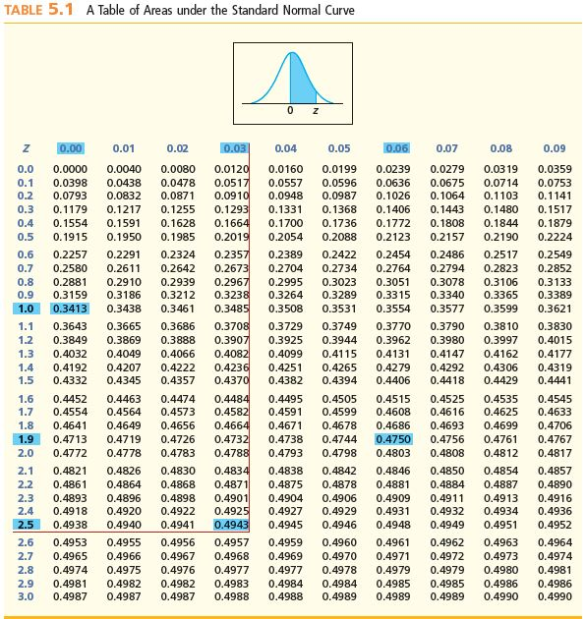
Table 5.1: Standard Normal Table of Probabilities(Appendix A.3)

Slide 26
The Standard Normal Table #2
L03
The values of z (accurate to the nearest tenth) in the table range from 0.00 to 3.09 in increments of 0.01
  z accurate to tenths are listed in the far left column
  The hundredths digit of z is listed across the top of the table
The areas under the normal curve to the right of the mean up to any value of z are given in the body of the table

Slide 27
The Standard Normal Table Example
L03
Find P(0 ≤ z ≤ 1)
  Find the area listed in the table corresponding to a z value of 1.00
  Starting from the top of the far left column, go down to “1.0”
  Read across the row z = 1.0 until under the column headed by “.00”
  The area is in the cell that is the intersection of this row with this column
  As listed in the table, the area is 0.3413, so
P(0 ≤ z ≤ 1) = 0.3413

Slide 28
Normal table lookup
L03
L06
34.13% of the curve

Slide 29
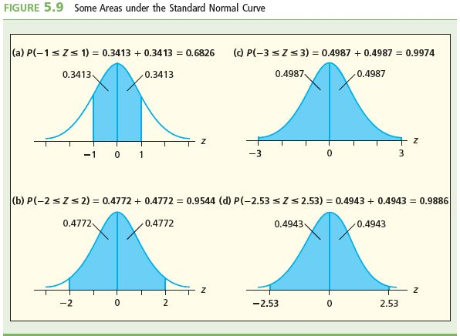
Some Areas under the
Standard Normal Curve
L03

Slide 30
Calculating P(-2.53 ≤ z ≤ 2.53) #1
L03
First, find P(0 ≤ z ≤ 2.53)
  Go to the table of areas under the standard normal curve
  Go down left-most column for z = 2.5
  Go across the row 2.5 to the column headed by .03
  The area to the right of the mean up to a value of z = 2.53 is the value contained in the cell that is the intersection of the 2.5 row and the .03 column
  The table value for the area is 0.4943
Continued

Slide 31
Normal Table Lookup
L03
49.43% of the curve

Slide 32
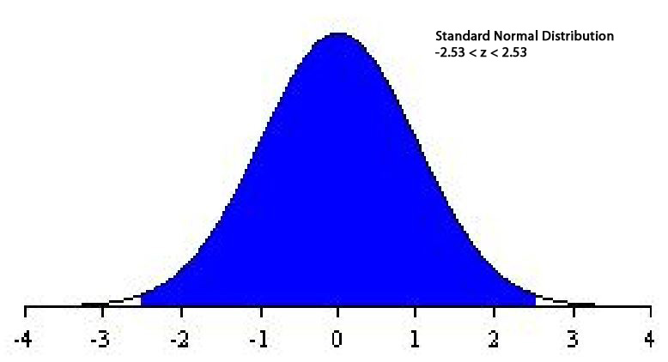
Calculating P(-2.53 ≤ z ≤ 2.53) #2
L03
From last slide, P(0 ≤ z ≤ 2.53)=0.4943
By symmetry of the normal curve, this is also the area to the LEFT of the mean down to a value of z = –2.53
  Then P(-2.53 ≤ z ≤ 2.53) = 0.4943 + 0.4943 = 0.9886
http://davidmlane.com/hyperstat/z_table.html

Slide 33
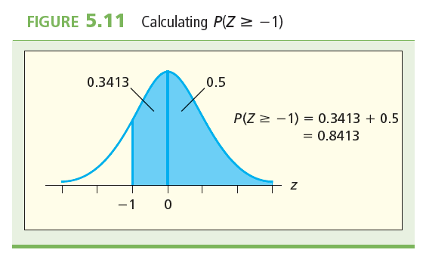
Calculating P(z ≥ -1)
L03
An example of finding the area under the standard normal curve to the right of a negative z value
  Shown is finding the under the standard normal for z ≥ -1

Slide 34
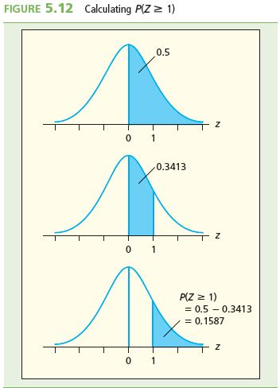
Calculating P(z ≥ 1)
L03
An example of finding tail areas
Shown is finding the right-hand tail area for z ≥ 1.00
  Equivalent to the left-hand tail area for z ≤ -1.00

Slide 35
Finding Normal Probabilities
L04
General procedure:
1. Formulate the problem in terms of x values
2. Calculate the corresponding z values, and restate the problem in terms of these z values
3. Find the required areas under the standard normal curve by using the table
Note: It is always useful to draw a picture showing the required areas before using the normal table

Slide 36
Example 5.2: Coffee Temperature
L04
What is the probability of a randomly purchased cup of coffee will be outside the requirements that the temperature be between 67 and 75 degrees?
  Let x be the random variable of coffee temperatures, in degrees Celsius
  Want P(x<67) and P(x > 75)
  Given: x is normally distributed

Slide 37
Example 5.2: Coffee Temperature
L04
For x = 67°, the corresponding z value is:
  (so the temperature of 75° is 1.27 standard deviations above (to the right of) the mean)
For x = 80°, the corresponding z value is:
  (so the temperature of 80° is 2.95 standard deviations above (to the right of) the mean)
Then P(67° ≤ x ≤ 75°) = P( -1.41 ≤ z ≤ 1.27)

Slide 38
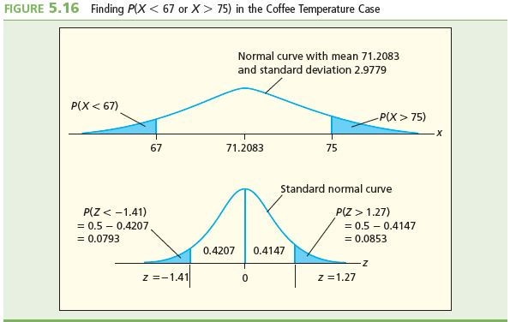
Example 5.2: Coffee Temperature
L04
Want: the area under the normal curve less than 67° and greater than 75°
Will find: the area under the standard normal curve less than -1.41 and greater than 1.27 which will give the same area
Continued

Slide 39
Normal Table Lookup for z=-1.41 and z=1.27
L04
42.07% of the curve
39.80% of the curve

Slide 40
The area in question
L04
P(X <67 or X > 75) = P(x < 67) + P(x >75)
= P(z<-1.41) + P(z < 1.27)
= (0.5 - 0.4207) + (0.5 - 0.3980)
= 0.0793 + 0.102 = 0.1813 = 18.13%

Slide 41
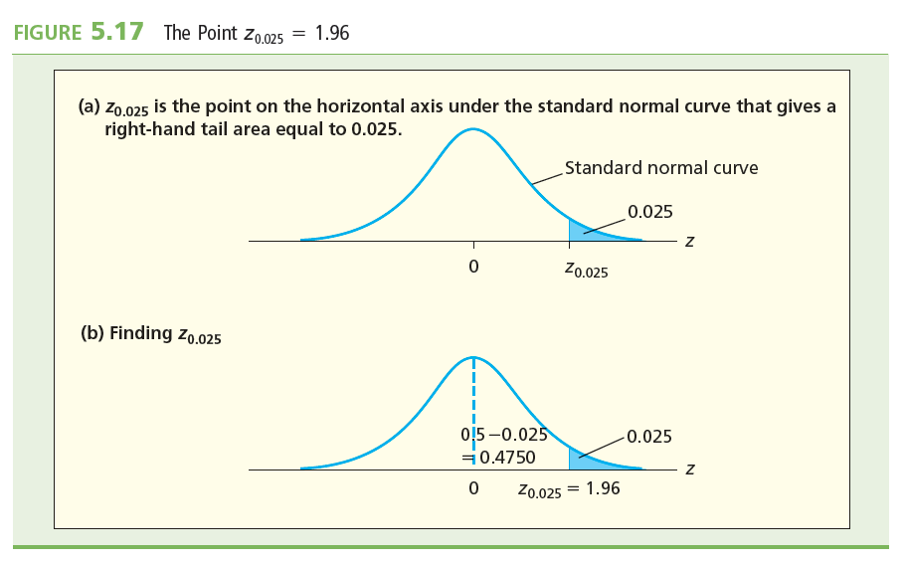
Finding Z Points on a Standard Normal Curve
L05

Slide 42
Finding X Points on a Normal Curve
L05
Example 5.3 Stocking Energy Drinks
  A grocery store sells a brand of energy drinks
  The weekly demand is normally distributed with a mean of 1,000 cans and a standard deviation of 100
  How many cans of the energy drink should the grocery store stock for a given week so that there is only a 5 percent chance that the store will run out of the popular drinks?
We will let x be the specific number of energy drinks to be stocked. So the value of x must be chosen so that P(X >x) = 0.05 = 5%

Slide 43
Example 5.3 Stocking Energy Drinks
L05
Using our formula for finding the equivalent z value we have:
The z value corresponding to x is z_{0.05}
  Since the area under the standard normal curve between 0 and z_{0.05} is 0.5 - 0.05 = 0.45 (see Figure 5.18(b))

Slide 44
Example 5.3 Stocking Energy Drinks
L05
Use the standard normal table to find the z value associated with a table entry of 0.45
  The area for 0.45 is not listed ; instead find values that bracket 0.45 since it is halfway between
  For a table entry of 0.4495, z = 1.64
  For a table entry of 0.4505, z = 1.65
  For an area of 0.45, use the z value midway between these
  So z_{0.005} = 1.645

Slide 45
Z Score Lookup
L05
z = 1.645
0.45

Slide 46
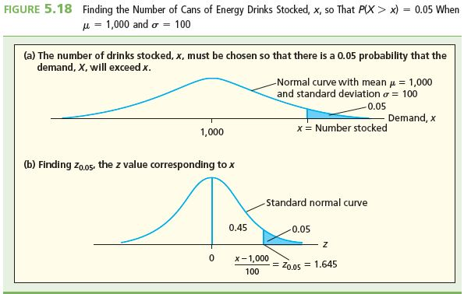
Finding X Points on a Normal Curve
L05

Slide 47
Example 5.3 Stocking Energy Drinks
L05
Combining this result with the result from a prior slide:
Solving for x gives x = 1000 + (1.645 × 100) = 1164.5
  Rounding up, 1165 energy drinks should be stocked so that the probability of running out will not be more than 5 percent

Slide 48
The Cumulative Normal Table
L06
The cumulative normal table gives the area under the standard normal curve below z
Including negative z values
The cumulative normal table gives the probability of being less than or equal any given z value
  See Table 5.2
  Also see Table A.## in Appendix A

Slide 49
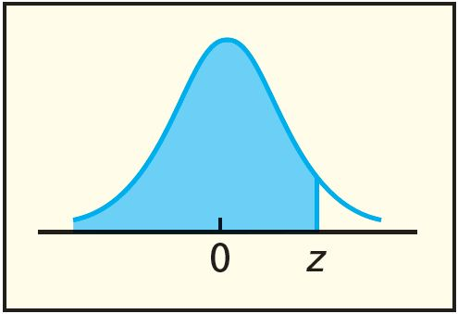
The Cumulative Normal Curve Continued
L06
The cumulative normal curve is shown below:
The cumulative normal table gives the shaded area

Slide 50
The Cumulative Normal Table
L06
Most useful for finding the probabilities of threshold values like P(z ≤ a) or P(z ≥ b)
  Find P(z ≤ 1)
    Find directly from cumulative normal table that
    P(z ≤ 1) = 0.8413
  Find P(z ≥ 1)
    Find directly from cumulative normal table that
    P(z ≤ 1) = 0.8413
    Because areas under the normal sum to 1
    P(z ≥ 1) = 1 – P(z ≤ 1)
    so
    P(z ≥ 1) = 1 – 0.8413 = 0.1587

Slide 51
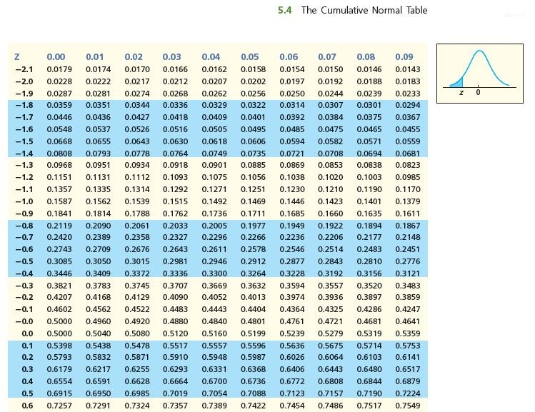
Using the Cumulative Normal Table
L06
P(z≤-1.01)=0.1562

Slide 52
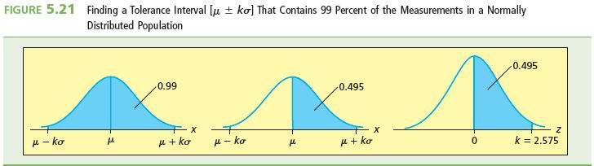
Finding a Tolerance Interval
Finding a tolerance interval [μ ± kσ] that contains 99% of the measurements in a normal population

Slide 53
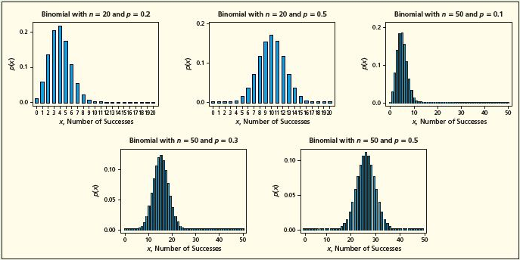
Normal Approximation to the Binomial
L02
The figure below shows several binomial distributions
  Can see that as n gets larger and as p gets closer to 0.5, the graph of the binomial distribution tends to have the symmetrical, bell-shaped, form of the normal curve

Slide 54
Normal Approximation to the Binomial Distribution
L02
Generalize observation from last slide for large p
Suppose x is a binomial random variable, where n is the number of trials, each having a probability of success p
Then the probability of failure is 1 – p
If n and p are such that np ≥ 5 and n(1 – p) ≥ 5, then x is approximately normal with

Slide 55
Example 5.8: Flipping a Fair Coin
L02
Suppose there is a binomial variable x with n = 50 and p = 0.5
Want the probability of x = 23 successes in the n = 50 trials
  Want P(x = 23)
  Approximating by using the normal curve with

Slide 56
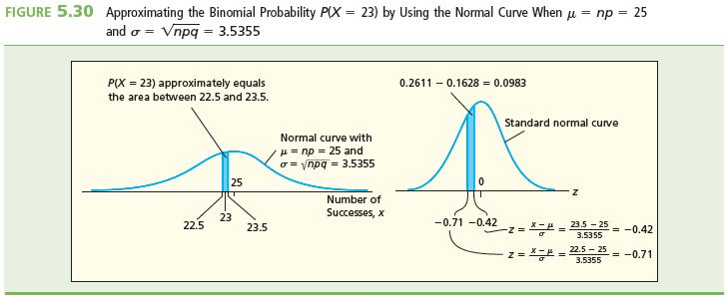
Example 5.6: Normal Approximation to a Binomial
L02
With continuity correction, find the normal probability P(22.5 ≤ x ≤ 23.5)

Slide 57
Example 5.6: Normal Approximation to a Binomial
L02
For x = 22.5, the corresponding z value is:
For x = 23.5, the corresponding z value is:
Then P(22.5 ≤ x ≤ 23.5) = P(-0.71 ≤ z ≤ -0.42)
= 0.2611 – 0.1628
= 0.0983
  Therefore the estimate of the binomial probability P(x = 23) is 0.0983
  The actual answer, using the binomial probability distribution function with n=50, p=0.5, and x=23 is 0.0959617.
  The approximation was pretty good!

Slide 58
The Exponential Distribution
L02
Suppose that some event occurs as a Poisson process
That is, the number of times an event occurs is a Poisson random variable
Let x be the random variable of the interval between successive occurrences of the event
The interval can be some unit of time or space
Then x is described by the exponential distribution
With parameter λ, which is the mean number of events that can occur per given interval

Slide 59
The Exponential Distribution
L02
If λ is the mean number of events per given interval, then the equation of the exponential distribution is:
The probability that x is any value between the given values a and b (a < b) is:

Slide 60
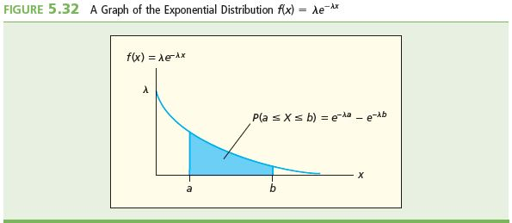
The Exponential Distribution
L02
The mean m_{X} and standard deviation s_{X} of an exponential random variable x are:

Slide 61
Example 5.10: Cell Phone Batteries
L02
The time to failure of one brand of cell phone battery is exponentially distributed with a mean of 40,000 hours
The company that manufactures these batteries, which have a 1,000-hour guarantee, has a device that can measure hours of usage
Find the proportion of customers who would have their batteries replaced
Determine P(X < 1,000)

Slide 62
Example 5.10: Cell Phone Batteries
L02
The exponential distribution is given by the equation:
Determine P(X < 1,000)
2.47% of the customers would have their batteries replaced free

Slide 63
Summary
Continuous probability distributions are described by continuous probability curves
The areas under these curves are associated with the probabilities ➔ find the area = find the probability
Types of probability distributions are uniform (probabilities are distributed evenly), exponential and normal, the normal is the most important
The standard normal distribution has a mean of 0 and a standard deviation of 1. Areas can be looked up using the standard normal table and also z scores corresponding to an area can be looked up as well
The area of any normal distribution with a mean and standard deviation can be looked up using the standard normal table using the transformation:

