Slide 1
Chapter 4
Discrete Random Variables

Slide 2
Discrete Random Variables
4.1 Two Types of Random Variables
4.2 Discrete Probability Distributions
4.3 The Binomial Distribution
4.4 The Poisson Distribution
4.5 The Hypergeometric Distribution

Slide 3
Random Variables
L01
L02
A random variable is a variable that assumes numerical values that are determined by the outcome of an experiment
Discrete random variable: Possible values can be counted or listed
  For example, the number of defective units in a batch of 20, a listener rating (on a scale of 1 to 5) in a music survey
Continuous random variable: May assume any numerical value in one or more intervals
  For example, the waiting time for a credit card authorization, the interest rate charged on a business loan

Slide 4
Discrete Probability Distributions
L02
The probability distribution of a discrete random variable is a table, graph, or formula that gives the probability associated with each possible value that the variable can assume
Notation: Denote the values of the random variable by x and the value’s associated probability by p(x)
Properties
1. For any value x of the random variable, p(x) ≥ 0
2. The probabilities of all the events in the sample space must sum to 1, that is,

Slide 5
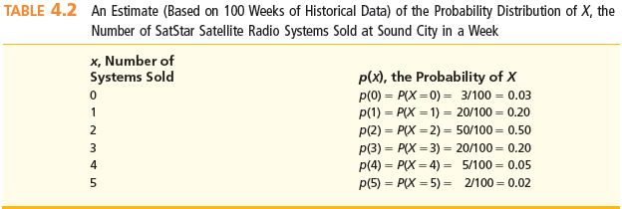
Example 4.3: Number of Radios
Sold at Sound City in a Week
L03
Let X be the random variable of the number of radios sold per week
  X has values x = 0, 1, 2, 3, 4, 5
Given: Frequency distribution of sales history over past 100 weeks
  Let f(x) be the number of weeks (of the past 100) during which x number of radios were sold

Slide 6
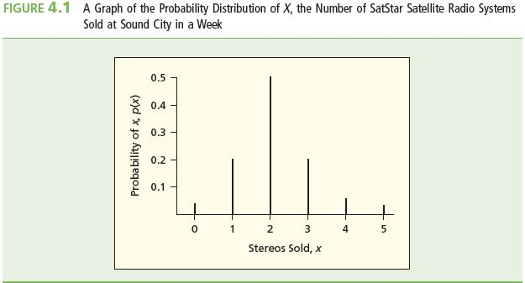
Example 4.3
L03
Interpret the relative frequencies as probabilities
  So for any value x, f(x)/n = p(x)
  Assuming that sales remain stable over time
Number of Radios Sold at Sound City in a Week
Radios, x Probability, p(x)
0 p(0) = 0.03
1 p(1) = 0.20
2 p(2) = 0.50
3 p(3) = 0.20
4 p(4) = 0.05
5 p(5) = 0.02
1.00

Slide 7
Example 4.3
L03
What is the chance that two radios will be sold in a week?
  p(x = 2) = 0.50

Slide 8
Example 4.3 Continued
L03
What is the chance that fewer than 2 radios will be sold in a week?
  p(x < 2) = p(x = 0 or x = 1)
    = p(x = 0) + p(x = 1)
    = 0.03 + 0.20 = 0.23
What is the chance that three or more radios will be sold in a week?
  p(x ≥ 3) = p(x = 3, 4, or 5)
    = p(x = 3) + p(x = 4) + p(x = 5)
    = 0.20 + 0.05 + 0.02 = 0.27
Using the addition rule
for the mutually
exclusive values of
the random variable

Slide 9
Expected Value of a Discrete
Random Variable
L04
The mean or expected value of a discrete random variable X is:
μ is the value expected to occur in the long run and on average

Slide 10
Example 4.3: Number of Radios
Sold at Sound City in a Week
L04
How many radios should be expected to be sold in a week?
  Calculate the expected value of the number of radios sold, μ_{X}
Radios, x Probability, p(x) x p(x)
0 p(0) = 0.03 0 × 0.03 = 0.00
1 p(1) = 0.20 1 × 0.20 = 0.20
2 p(2) = 0.50 2 × 0.50 = 1.00
3 p(3) = 0.20 3 × 0.20 = 0.60
4 p(4) = 0.05 4 × 0.05 = 0.20
5 p(5) = 0.02 5 × 0.02 = 0.10
1.00 2.10
On average, expect to sell 2.1 radios per week

Slide 11
Variance and Standard Deviation
L04
The variance of a discrete random variable is:
The variance is the average of the squared deviations of the different values of the random variable from the expected value
The standard deviation is the square root of the variance
The variance and standard deviation measure the spread of the values of the random variable from their expected value

Slide 12
Example 4.6: Number of Radios
Sold at Sound City in a Week
L04
Calculate the variance and standard deviation of the number of radios sold at Sound City in a week
Radios, x Probability, p(x) (x - μ_{X})² p(x)
0 p(0) = 0.03 (0 – 2.1)² (0.03) = 0.1323
1 p(1) = 0.20 (1 – 2.1)² (0.20) = 0.2420
2 p(2) = 0.50 (2 – 2.1)² (0.50) = 0.0050
3 p(3) = 0.20 (3 – 2.1)² (0.20) = 0.1620
4 p(4) = 0.05 (4 – 2.1)² (0.05) = 0.1805
5 p(5) = 0.02 (5 – 2.1)² (0.02) = 0.1682
1.00 0.8900
Variance
Standard deviation

Slide 13
The Binomial Distribution
L05
The Binomial Experiment:
1. Experiment consists of n identical trials
2. Each trial results in either “success” or “failure”
3. Probability of success, p, is constant from trial to trial
4. Trials are independent
Note: The probability of failure, q, is 1 – p and is constant from trial to trial
If x is the total number of successes in n trials of a binomial experiment, then x is a binomial random variable

Slide 14
The Binomial Distribution #2
L05
For a binomial random variable x, the probability of x successes in n trials is given by the binomial distribution:
Note: n! is read as “n factorial” and n! = n × (n-1) × (n-2) × ... × 1
  For example, 5! = 5 × 4 × 3 × 2 × 1 = 120
Also, 0! =1
Factorials are not defined for negative numbers or fractions

Slide 15
The Binomial Distribution #3
L05
What does the equation mean?
  The equation for the binomial distribution consists of the product of two factors
Number of ways to get x successes and (n–x) failures in n trials
The chance of getting x successes and (n–x) failures in a particular arrangement

Slide 16
Example 4.10: Incidence of Nausea after Treatment
L05
x = number of patients who will experience nausea following treatment with Phe-Mycin out of the 4 patients tested
Find the probability that 2 of the 4 patients treated will experience nausea
  Given: n = 4, p = 0.1, with x = 2
  Then: q = 1 – p = 1 – 0.1 = 0.9 and

Slide 17
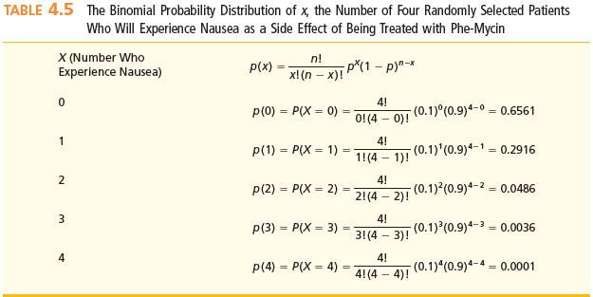
Example 4.10: Incidence of Nausea after Treatment
L05
Similarly we can compute the probability for x = 0, 1, 3, and 4

Slide 18
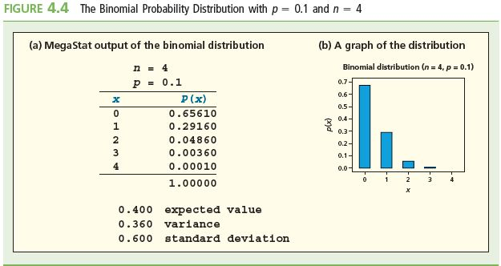
Using MegaStat: Binomial Distribution n = 4, p = 0.1
L05

Slide 19
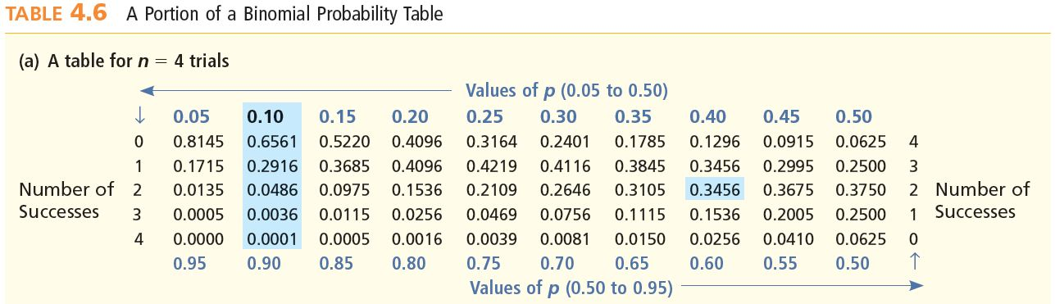
Using Binomial Probability Tables x success in n trials
L05
Find P(x=2) for 4 trials with a probability of 0.10 of success for each trial
Find P(x=2) for 4 trials with a probability of 0.4 of success for each trial
P(x=2)=0.0486 if p=0.10 and P(x=2)=0.3456 if p=0.40

Slide 20
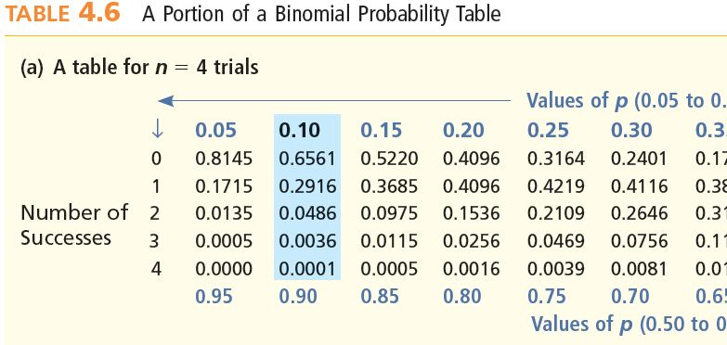
Example 4.11: Incidence of Nausea after Treatment
L05
x = number of patients who will experience nausea following treatment with Phe-Mycin out of the 4 patients tested
Find the probability that at least 3 of the 4 patients treated will experience nausea

Slide 21
Example 4.11: Rare Events
L05
Suppose at least three of four sampled patients actually did experience nausea following treatment
  If p = 0.1 is believed, then there is a chance of only 37 in 10,000 of observing this result (0.37%)
  So this is very unlikely!
    But it actually occurred
  So, this is very strong evidence that p does not equal 0.1
    There is very strong evidence that p is actually greater than 0.1

Slide 22
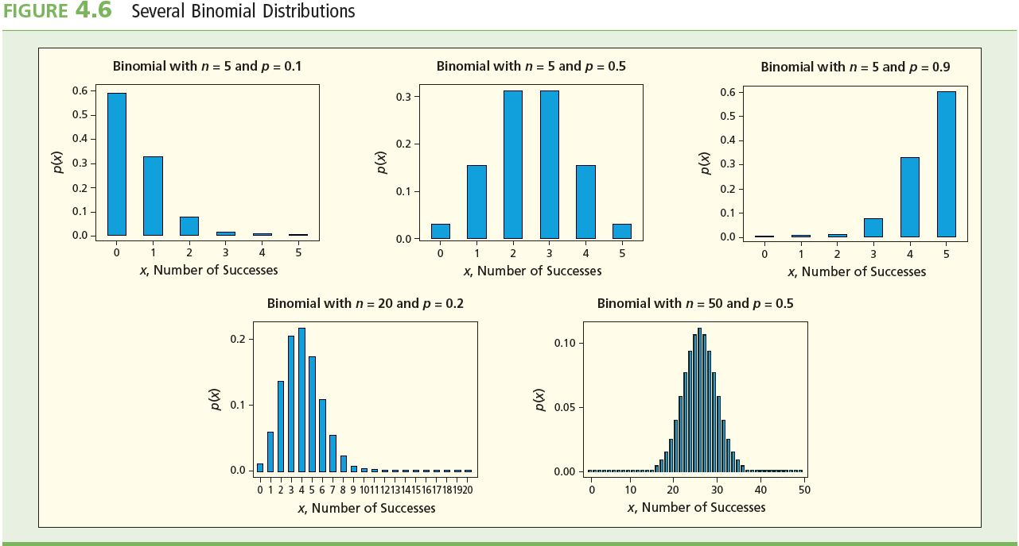
Several Binomial Distributions
L05

Slide 23
Mean and Variance of a Binomial
Random Variable
L05
If x is a binomial random variable with parameters n and p (so q = 1 – p), then

Slide 24
Back to Example 4.10
L05
Of 4 randomly selected patients, how many can we expect to experience nausea after treatment?
  Given: n = 4, p = 0.1
  Then μ_{X} = np = 4 × 0.1 = 0.4
  So expect 0.4 of the 4 patients to experience nausea
    If at least three of four patients experienced nausea, this would be many more than the 0.4 that are expected

Slide 25
The Poisson Distribution
L05
Consider the number of times an event occurs over an interval of time or space, and assume that
1. The probability of occurrence is the same for any intervals of equal length
2. The occurrence in any interval is independent of an occurrence in any non-overlapping interval
If x = the number of occurrences in a specified interval, then x is a Poisson random variable

Slide 26
The Poisson Distribution Continued
L05
Suppose “m” is the mean or expected number of occurrences during a specified interval
The probability of x occurrences in the interval when m are expected is described by the Poisson distribution:
where x can take any of the values x = 0, 1, 2, 3, …
and e = 2.71828 = Euler’s constant… (e is the base of the natural logs)

Slide 27
Example 4.13: ATC Center Errors
L05
An air traffic control (ATC) center has been averaging 20.8 errors per year and lately has been making 3 errors per week
Let x be the number of errors made by the ATC center during one week
  Given: μ = 20.8 errors per year
  Then: μ = 0.4 errors per week
  Because there are 52 weeks per year, m for a week is:
  m = (20.8 errors/year) / (52 weeks/year) = 0.4 errors/week

Slide 28
Example 4.12: ATC Center Errors Continued
L05
Find the probability that 3 errors (x =3) will occur in a week
  Want p(x = 3) when μ = 0.4
Find the probability that no errors (x = 0) will occur in a week
  Want p(x = 0) when μ = 0.4

Slide 29
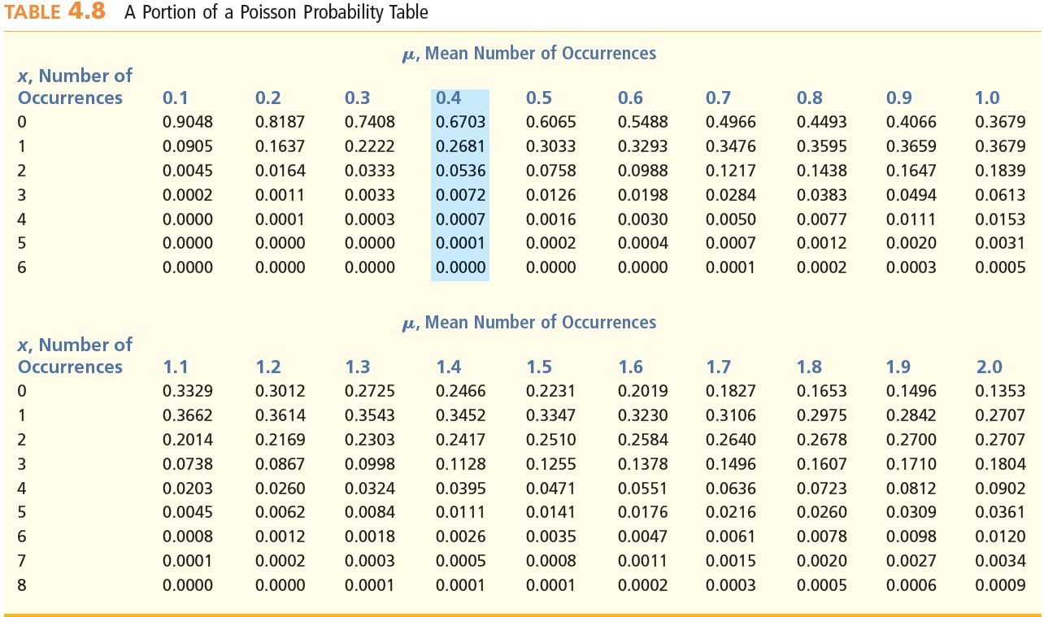
Using a Poisson Probability Table
L05
Find the probability that 3 errors (x =3) will occur in a week
  Want p(x = 3) when μ = 0.4

Slide 30
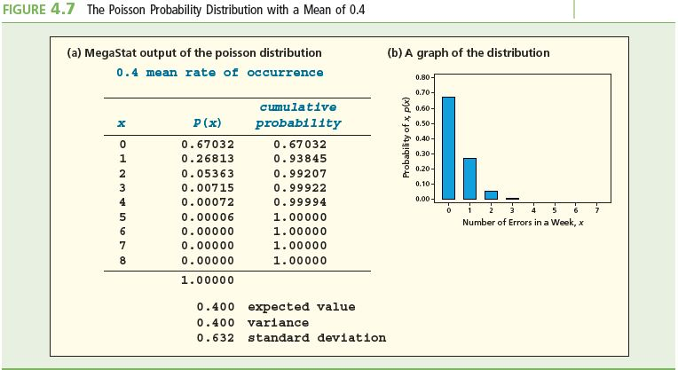
Using MegaStat: Poisson Distribution μ = 4
L05

Slide 31
Mean and Variance of a
Poisson Random Variable
L05
If x is a Poisson random variable with parameter μ, then

Slide 32
Several Poisson Distributions
L05

Slide 33
Back to Example 4.13
L05
In the ATC center situation, 20.8 errors occurred on average per year
Assume that x, the number of errors during any span of time follows a Poisson distribution for that time span
Per week, the parameters of the Poisson distribution are:
  mean μ = 0.4 errors/week
  Because there are 52 weeks per year, m for a week is
  m = (20.8 errors/year) / (52 weeks/year) = 0.4 errors/week
  standard deviation s = 0.6325 errors/week.

Slide 34
The Hypergeometric Distribution
L06
Recall the Binomial Distribution
  The trials are independent ensuring that the probability of success and failure remains constant from trial to trial
If the trials are not independent we instead use the hypergeometric probability distribution
N items in the population with
  r successes
  N - r failures
  Select a sample of n items without replacement
  The probability of obtaining exactly x successes in n trials is

Slide 35
Computation Formula
L07
If N is say at least 20 times as large as n
Assume the probability of success stays essentially constant
p = r/N
Then we can approximate the hypergeometric distribution by the easier to compute binomial formula

Slide 36
Example 4.16: Big Screen Televisions
L07
Purchase (randomly select) 15 televisions from a production run of 500
450 destined to last at least five years without repair
Find the exact probability that at least 14 of the 15 televisions will last at least five years without needing a single repair:
P(X ≥ 14) = P(X=14) + P(X=15) = p(14) + p(15)
  X = the number of televisions that will last at least five years without needing a single repair

Slide 37
Example 4.16: Big Screen Televisions
L07
P(X ≥ 14) = P(X=14) + P(X=15) = p(14) + p(15) = 0.3456+0.2010 = 0.5469

Slide 38
Computational Formula
L07
p = r/N = 450/500 = 0.9
Using x = 14 and x = 15 above we can find:
P(X≥14) = 0.5490

Slide 39
Summary
Random variables are uncertain numerical outcomes
Random outcomes can be classified as discrete (able to be listed) or continuous (any interval along the real number line) and assigned a variable to represent the value
A probability distribution is a table, graph or formula that that can give the value of the probability associated with each of the random variables possible values
The mean or expected value (what is expected to happen over an infinite number of trials of an experiment), the variance and the standard deviation can be calculated for a discrete random value
The Binomial and Poisson distributions are extremely useful for making statistical inferences
The Hypergeometric distribution can be approximated by the Binomial distribution if say N is 20 times as large as n

