Slide 1
Chapter 3
Probability

Slide 2
Probability
3.1 The Concept of Probability
3.2 Sample Spaces and Events
3.3 Some Elementary Probability Rules
3.4 Conditional Probability and Independence
3.5 Bayes’ Theorem

Slide 3
Probability Concepts
L02
An experiment is any process of observation with an uncertain outcome
The possible outcomes for an experiment are called the experimental outcomes
Probability is a measure of the chance that an experimental outcome will occur when an experiment is carried out

Slide 4
Probability
L02
If E is an experimental outcome, then P(E) denotes the probability that E will occur and
Conditions
1. 0 ≤ P(E) ≤ 1
such that:
  If E can never occur, then P(E) = 0
  If E is certain to occur, then P(E) = 1
2. The probabilities of all the experimental outcomes must sum to 1

Slide 5
Assigning Probabilities to
Experimental Outcomes
Classical Method
  For equally likely outcomes
Relative frequency
  In the long run
Subjective
  Assessment based on experience, expertise, or intuition

Slide 6
Classical Method
L02
Classical Method
  All the experimental outcomes are equally likely to occur
  Example: tossing a “fair” coin
    Two outcomes: head (H) and tail (T)
    If the coin is fair, then H and T are equally likely to occur any time the coin is tossed
    So P(H) = 0.5, P(T) = 0.5
      0 < P(H) < 1, 0 < P(T) < 1
      P(H) + P(T) = 1

Slide 7
Relative Frequency Method
L02
Let E be an outcome of an experiment
If the experiment is performed many times, P(E) is the relative frequency of E
  P(E) is the percentage of times E occurs in many repetitions of the experiment
    Use sampled or historical data to calculate probabilities
    Example: Of 1,000 randomly selected consumers, 140 preferred brand X
    The probability of randomly picking a person who prefers brand X is 140/1,000 = 0.14 or 14%

Slide 8
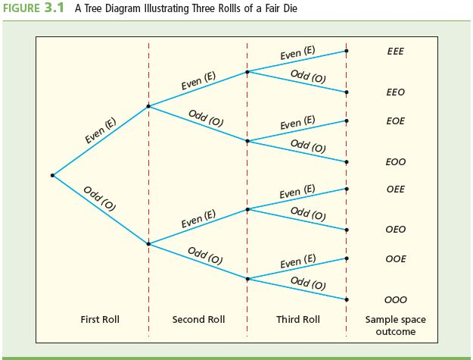
The Sample Space
L01
The sample space of an experiment is the set of all possible experimental outcomes
Example 3.3: Student rolls a six sided fair die three times
Let: E be the outcome of rolling an even number
O be the outcome of rolling an odd number
Sample space S:
S = {EEE, EEO, EOE, EOO, OEE, OEO, OOE, OOO}
Rolling an E and O are equally likely , therefore P(E) = P(O) = ½
P(EEE) = P(EEO) = P(EOE) = P(EOO) =
P(OEE) = P(OEO) = P(OOE) = P(OOO) =
½ × ½ × ½ = 1/8

Slide 9
Example: Computing Probabilities
L01
Example 3.4: Student rolls a six sided fair die three times
Events
Find the probability that exactly two even numbers will be rolled
P(EEO) + P(EOE) = P(OEE) = 1/8 + 1/8 + 1/8 = 3/8
P(at most one even number is rolled) is
P(CCI) + P(ICC) + P(CIC) + P(CCC) = 1/8 + 1/8 + 1/8 + 1/8 = 4/8 = 1/2

Slide 10
Probabilities: Equally Likely Outcomes
L01
L02
If the sample space outcomes (or experimental outcomes) are all equally likely, then the probability that an event will occur is equal to the ratio

Slide 11
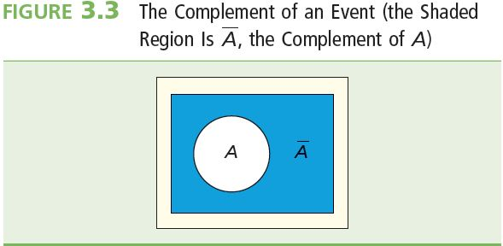
Some Elementary Probability Rules
L03
The complement of an event A is the set of all sample space outcomes not in A
Further,

Slide 12
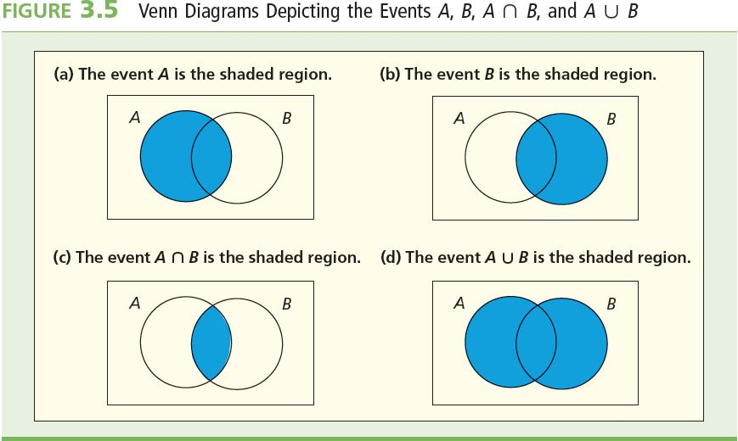
Some Elementary Probability Rules
L03
Union of A and B,
Elementary events that belong to either A or B (or both)
Intersection of A and B,
Elementary events that belong to both A and B

Slide 13
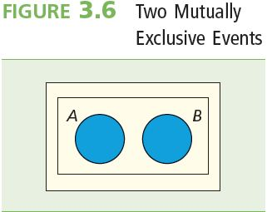
The Addition Rule
L03
The probability that A or B (the union of A and B) will occur is
where the “joint” probability of A and B both occurring together
A and B are mutually exclusive if they have no sample space outcomes in common, or equivalently, if
If A and B are mutually exclusive, then

Slide 14
Example: Randomly selecting a card from a standard deck of 52 playing cards
L03
Define events:
  J =the randomly selected card is a jack
  Q = the randomly selected card is a queen
  R = the randomly selected card is a red card
Given:
  total number of cards, n(S) = 52
  number of jacks, n(J) = 4
  number of queens, n(Q) = 4
  number of red cards, n(R) = 26

Slide 15
Example: Probabilities
L03
Use the relative frequency method to assign probabilities

Slide 16
Conditional Probability
L04
The probability of an event A, given that the event B has occurred, is called the “conditional probability of A given B” and is denoted as
Further,
Note: P(B) ≠ 0
Interpretation: Restrict the sample space to just event B. The conditional probability is the chance of event A occurring in this new sample space
  Furthermore, P(B|A) asks “if A occurred, then what is the chance of B occurring?”

Slide 17
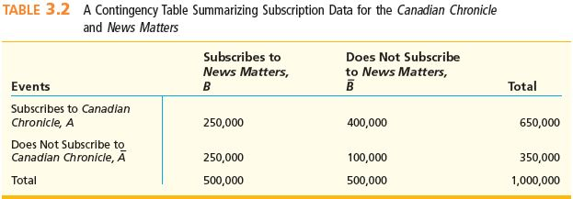
Example: Newspaper Subscribers
L04
Refer to the following contingency table regarding subscribers to the newspapers Canadian Chronicle (A) and News Matters (B)

Slide 18
Example: Newspaper Subscribers
L04
Of the households that subscribe to the Canadian Chronicle, what is the chance that they also subscribe to the News Matters?
Want P(B|A), where

Slide 19
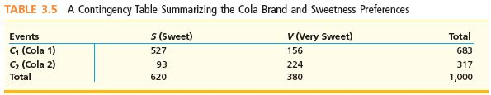
Example: Soft Drink Taste Test
L04
1,000 consumers choose between two colas C₁ and C₂ and state whether they like their colas sweet (S) or very sweet (V)
What is the probability that a person who prefers very sweet colas (V) will choose cola 1 (C₁) given the following contingency table?

Slide 20
Example: Soft Drink Taste Test
L04
We would write:
There is a 41.05% chance that a person will choose cola 1 given that he/she prefers very sweet colas

Slide 21
Independence of Events
L05
Two events A and B are said to be independent if and only if:
P(A|B) = P(A)
The condition that B has or will occur will have no effect on the outcome of A
or, equivalently,
P(B|A) = P(B)
The condition that A has or will occur will have no effect on the outcome of B

Slide 22
Example: Newspaper Subscribers
L05
Are events A and B independent?
  If independent, then P(B|A) = P(B)
Is P(B|A) = P(B)?
  Know that
  We just calculated P(B|A) = 0.3846
  0.3846 ≠ 0.50, so P(B|A) ≠ P(B)
Therefore A is not independent of B
  A and B are said to be dependent

Slide 23
The Multiplication Rule
L04
The joint probability that A and B (the intersection of A and B) will occur is
If A and B are independent, then the probability that A and B (the intersection of A and B) will occur is

Slide 24
Recall: Soft Drink Taste Test
L04
1,000 consumers choose between two colas C₁ and C₂ and state whether they like their colas sweet (S) or very sweet (V)
Assume some of the information was lost. The following remains
  68.3% of the 683 consumers preferred Cola 1 to Cola 2
  62% of the 620 consumers preferred their Cola sweet
  85% of the consumers who said they liked their cola sweet preferred Cola 1 to Cola 2
  We know P(C₁) = 0.0683, P(S) = 0.62, P(C₁|S) = 0.85
We can recover all of the lost information if we can find

Slide 25
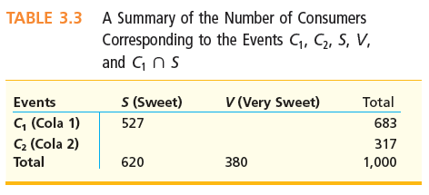
Recall: Soft Drink Taste Test
L04
Since
Therefore

Slide 26
Introduction to Bayes’ Theorem
L06
S₁, S₂, …, S_{k} represents k mutually exclusive possible states of nature, one of which must be true
P(S₁), P(S₂), …, P(S_{k}) represents the prior probabilities of the k possible states of nature
If E is a particular outcome of an experiment designed to determine which is the true state of nature, then the posterior (or revised) probability of a state S_{i}, given the experimental outcome E, is:

Slide 27
Bayes’ Theorem
Driver’s Education
L06
In a certain area 60% of new drivers enroll in driver’s education classes
The facts for the first year of driving:
  Without driver’s education, new drivers have an 8% chance of having an accident
  With driver’s education , new drivers have a 5% chance of having an accident
Aiden, a first-year driver, has had no accidents. What is the probability that he has driver’s education?

Slide 28
Bayes’ Theorem
Driver’s Education
L06
Given:
Find:
There is a 60.77% chance that Aiden has had driver’s education (if he has not had an accident in the first year)

Slide 29
Summary
An event “E” is an experimental outcome that may or may not occur. A value is assigned to the number of times the outcome occurs
Dividing E by the total number of possibilities that can occur (sample space) gives a value called probability which is the likelihood an event will occur
Probability rules such as the addition (“OR”), multiplication (“AND”) and the complement (“NOT”) rules allow us to compute the probability of many types of events occurring
The conditional probability (“GIVEN”) rule is the probability an event occurs given that another even will occur
Independent events can be determined using the conditional probability rule
Bayes’ Theorem is used to revise prior probability to posterior probabilities (probabilities based on new information)

