Slide 1
Chapter 1
An Introduction to Business Statistics
Adapted by Peter Au, George Brown College

Slide 2
An Introduction to Business Statistics
1.1 Populations and Samples
1.2 Sampling a Population of Existing Units
1.3 Sampling a Process
1.4 Levels of Measurement: Nominal, Ordinal, Interval, and Ratio
1.5 Brief introduction to Surveys
1.6 An introduction to Survey Sampling

Slide 3
Populations and Samples
L01
Population | A set of existing units (people, objects, or events)
Variable | A measurable characteristic of the population
Census | An examination of the entire population of measurements
Sample | A selected subset of the units of a population

Slide 4
Samples are subsets of a population
L01
Population
Sample

Slide 5
Terminology 1
L01
Measurement
 | The process of measuring to find out the extent, quantity, amount, etcetera of the variable of interest for some item from the population
 | Produces data for analysis For example, collecting annual starting salaries of graduates from last year’s MBA program
Value
 | The result of measurement The specific measurement for a particular unit in the population For example, the starting salaries of graduates from last year’s MBA Program

Slide 6
Terminology 2
L01
Quantitative
 | Measurements that represent quantities (for example, “how much” or “how many”)
 | Annual starting salary is quantitative Age and number of children is also quantitative
Qualitative
 | Collected data that describes something (descriptive)
 | A person’s sex is qualitative Hair colour is qualitative

Slide 7
Terminology 3
L01
Population of measurements
 |  | Measurement of the variable of interest for each and every population unit
 |  | Reasonable only if the population is relatively small For example, annual starting salaries of all graduates from last year’s MBA program
The process of collecting the population of all measurements is a census
 | Census usually too expensive, and too time consuming

Slide 8
Terminology 4
L01
Sample
 |  | A subset of a population
 |  | For example, a university graduated 8,742 students and we wish to know their annual starting salaries This is too large for a census So, we select a sample of these graduates and learn their annual starting salaries
Sample of measurements
 | Measured values of the variable of interest for the sample units For example, the actual annual starting salaries of the sampled graduates

Slide 9
Terminology 5
L01
Descriptive statistics
 | The science of describing the important aspects of a set of measurements
 | For example, for a set of annual starting salaries, we want to know: How much to expect What is a high versus low salary How much the salaries differ from each other If the population is small enough, we could take a census and not have to sample and make any statistical inferences But if the population is too large, then …

Slide 10
Terminology 6
L01
Statistical Inference
 | The science of using a sample of measurements to make generalizations about the important aspects of a population of measurements
 | For example, use a sample of starting salaries to estimate the important aspects of the population of starting salaries

Slide 11
Uses of Statistics
L01
Descriptive Statistics | The science of describing important aspects of a set of measurements
Statistical Inference | The science of using a sample of measurements to make generalizations about important aspects of a population

Slide 12
Sampling a Population of Existing Units
L02
Random sample
 | A random sample is a sample selected from a population so that:
 | Each population unit has the same chance of being selected as every other unit
 | For example, randomly pick two different people from a group of 15: Number the people from 1 to 15; and write their numbers on 15 different slips of paper Thoroughly mix the papers and randomly pick two of them The numbers on the slips identifies the people for the sample

Slide 13
How to Pick?
L02
Sample with replacement
 | Replace each sampled unit before picking next unit
 | The unit is placed back into the population for possible reselection However, the same unit in the sample does not contribute new information
Sample without replacement
 | A sampled unit is withheld from possibly being selected again in the same sample
 | Guarantees a sample of different units Each sampled unit contributes different information Sampling without replacement is the usual and customary sampling method

Slide 14
Drawing the Random Sample
L02
If the population is large, use a table of random numbers
 | In large sampling projects, tables of random numbers are often used to automate the sample selection process
 | See Table 1.1 in the textbook for a table of random numbers For a demonstration of the use of random numbers, read Example 1.1, “Cell Phone Case: Random numbers can be computer-generated using any of the statistical software packages available such as Excel (MegaStat), Minitab, or SPSS

Slide 15
Approximately Random Samples
L02
In general, we must make a list identifying each and every individual population unit (called a frame)
If the population is very large, it may not be possible to list every individual population unit
 | So instead draw a “systematic” sample
 | Randomly enter the population and systematically sample every k^{th} unit This usually approximates a random sample Read Example 1.2, “Marketing Research Case: Rating a New Bottle Design,” in the textbook

Slide 16
Another Sampling Method
L02
Voluntary response sample
 | Participants select themselves to be in the sample
 | Participants “self-select” For example, calling in to vote on So You Think You can Dance Canada or responding to a online vote at the Globe and Mail Commonly referred to as a “non-scientific” sample
 | Usually not representative of the population
 | Over-represent individuals with strong opinions Usually, but not always, negative opinions

Slide 17
Sampling a Process
L03
Process
A sequence of operations that takes inputs (labour, raw materials, methods, machines, and so on) and turns them into outputs (products, services, and the like)
Inputs
Process
Outputs

Slide 18
Process “Population”
L03
The “population” from a process is all output produced in the past, present, and the future
 | For example, all automobiles of a particular make and model, for instance, the Honda Civic or all cans of chicken noodle soup canned at the Campbell’s Soup factory
 | Cars will continue to be made over time Soup will continue to be canned over time

Slide 19
Population Size
L03
A population may be “finite” or “infinite”
 | Finite if it is of fixed and limited size
 | Finite if it can be counted Even if very large For example, all the Honda Civic cars actually made during just this model year is a finite population Because a specific number of cars was made between the start and end of the model year
 | Infinite if it is unlimited
 | Infinite if listing or counting every element is impossible For example, all the Honda Civics' that could have possibly been made this model year is an infinite population

Slide 20
Statistical Control
L03
A process is in statistical control if it does not exhibit any unusual process variations
 | A process in statistical control displays a constant amount of variation around a constant level A process not in statistical control is “out of control”
To determine if a process is in control or not, sample the process often enough to detect unusual variations
 | Issue: How often to sample? See Example 1.3, “The Coffee Temperature Case: Monitoring Coffee Temperature” in the textbook

Slide 21
Runs Chart
L03
A runs chart is a graph of actual individual measurements of process output over time
Process output (the variable of interest) is plotted on the vertical axis against time plotted on the horizontal axis
The constant process level is plotted as a horizontal line
The variation is plotted as an up and down movement as time goes by of the individual measurements, relative to the constant level

Slide 22
Temperature of Coffee
L03
The coffee temperature case of Example 1.3
Coffee made by a fast-food restaurant was sampled every half hour from 10:00 AM to 9:30 PM, and its temperature measured
The 24 timed measurements are graphed in the runs plot on the next slide
Note that the sample index is the number of half hours since 10:00 AM

Slide 23
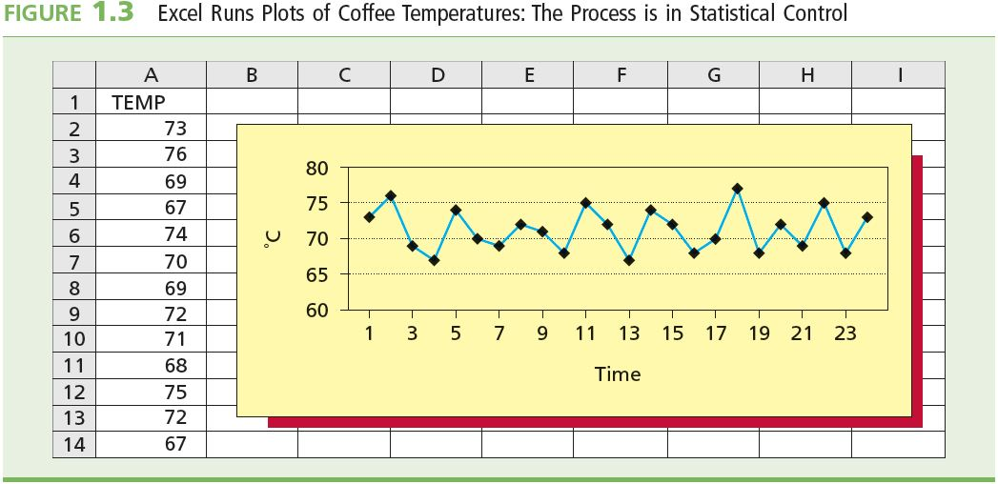
Runs Plot
L03
A runs plot is a graph of individual process measurements over time

Slide 24
Results
L03
Over time, temperatures appear to have a fairly constant amount of variation around a fairly constant level
The temperature is expected to be at the constant level at about 72°C
Sometimes the temperature is higher and sometimes lower than the constant level
About the same amount of spread of the values (data points) around the constant level
The points are as far above the line as below it
The data points appear to form a horizontal band
So, the process is in statistical control
Coffee-making process is operating “consistently”

Slide 25
Outcome
L03
Because the coffee temperature has been and is presently in control, it will likely stay in control in the future
If the coffee making process stays in control, then coffee temperature is predicted to be between 67º and 77º C
In general, if the process appears from the runs plot to be in control, then it will probably remain in control in the future
The sample of measurements was approximately random
Future process performance is predictable

Slide 26
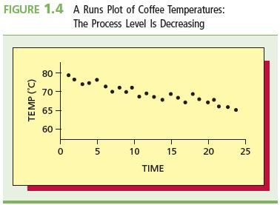
Out of Control
If, instead of a constant level, there is a trend in the process performance
Following the trend, future performance of the process will be outside established limits
See Figure 1.4 below

Slide 27
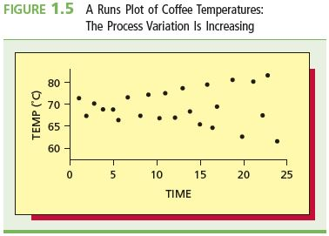
Out of Control
L03
If there is a constant level, but the amount of the variation is varying as time goes by
Data points fan out from or neck down to the constant level
See Figure 1.5 below

Slide 28
Statistical Process Control
L03
The real purpose is to see if the process is out of control so that corrective action can be taken if necessary
If the process is out of control, we must investigate further to find out why it is so

Slide 29
Scales of Measurement
L04
Qualitative variables
Descriptive categorization of population or sample units
Two types:
Nominative
Ordinal
Quantitative variables
Numerical values represent quantities measured with a fixed or standard unit of measure
Two types:
Interval
Ratio

Slide 30
Qualitative Variables
L04
Nominative:
Identifier or name
Unranked categorization
Example: sex, eye colour
Ordinal:
All characteristics of nominative plus the following;
Rank-order categories
Ranks are relative to each other
Example: small (1), medium (2), large (3) or
very useful (1), useful (2), moderately useful (3), not very useful (4)

Slide 31
Interval Variable
L04
All of the characteristics of ordinal plus the following;
Measurements are on a numerical scale with an arbitrary zero point
The “zero” is assigned: it is unphysical and not meaningful
Zero does not mean the absence of the quantity that we are trying to measure
Can only meaningfully compare values in terms of the interval between them
Cannot compare values by taking their ratios
“Interval” is the mathematical difference between the values
Example: temperature
0° C means “cold,” not “no heat”
20° C is NOT twice as warm as 10° C
But 20° C is 10° warmer than 10° C

Slide 32
Ratio Variable
L04
All the characteristics of interval plus the following;
Measurements are on a numerical scale with a meaningful zero point
Zero means “none” or “nothing”
Values can be compared in terms of their interval and ratio
$30 is $20 more than $10
$30 is 3 times as much as $10
$0 means no money
In business and finance, most quantitative variables are ratio variables, such as anything to do with money
Examples: Earnings, profit, loss, age, distance, height, weight

Slide 33
Surveys
L05
Surveys are questionnaires
The purpose?
To elicit a response
Four Step Process for Creating a Survey
Decide what is being studied and how to ask the questions
Generate questions that are either open or closed (choice of answers). Questions should be short and easy to read and understand
Compile or put together the survey. Order of questions is important as the previous question may influence answers to the next one
Test Pilot the survey for reliability and validity

Slide 34
Delivery of Survey
L05
Mailed
Direct or mass/bulk
Telephone
Telephone directories
RDD – random digit dialing
In-person (face to face) interview
Structured
Respondents given same questions in same order in which answers are rated
Intensive Interview
Informal unstructured
Focus Group
Usually used for market research
Involving 4-15 people and approximately 10 issues
Discuss the pros and the cons of each of these methods

Slide 35
Survey Sampling
L05
Already know some sampling methods
Also called sampling designs, they are:
Random sampling
The focus of this book
Systematic sampling
Voluntary response sampling
But there are other sample designs:
Stratified random sampling
Cluster sampling

Slide 36
Stratified Random Sample
L05
Divide the population into non-overlapping groups, called strata, of similar units (people, objects, etc.)
Separately, select a random sample from each and every stratum
Combine the random samples from each stratum to make the full sample
Appropriate when the population consists of two or more different groups so that:
The groups differ from each other with respect to the variable of interest
Units within a group are similar to each other
For example, divide population into strata by age, sex, income, etc

Slide 37
Cluster Sampling
“Cluster” or group a population into subpopulations
Cluster by geography, time, and so on
Each cluster is a representative small-scale version of the population (i.e. heterogeneous group)
A simple random sample is chosen from each cluster
Combine the random samples from each cluster to make the full sample
Appropriate for populations spread over a large geographic area so that;
There are different sections or regions in the area with respect to the variable of interest
There is a random sample of the cluster

Slide 38
More on Systematic Sampling
L05
Want a sample containing n units from a population containing N units
Take the ratio N/n and round down to the nearest whole number
Call the rounded result k
Randomly select one of the first k elements from the population list
Step through the population from the first chosen unit and select every k^{th} unit
This method has the properties of a simple random sample, especially if the list of the population elements is a random ordering

Slide 39
Sampling Problems
L05
Random sampling should eliminate bias
But even a random sample may not be representative because of:
Under-coverage
Too few sampled units or some of the population was excluded
Non-response
When a sampled unit cannot be contacted or refuses to participate
Response bias
Responses of selected units are not truthful

Slide 40
Summary
A sequence of operations that takes inputs and turns them into outputs
A process is in statistical control if it does not exhibit any unusual process variations
Survey construction and dissemination is an important part of collecting data. There are methods such as stratified random and multistage cluster sampling
Sample data is used in conjunction with statistical methods to make inferences about the population
There are two types of data called Quantitative and Qualitative and there are different ways to deal with the individual types and sub-types

